Slide 1
Let’s Make Happiness Matter
Learning objective: we are learning to explore what happiness is.

Slide 2
“Happiness is a matter of one’s most ordinary and everyday mode of consciousness being busy, lively and unconcerned with self.”
-Iris Murdoch.

Slide 3
Being happy is not the same as being in a good mood. Do you agree?
What do you think happiness could mean?
How could things that sometimes stop us from being in a good mood make us happier overall?
What word class is it?
Have you heard it used anywhere before?
Is feeling happy different from having a happy life?
How might they be different?

Slide 4
Feeling happy is an internal thing
and having a happy life is based on external things.

Slide 5
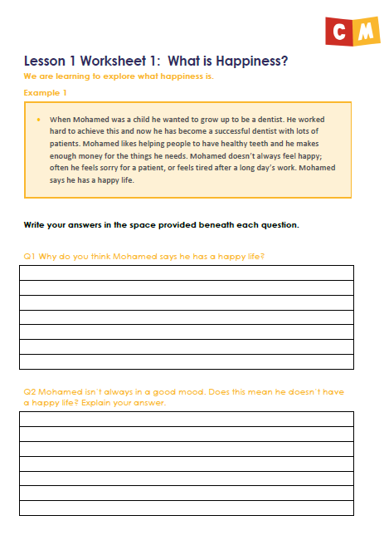
ACTIVITY 1
What is happiness?
Read the examples and answer the questions on worksheet 1.

Slide 6
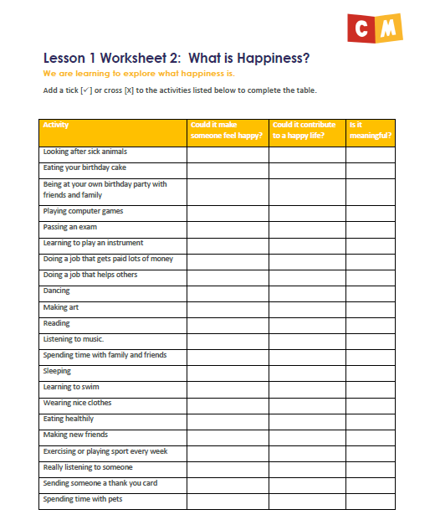
ACTIVITY 2
Happiness, meaning and a happy life
Evaluate the list of activities on worksheet 2 and decide if they are making someone feel happy, contributing to a happy life and/or is meaningful.

Slide 7
ACTIVITY 3
Self-compassion
Be warm, forgiving and understanding toward yourselves when you suffer, fail, or feel inadequate.
Complete a self-compassion exercise.

Slide 8
Finally ...
Who decides if something is meaningful?
Is it the same for everyone or does it depend on the person who is doing it?

