Slide 1
BreatheUni Session: Coming of Age

Slide 2
Contracting
Here we will set the ground rules of these sessions
Respect - be respectful of each other's opinions and give your classmates the opportunity to speak and be listened to
Openness - do not be afraid to give your honest opinions this is a space where diversity of opinion is welcomed
Empathy - understand that others may have wildly different views to you. This is because they live in completely different environments and situations

Slide 3
Learning Objectives
Career and Educational Development
Personal and Emotional Development
Understanding and dealing with the Pressures of Coming of Age

Slide 4
Career and Education: Topic Background Info
As you come of age you will face numerous decisions regarding your career and education.
‘Do I go to university or pursue other options such as an apprenticeship?’
‘What sort of job do I want to apply for?’
‘Is it ok if I switch jobs/delay university/choose an alternative career path?’
Throughout this time you will likely feel pressure from various places including parents, teachers, peers, society etc
We (Masteri Mentors) hope to explain some of the challenges to you and give a better understanding of what is to come

Slide 5
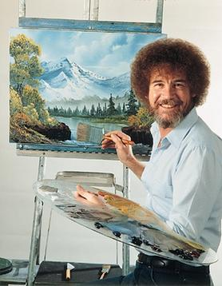
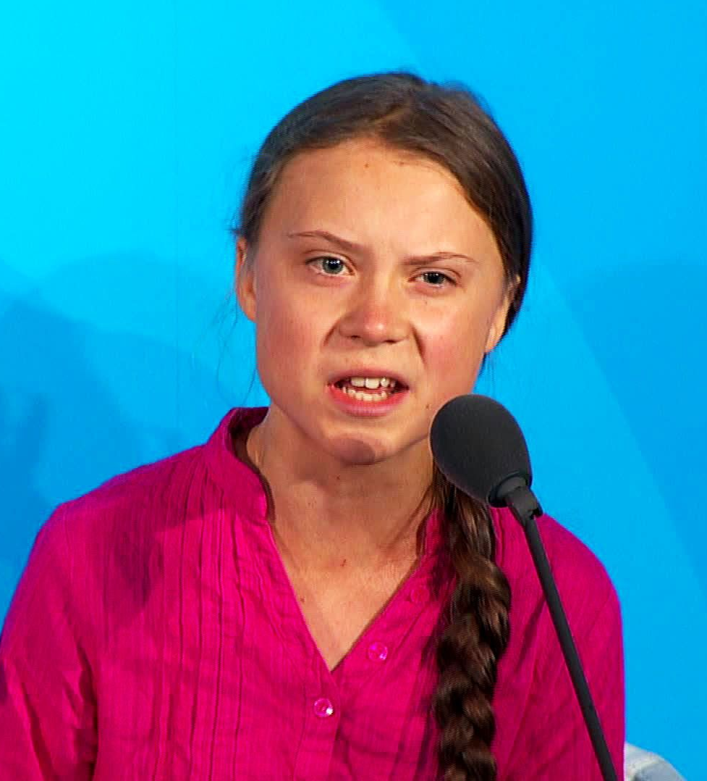
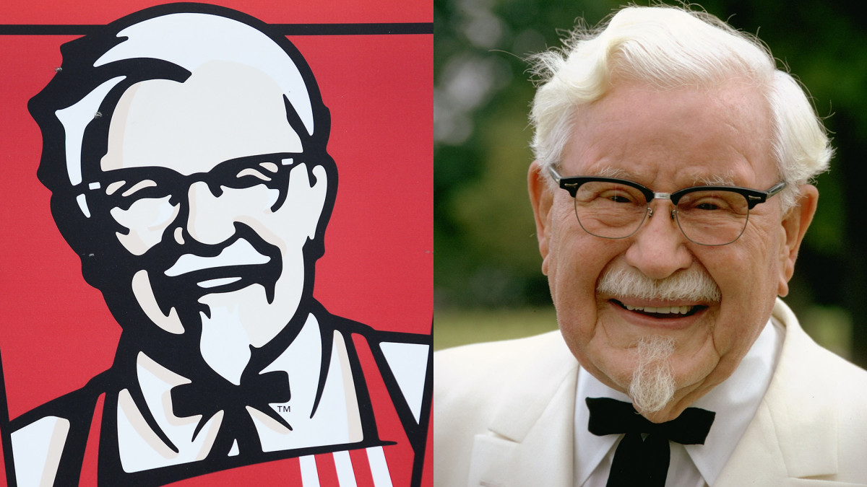
Game: Guess the Age

Slide 6
Discussion:
What moments have you felt pressured to make a choice so far?
What moments in your near future do you feel will be significant choices and how do you feel about these?
Have you started thinking about future career paths?
What do you think are important considerations when making big decisions?

Slide 7
Personal and Emotional Coming of Age: The Background Info
People with higher emotional intelligence find it easier to form and maintain interpersonal relationships and to ‘fit in’ to group situations.
People with higher emotional intelligence are also better at understanding their own psychological state, which can include managing stress effectively and being less likely to suffer from depression
Self-awareness
Emotional awareness
Accurate self-assessment
Self-confidence
Self-regulation
Self-control
Trustworthiness
Conscientiousness
Adaptability
Innovation

Slide 8
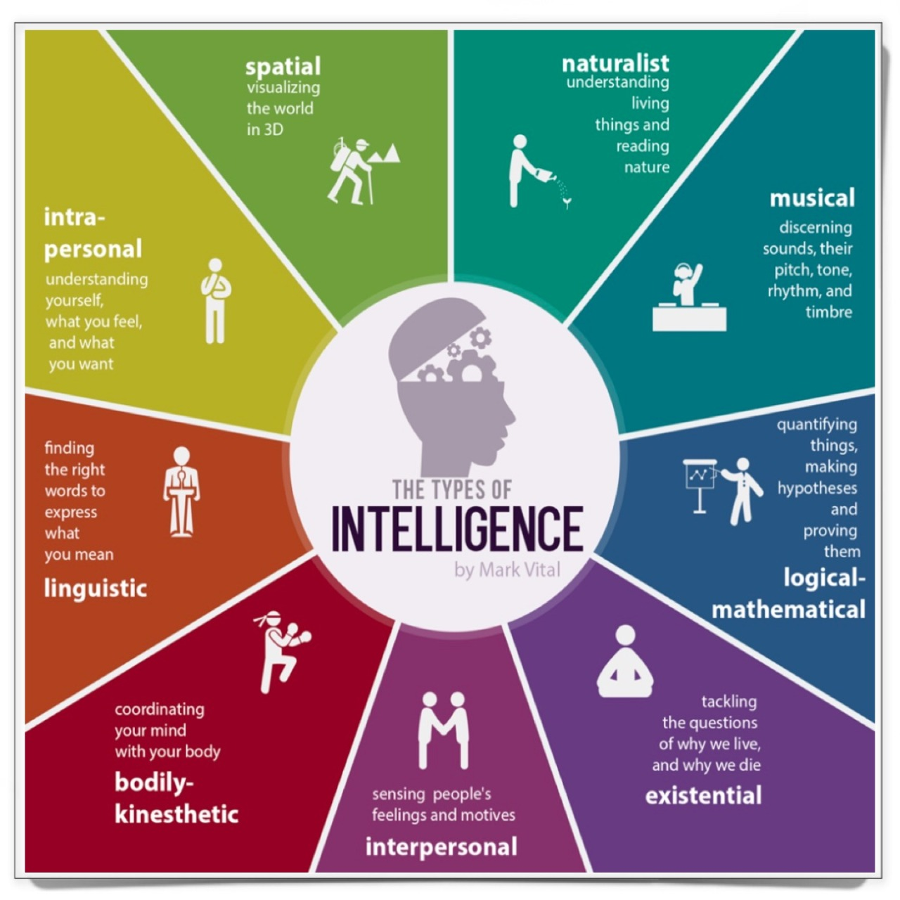
9 types of Intelligence

Slide 9
Discussion:
On a personal level, what does Coming of Age mean to you?
What examples can you think of for different types of intelligence?
Do you think emotional intelligence develops overtime?
What activities beyond education do you think contribute to your personal development?

Slide 10
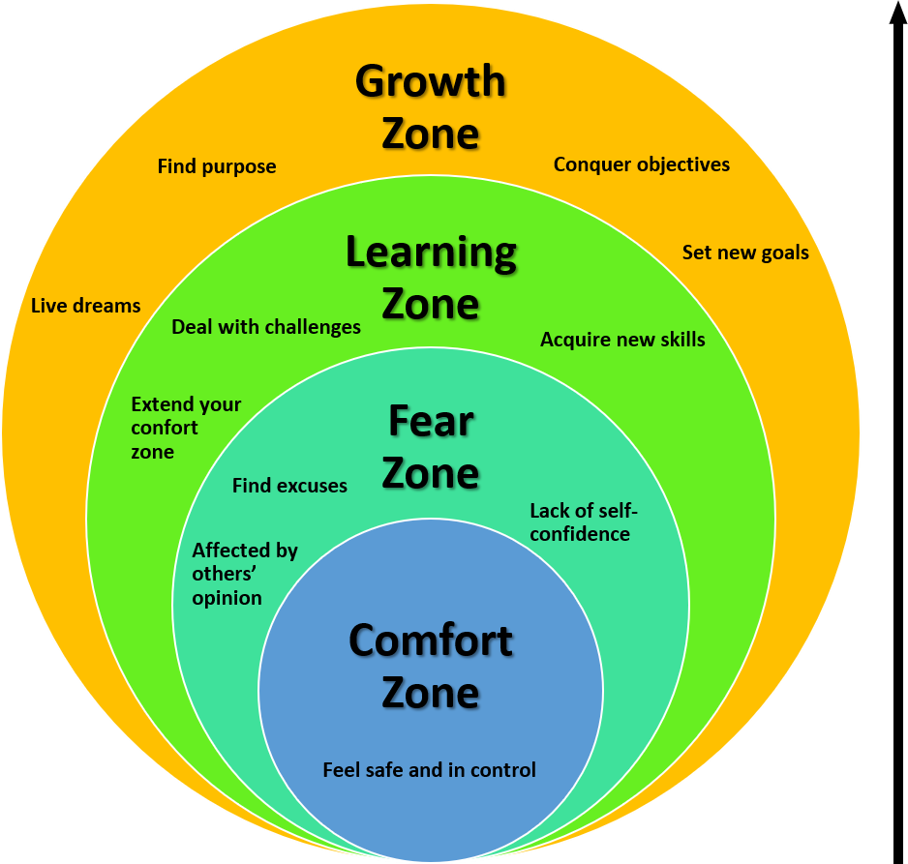
Understanding the Pressures: Background Information

Slide 11
Background Info: Understanding the Pressures
Pressure Can be Bad: Increase stress, lead to feelings of overwhelm, physical and mental negatives, affects everyone, can cause overload and cause us to lose sight of the goal
Pressure can be Good: a motivator, can increase performance, encourage us to move beyond our comfort zone, shows you care about something, is natural, helps us stay focussed
Ways to cope with Pressure: time management e.g. calendar, taking time out to do hobbies e.g. exercise, seeking help if feeling overwhelmed

Slide 12
Discussion: Pressure
Who do you feel pressure most from?
Is pressure always negative?
Is it best to grow outside of your comfort zone

Slide 13
Feedback
How do you feel?
Name one thing you’ve learnt from today

