Slide 1
This PSHE lesson is delivered through PowerPoint with integrated delivery notes on each slide.
How to deliver the topic
1. First, launch the programme with the energiser Assembly to be delivered to the class completing the programme or enjoyed by the wider school.
2. Teach this 60-minute PSHE session in the classroom. An optional 'active brain break' has been provided on the next slide for use before the main activity to add extra movement to the lesson.
3. Reflect with pupils how they feel at the end of the lesson.
PowerPoint lesson presentation (includes notes on delivery and inclusion)
Pupils will need to move around the classroom during the main activities. You may wish to use a hall or outdoor space, if available
If you are using a classroom, work with the pupils to move any desks and chairs to create a suitable space
Notes:
Learning objective:
To develop our self-confidence to become a confident mover.
Learning outcomes:
By the end of the lesson pupils will be able to:
Understand how regular physical activity benefits both mental and physical health
Recognise how low self-confidence might be a barrier to physical activity
Develop strategies to increase self-confidence in relation to physical activity

Slide 2
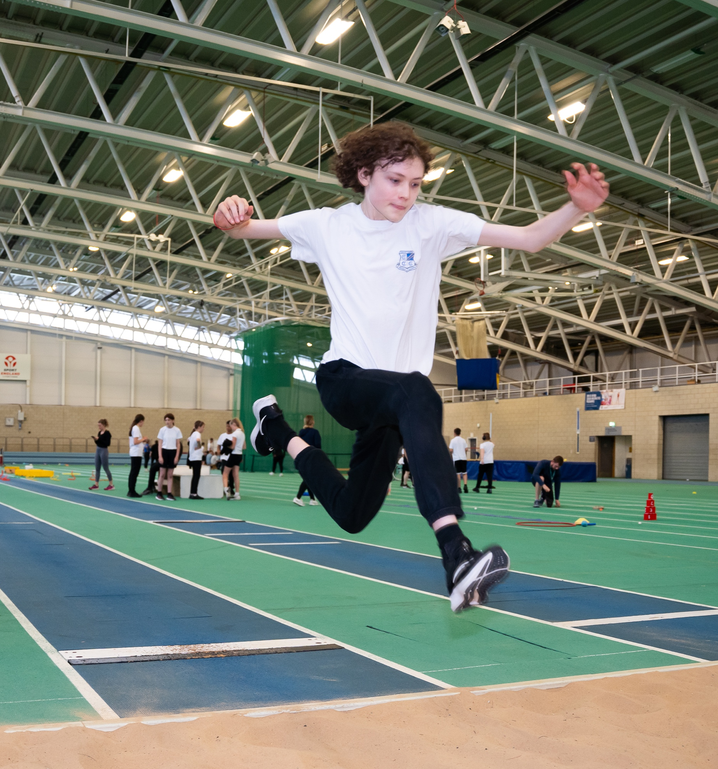
2 MINS
Active brain break
It’s time to get moving and increase
the flow of oxygen to your brains!
You have 2 minutes to…
1. Jump
2. Take three large steps
3. High-five a classmate
(a different one each time!)
Notes:
Delivery Notes
Challenge pupils to keep jumping for 2 minutes, following the instructions.
Ensure there is enough space for pupils to move safely by clearing chairs and tables or completing the activity in a large space such as a hall.
Inclusion Notes
For pupils with additional requirements, the movement can be adapted to suit their needs. For example, students could touch their toes or shake their wrists.

Slide 3
Notes:
Explain to the pupils that this is the first lesson of three and is all about the benefits of being a confident mover.

Slide 4
Are you ready to break limits?
Over the next three PSHE lessons, we will be breaking limits by removing the barriers that prevent us from moving.
Breaking limits is important because it helps us to push ourselves to achieve more.
We will be focusing on building three key aspects that help us to break common barriers:
Lesson One:
Self-confidence
Lesson Two: Inclusivity
Lesson Three: Positive mindset
Notes:
Delivery Notes:
The purpose of this slide is to give pupils an understanding of what is to come for all lessons.

Slide 5
5 MINS
Ground Rules
Setting ground rules is important as it means we can all feel safe and comfortable during the lesson.
An example of a ground rule is to listen to others and always be respectful of viewpoints that are different to yours.
Can you think of any more ground rules you would like to set for the lesson? Share with the group.
Notes:
Please see the teacher guidance on ground rules. Some examples have been provided but these can be added to – either by yourself or through suggestions by the class.
At this point, it is good practice to remind pupils about any ways they can ask questions. If you are choosing to let pupils submit questions anonymously (either through an envelope or box system), then make that clear here.

Slide 6
5 MINS
What do you already know?
Answer the following questions in your books:
What is meant by 'self-confidence'?
How can physical activity (or movement) benefit mental health?
How can physical activity benefit physical health?
What might make someone feel less confident about moving?
How could we help someone to feel more confident about moving?
Notes:
Pupils to record their answers in one colour pen so you can assess their prior knowledge.

Slide 7
This lesson we are thinking about…
Self-confidence
Self-confidence: feeling sure of yourself and your abilities.
Notes:
Delivery Notes:
Ask pupils: 'how can we explain what 'self-confidence' means?'
Self-confidence: feeling sure of yourself and your abilities.

Slide 8
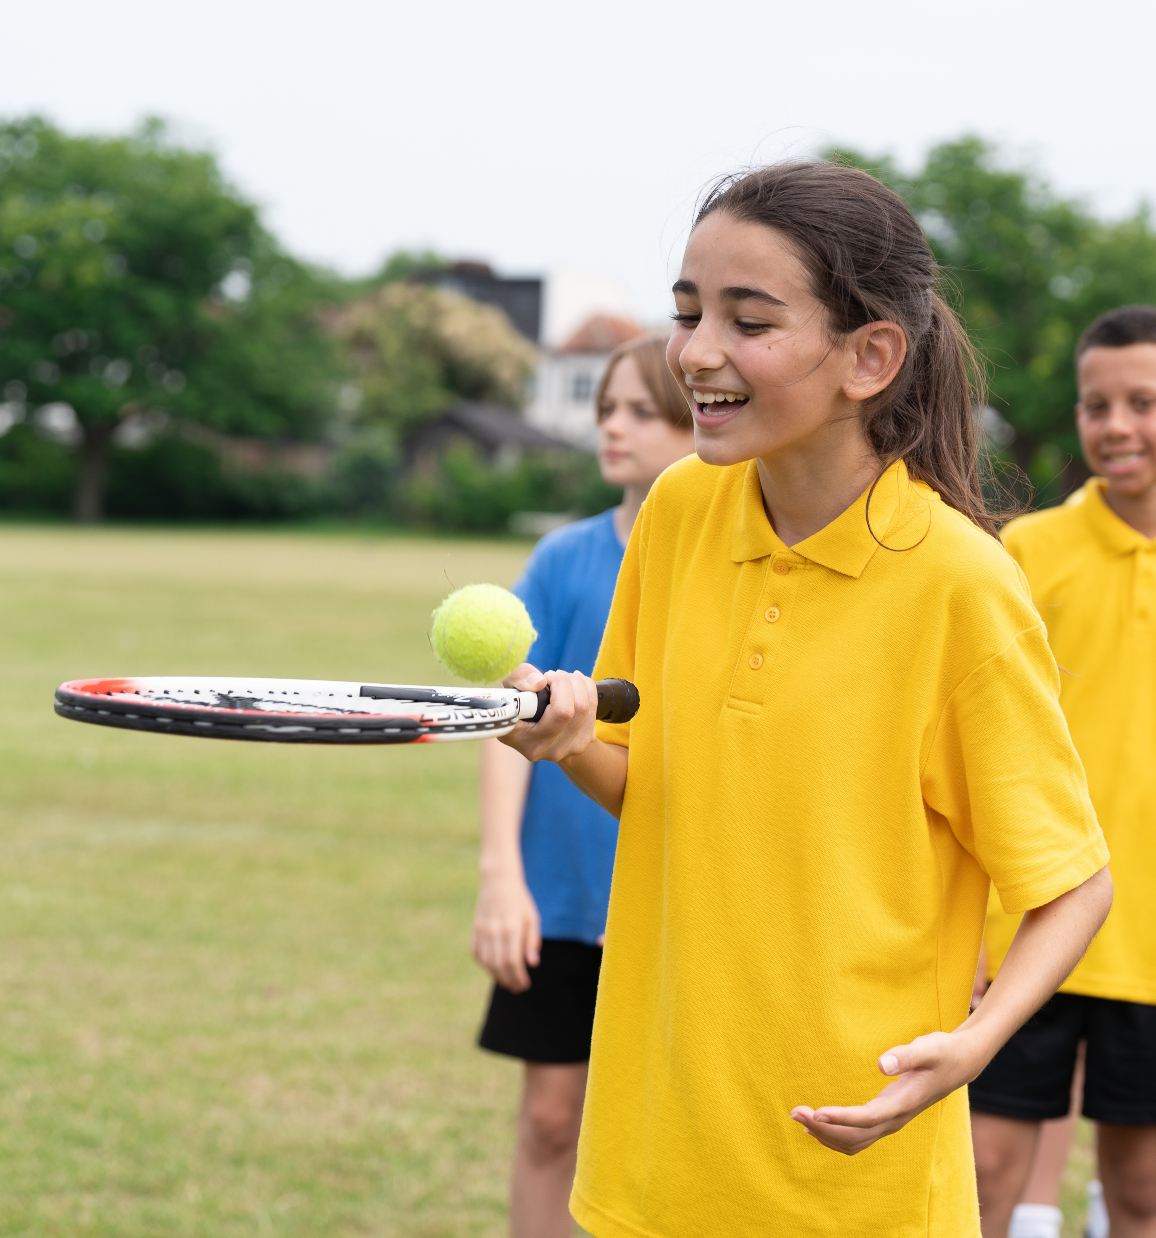
Learning Objective:
To develop our self-confidence to become a confident mover.
Learning outcomes:
By the end of the lesson pupils will be able to:
Understand how regular physical activity benefits both physical and mental health
Recognise how low self-confidence might be a barrier to physical activity
Develop strategies to increase self-confidence in relation to physical activity
Notes:
Delivery Notes:
Discussion:
Discuss with pupils the name of the lesson.
What does ‘confident mover’ mean to them?
How does it relate to self-confidence?
Run through the lesson objectives with pupils ensure they understand what they are aiming to achieve today.

Slide 9
10 MINS
Fill in the gap
Let’s play fill in the gap, with a difference.
You’ll use a move to show what you think the correct answer is.
Be careful, the move will change each time!
Get ready…
Notes:
To conduct this activity safely, ensure students have enough space by clearing space and moving chairs and tables.

Slide 10
Statement 1
Children need at least ______ minutes of activity per day.
Reaching tall
60 minutes
Children need at least 60 minutes of activity a day. This can be all at once, or in short bursts throughout the day.
Stretch to the floor
Notes:
Reference
https://www.nhs.uk/live-well/exercise/exercise-guidelines/physical-activity-guidelines-children-and-young-people/
Delivery Notes
Bring up the statement and give pupils time to decide on their answer and make the correct moment. Discuss the answer.
60 minutes a day doesn't have to be all at once. Short bursts could be playing in the playground or walking to school.
Getting 60 minutes a day is important for mental and physical health.
Inclusion Notes
Adjust the moves to make them inclusive for all pupil requirements in your class. E.g. 30 minutes: reach tall in your seat/ 60 minutes: stretch low to the floor.

Slide 11
Statement 2
Research shows that activity levels are _________ for disabled children as they are for non-disabled children.
Stretch to the right
The same
Research shows activity levels are the same for disabled children as they are for non-disabled children
Stretch to the left
Notes:
Reference:
https://sportengland-production-files.s3.eu-west-2.amazonaws.com/s3fs-public/2021-01/Active%20Lives%20Children%20Survey%20Academic%20Year%2019-20%20report.pdf?4Ti_0V0m9sYy5HwQjSiJN7Xj.VInpjV6
Delivery Notes
Bring up the statement and give pupils time to decide on their answer and make the correct moment. Discuss the answer.
It is a misconception that disabled people are less active – activity is the same amongst disabled and non-disabled children. There are many different sports that cater for people with disabilities meaning they are also able to be active.
Inclusion Notes
Adjust the moves to make them inclusive for all pupil requirements in your class. E.g. The same: reach tall in your seat/ Different: stretch low to the floor.

Slide 12
Statement 3
Research shows that being more active can lead to feeling ______ happy.
Stretch your arms out in front
More
Research shows that being more active can lead to feeling more happy.
Stretch your shoulders
Notes:
Reference:
PowerPoint Presentation (sportengland-production-files.s3.eu-west-2.amazonaws.com)
Delivery Notes
Bring up the statement and give pupils time to decide on their answer and make the correct moment. Discuss the answer.
Exercise makes you feel happier by releasing endorphins – chemicals which make you feel good. If you do exercise consistently, you are more likely to feel happier each day.
Inclusion Notes
Adjust the moves to make them inclusive for all pupil requirements in your class. E.g. More: put your hands up/ Less: clap your hands.

Slide 13
Statement 4
Ibtihaj Muhammad became the first Muslim American to compete in Sabre Fencing in ______ in the 2016 Olympics.
Do a back bend
A hijab
Ibtihaj Muhammad became the first Muslim American to compete in a hijab in 2016
Stretch your neck
Notes:
Reference:
https://www.vox.com/videos/2017/2/10/14575572/ibtihaj-muhammad-was-the-first-us-olympian-to-wear-a-hijab
Delivery Notes
Bring up the statement and give pupils time to decide on their answer and make the correct moment. Discuss the answer.
Ibtihaj Muhammad proved that high-level sport can be done in a hijab. Many sportswear brands are now making modest athletic clothes, including sportswear hijabs.
Inclusion Notes
Adjust the moves to make them inclusive for all pupil requirements in your class. E.g. A hijab: touch your toes/ Gloves: punch the air.

Slide 14
Statement 5
Women's ______ is the fastest growing sport in the UK.
Spotty Dogs
Football
Women’s football is currently the fastest growing sport in the UK.
Hands on
your head
Notes:
Reference:
https://www.levelplayingfield.org.uk/news-item/the-womens-game-survey/#:~:text=Women's%20football%20is%20one%20of,England's%20triumph%20at%20Euro%202022.
Delivery Notes
Bring up the statement and give pupils time to decide on their answer and make the correct moment. Discuss the answer.
Women's football is the fastest growing sport in the UK – particularly due to the success of England's Lionesses in the Euros and World Cup over the past 2 years.
Inclusion Notes
Adjust the moves to make them inclusive for all pupil requirements in your class. E.g. Cricket: wave your hands/ Football: put your hands on your head.

Slide 15
Statement 6
Research shows that children who are more active are _______ likely to keep trying difficult tasks until they can do them.
Hands in the Air
More
Research shows that children who are more active are more likely to keep trying difficult tasks until they can do them.
Click your fingers
Notes:
Reference:
PowerPoint Presentation (sportengland-production-files.s3.eu-west-2.amazonaws.com)
Delivery Notes
Bring up the statement and give pupils time to decide on their answer and make the correct moment. Discuss the answer.
Exercise increases our resilience – we are more likely to have a positive mindset and feel capable of doing things, and trying things until we get them right rather than giving up straight away.
Inclusion Notes
Adjust the moves to make them inclusive for all pupil requirements in your class. E.g. More: click your fingers/ Less: hands in the air.

Slide 16
15 MINS
Did you know?
Physical activity benefits both your physical and mental health.
Physical activity is good for your physical health.
It ensures healthy growth and development and improves your fitness.
Physical activity is good for your mental health, by improving sleep, managing activity and releasing chemicals that make you feel happy.
Notes:
References:
https://www.mind.org.uk/information-support/tips-for-everyday-living/physical-activity-and-your-mental-health/about-physical-activity/
https://www.who.int/news-room/fact-sheets/detail/physical-activity

Slide 17
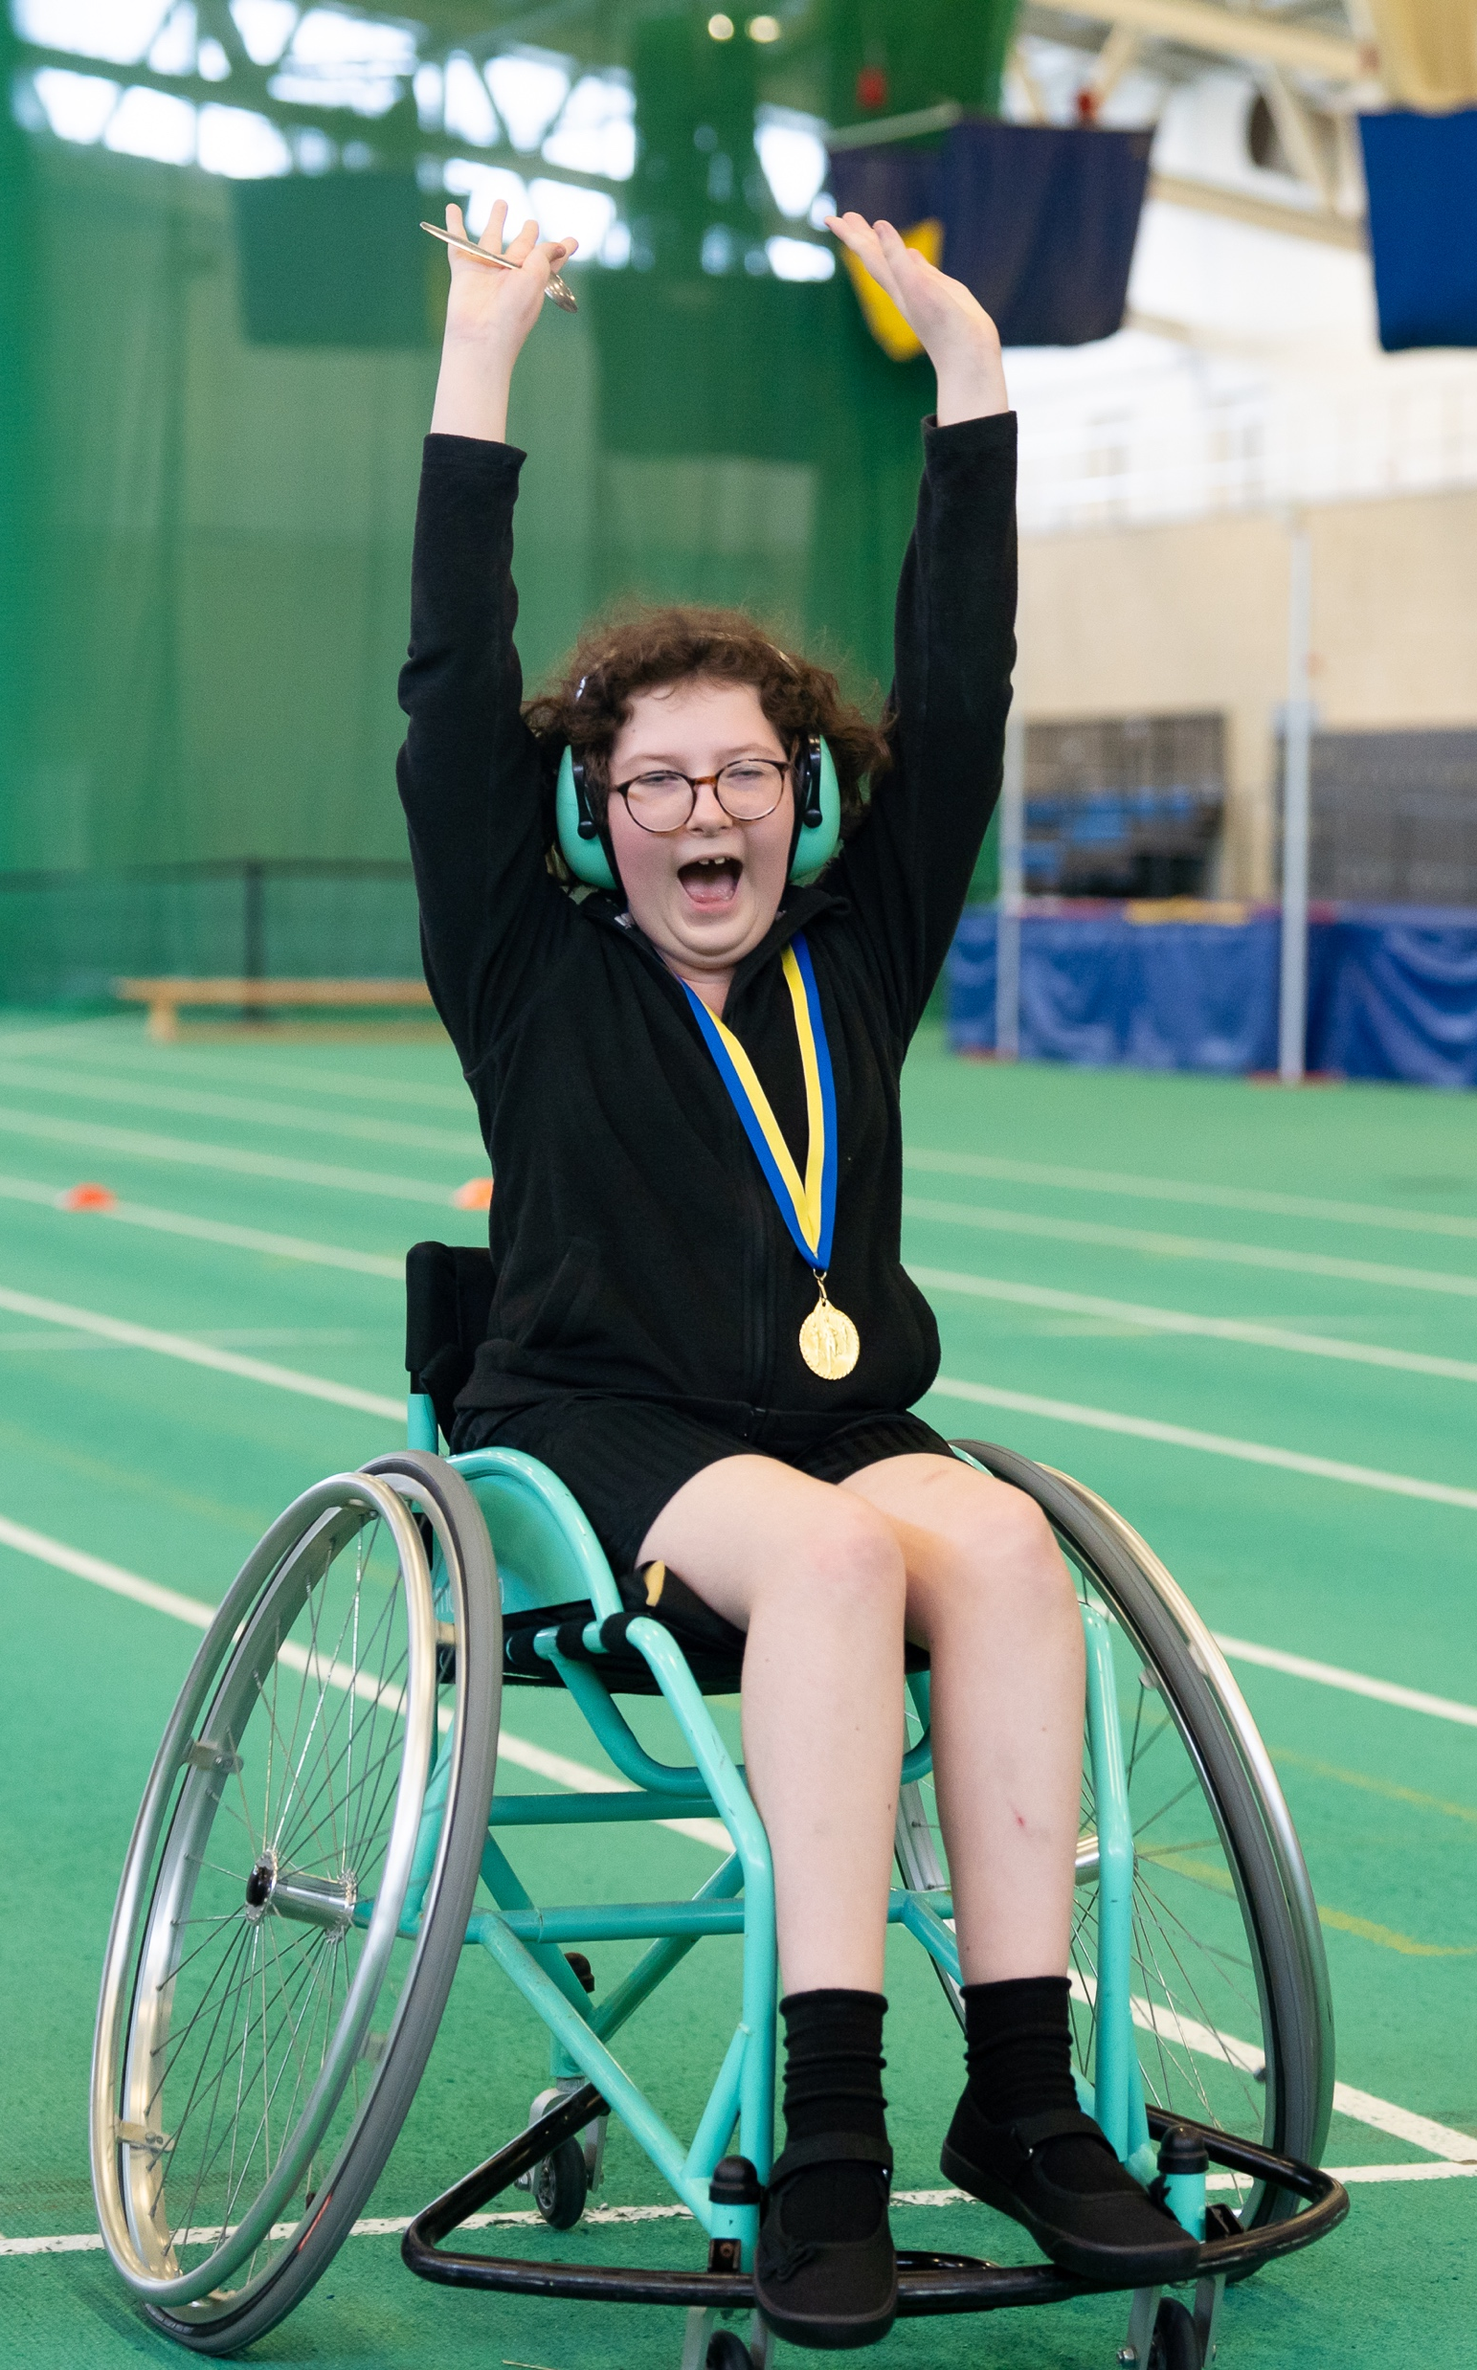
What might make someone feel less confident about moving?
What might give people confidence to move?
Notes:
Delivery Notes
Discuss question. To avoid unintentionally shaming, avoid talking about body 'size' and instead refer to an 'aspect of their body'.
Celebrate that it's great that pupils have ideas of when they have confidence, then explain that as we go through life, people can lose confidence. That could be because of an aspect of their body, gender, ability, and more.
Ensure you emphasise the need for pupils to be sensitive about what they are saying so as not to unintentionally shame anyone. Encourage pupils to use the term 'someone' and for them not to refer to anyone specific in their discussions in order to maintain a safe environment.
If age and stage appropriate, you may wish to ask questions which link to puberty. For example:
What kind of changes might a young person's body undergo as they get older? Hormones can make our moods change, our bodies will change shape, our voices may deepen (boys)
How might these changes impact someone's confidence? Body changes might make someone feel uncomfortable, unpredictable moods might make us enjoy things less

Slide 18
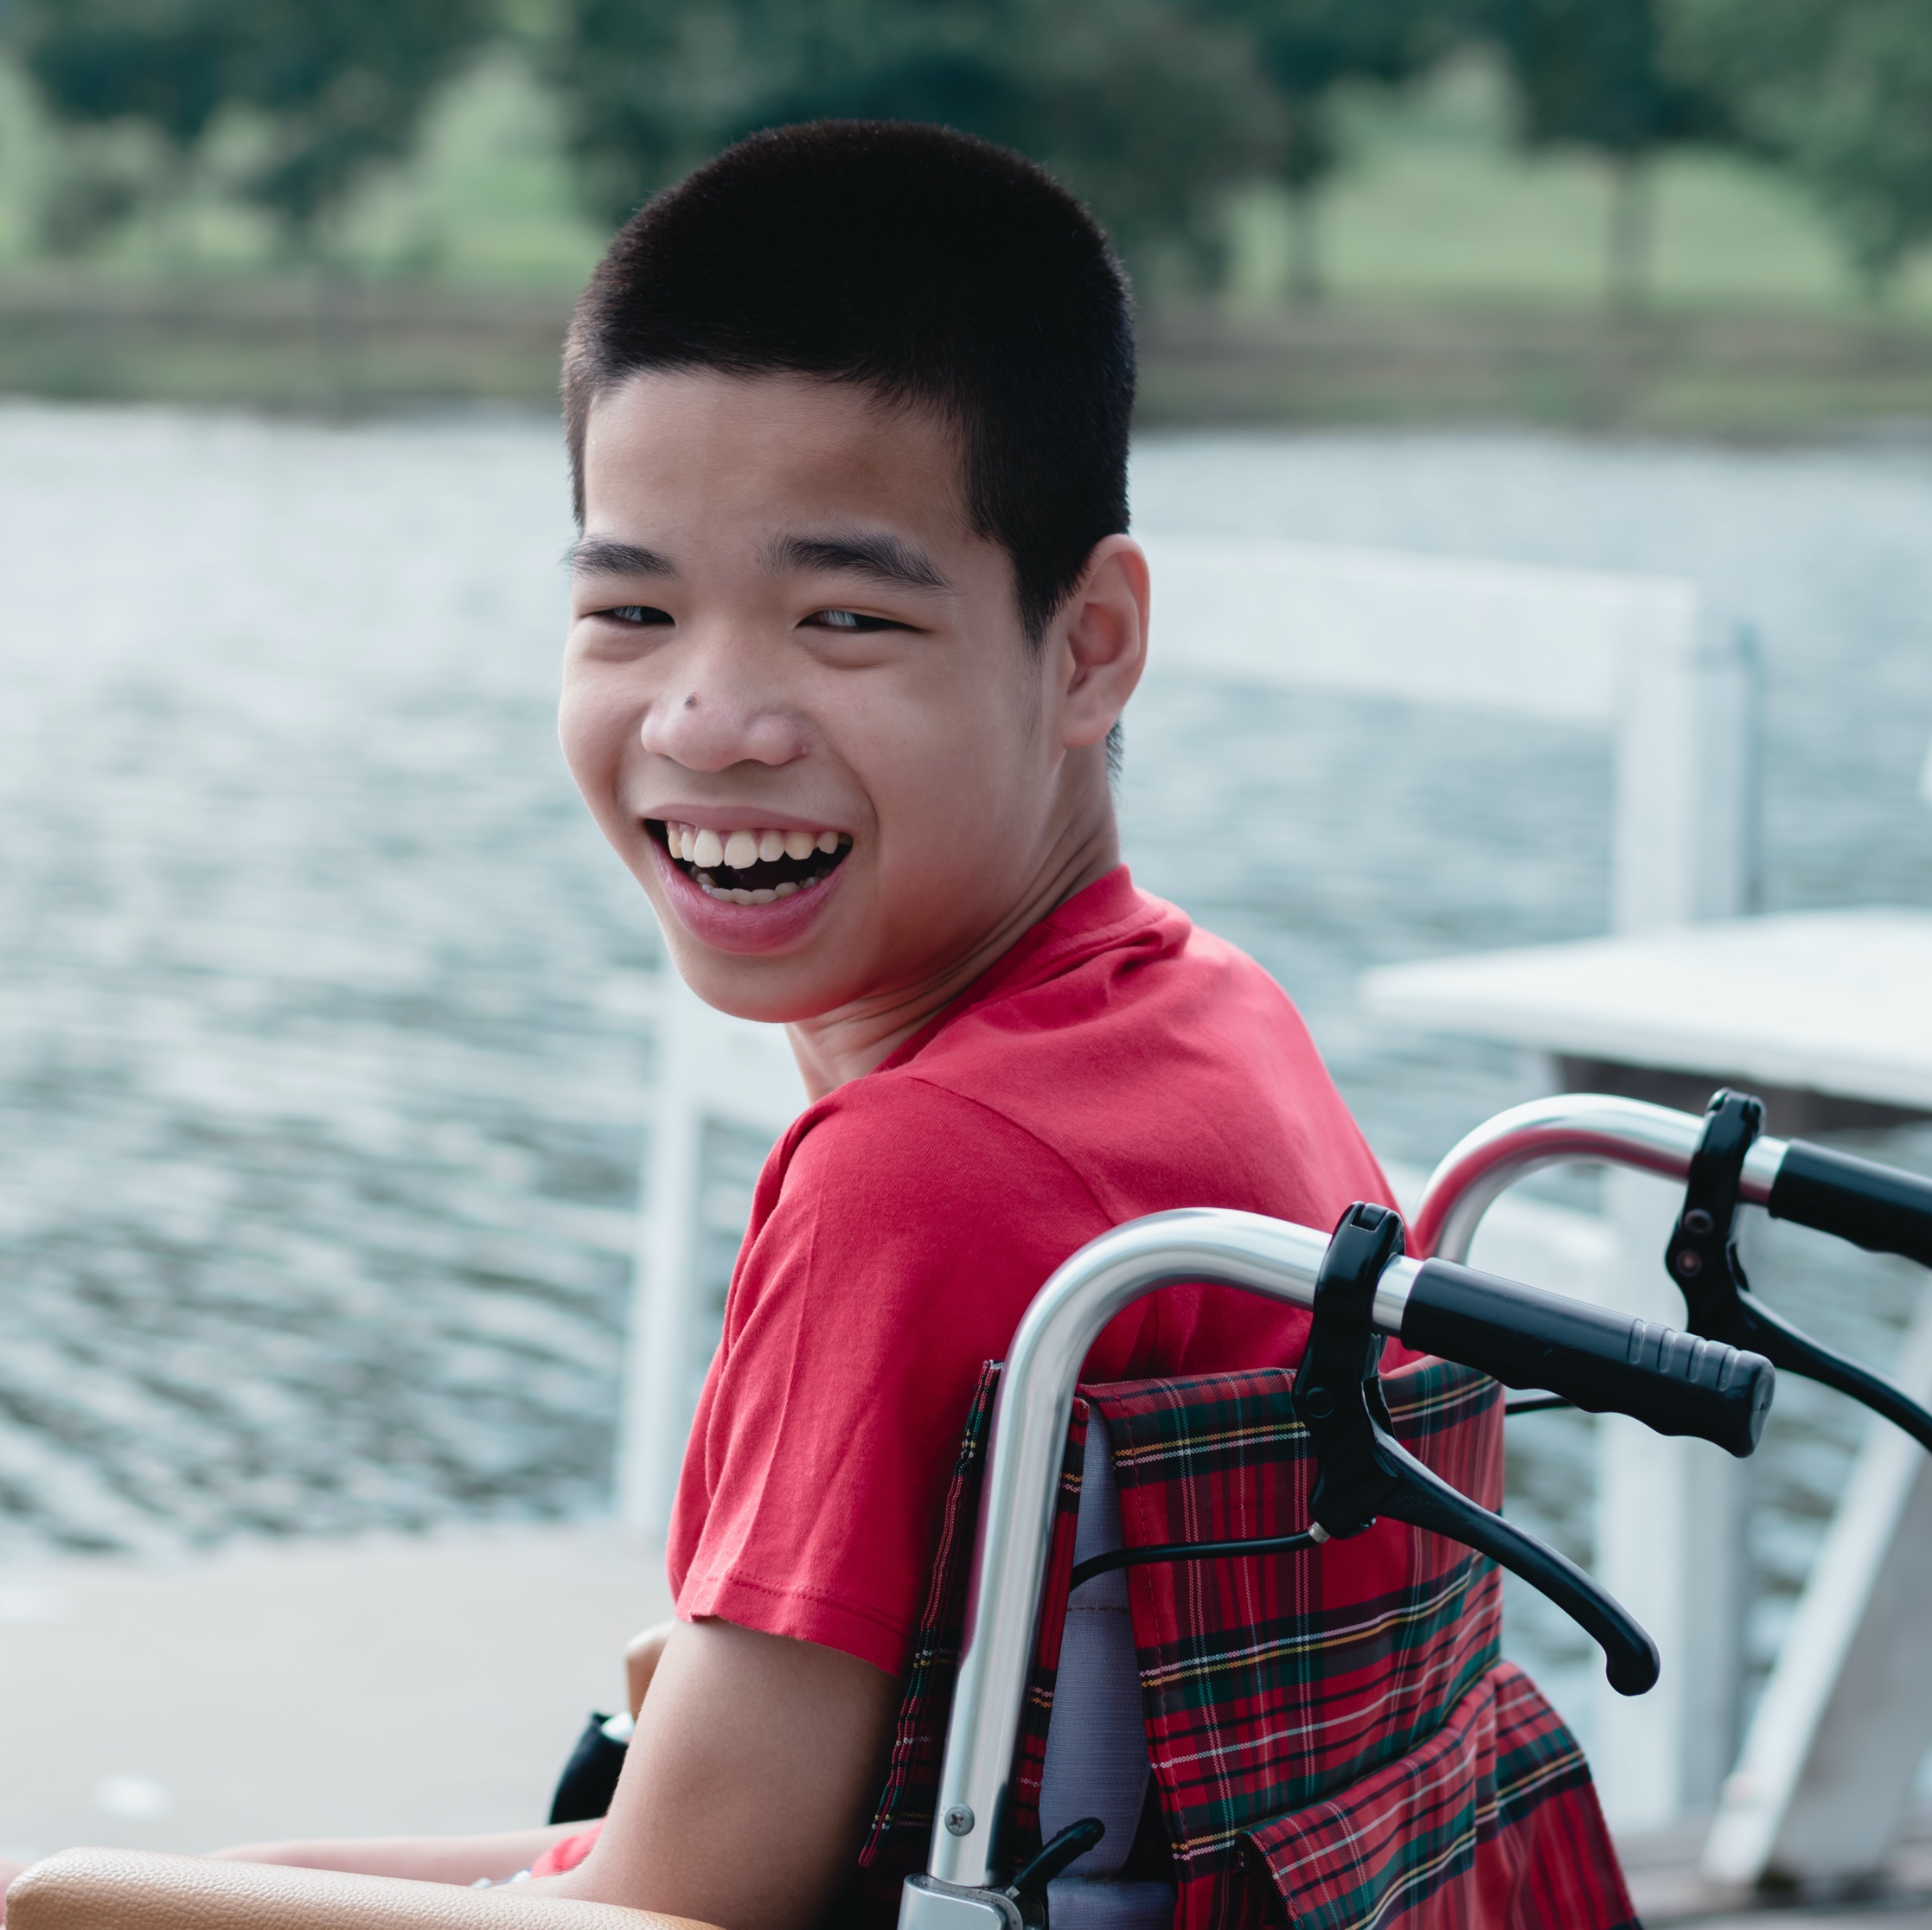
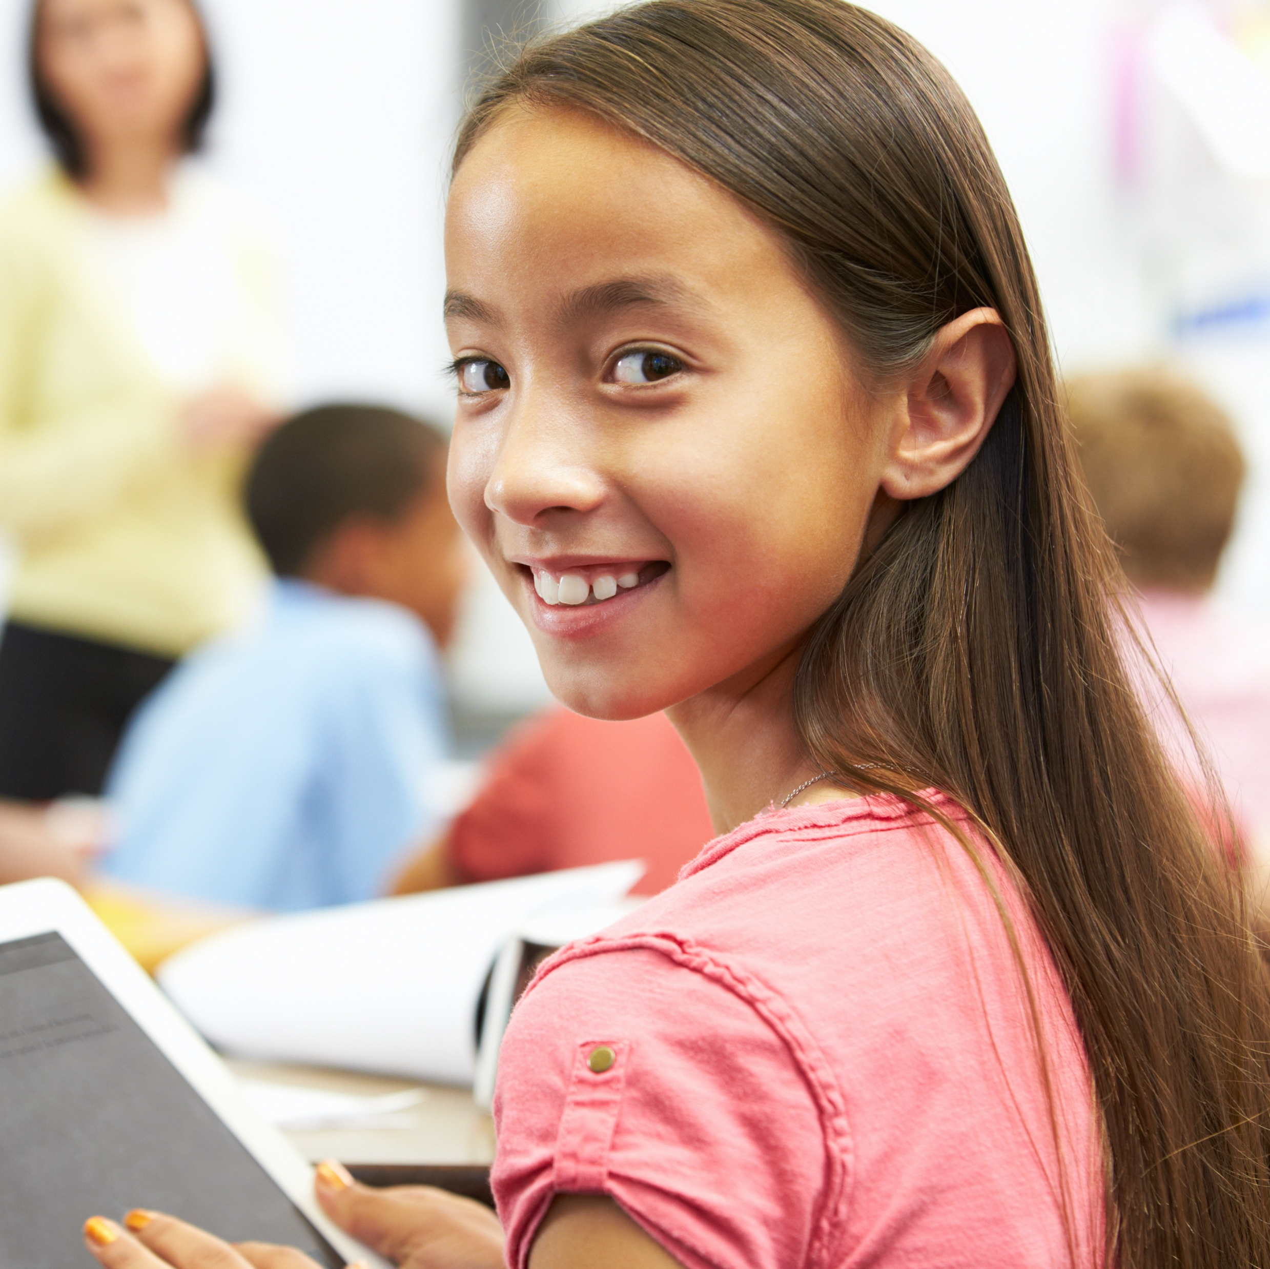
MO
I love playing sport, especially wheelchair basketball. However, recently I’ve noticed I get hot and sweaty when I play. I'm starting to feel a bit embarrassed and I'm not sure I want to play anymore.
Meet Mo and Kate…
Turn to someone near you. Give one piece of advice each for Mo and Kate to help them feel confident while being active.
KATE
I play for a local football team and love running up and down the pitch. My body is changing though as I get older and sometimes I feel a bit self-conscious about this. Now, I am considering leaving the team.
Notes:
Delivery Notes
Pupils can work in pairs or in small groups to create advice for Mo and Kate.
Share ideas as a class for things that will help them to stay confident when being active. For example, they could talk to a trusted adult about ways to increase their body confidence or focus on the things their body can do rather than what it looks like.
Discussion questions to ask students:
Why might a person feel embarrassed about their body changing?
Why is it important for people to stay active even if their body does change?
How could a person increase their confidence? Why is this important?

Slide 19
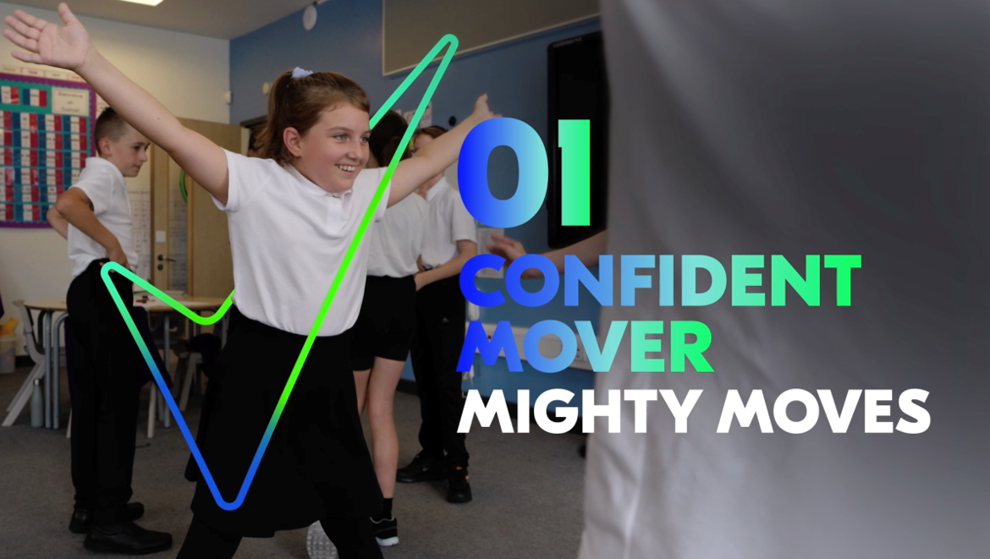

10 MINS
Mighty moves
First, watch the video guide below
Notes:
Teacher Notes:
An online version of the video is accessible here: https://vimeo.com/759167861

Slide 20
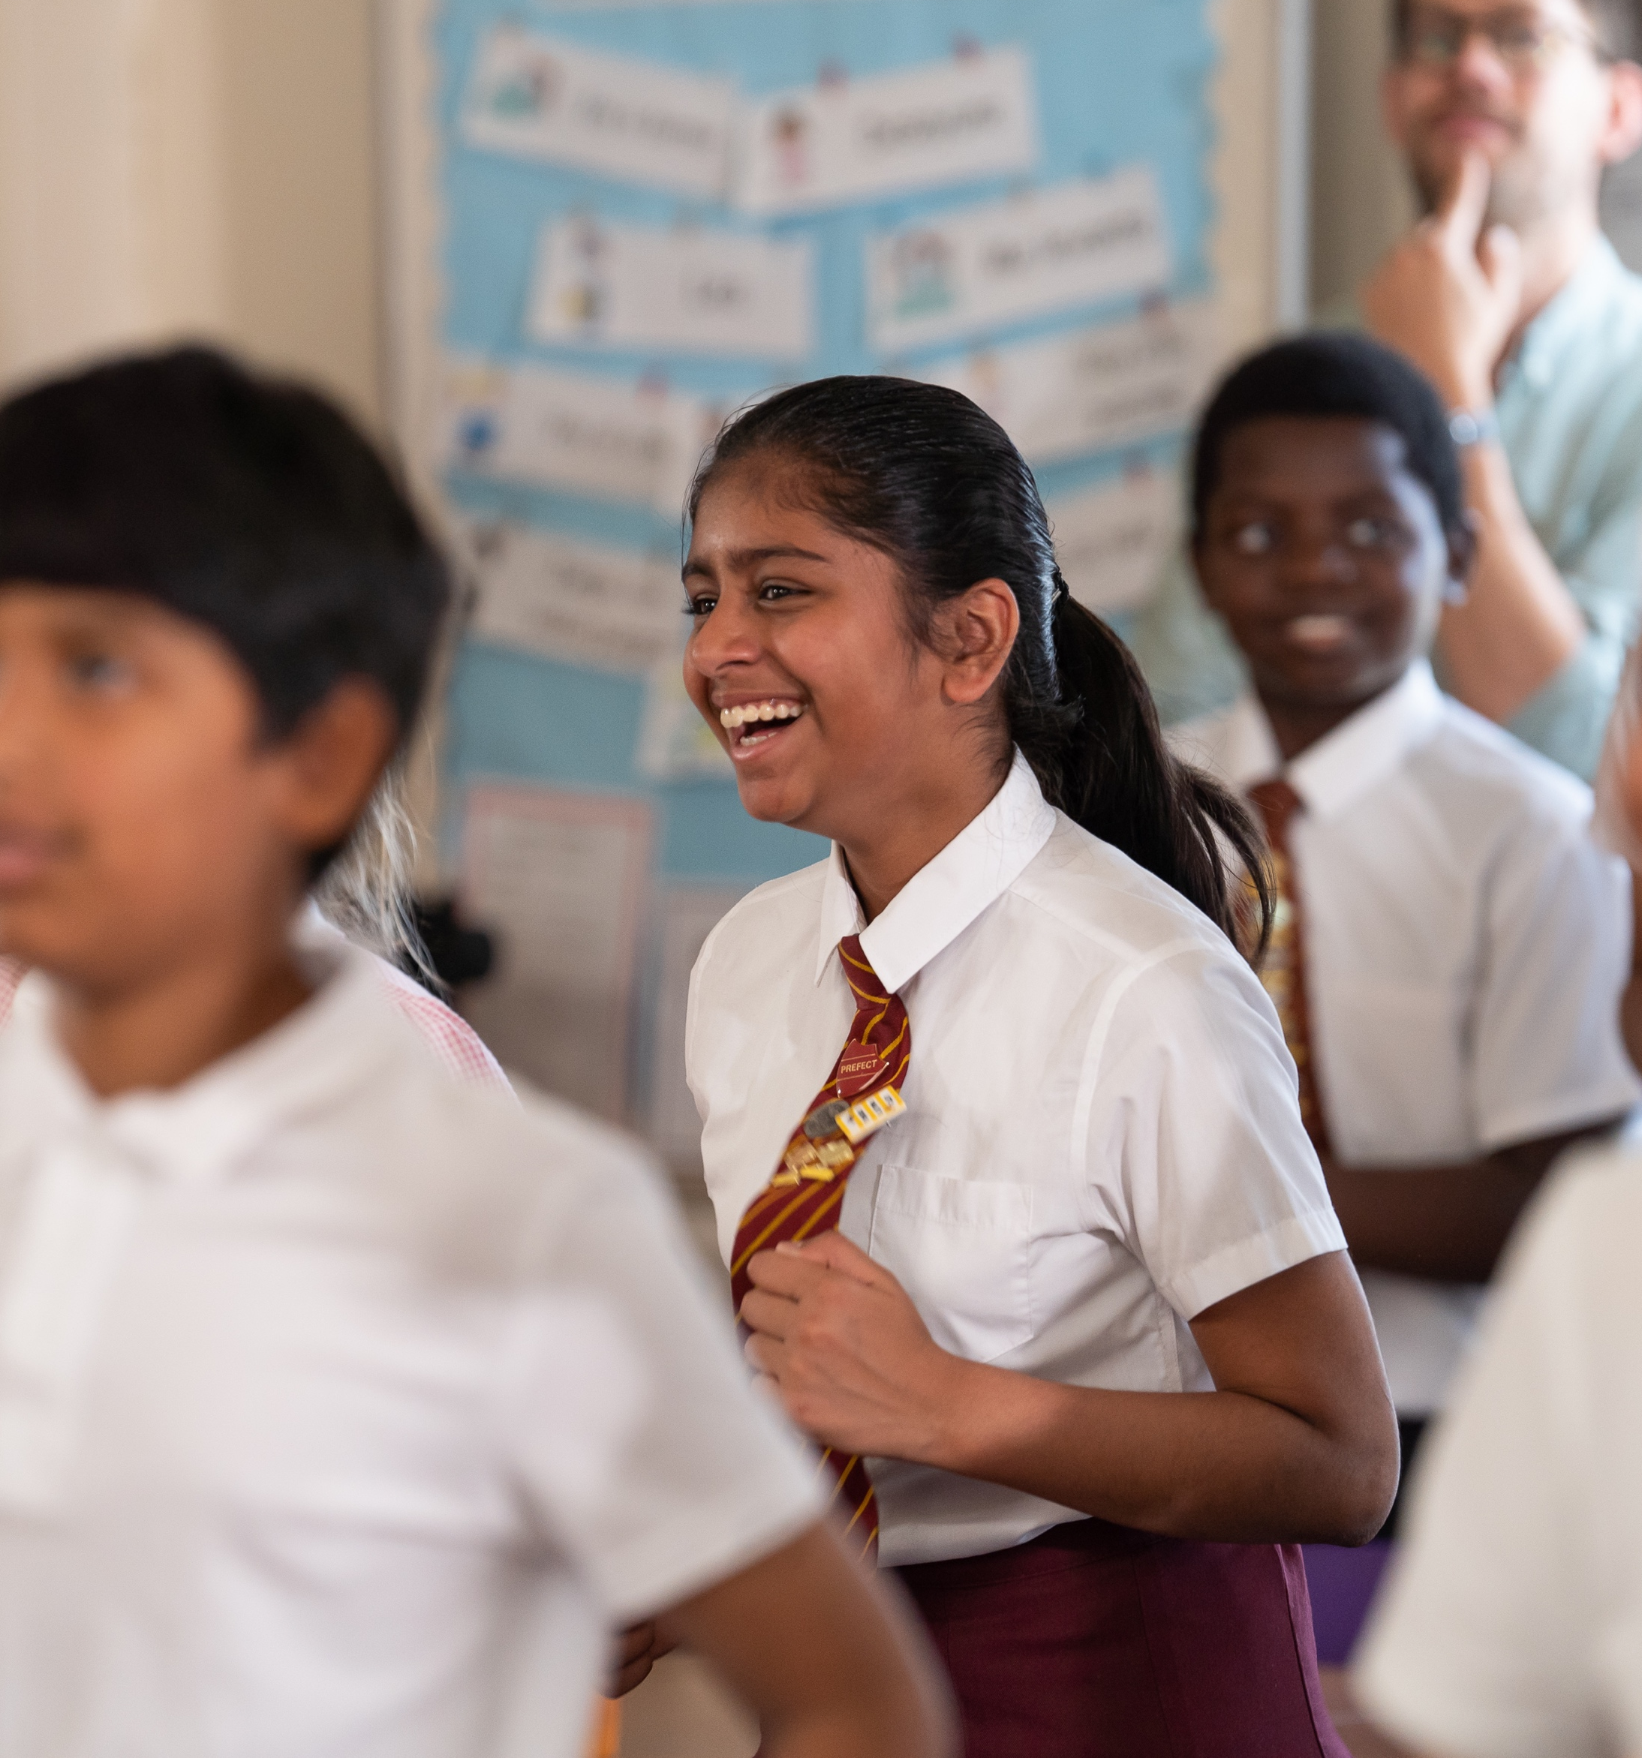
Mighty moves: your moves
How to play
1. Get into groups of 4 and number yourselves. Come up with 4 mighty moves.
2. Sequence your moves so that your
group all move to a beat.
3. Practice your sequence, making sure
your moves are powerful and in sync.
4. When your number is called,
move to a new group and learn their sequence.
Notes:
Delivery Notes
Use the next slide to try the activity yourselves
Ensure there is sufficient space in the classroom to complete the activity safely by clearing away chairs and tables, or use a large space such as a hall.
Inclusion Notes
Encourage all pupils to create a sequence of movements that are accessible to everyone in the class. Depending on your students' needs, this could involve raising/waving arms, kicking their feet or shaking their head.

Slide 21

Mighty moves: your moves
If your number is called, be ready to move!
In your group, number yourselves from 1 – 4.
If your number
is called,
be ready to
move to a new group!
Everyone must
keep performing
their sequence so the new member
can copy.
No talking!
Keep going until everyone has moved to a new group.
Notes:
Delivery Notes
Give pupils time to learn the sequence, then call out a different number.
Continue until all pupils have moved groups.
Call out the numbers 1 to 4 in a random order until all students have moved around the group at least once.
Pupils should try and learn the moves without verbal communication.

Slide 22
5 MINS
Activity Reflection
Do all people move in the same way? Is it important?
How did it feel learning a new sequence of movements by just joining in?
How did the new team help you to learn without being able to talk?
Sometimes people can experience self-doubt. How can people feel confident (and help others to feel the same) when moving?
Notes:
Delivery Notes
Lead pupils in a group discussion on the questions here.
Invite pupils to ask questions/share thoughts about anything else that came to mind during the main activity.

Slide 23
5 MINS
What do you know now?
Go back to the questions you answered during the baseline assessment. Using a different colour pen, add and amend your responses with what you have learned this lesson:
What is meant by 'self-confidence'?
How can physical activity (or movement) benefit mental health?
How can physical activity benefit physical health?
What might make someone feel less confident about moving?
How could we help someone to feel more confident about moving?
Notes:
Pupils to add and amend, in a new colour of pen, their answers from the baseline activity, demonstrating their new knowledge and understanding.
Go through the correct answers with pupils.
Self-confidence is feeling sure of yourself and your abilities.
Physical activity can benefit our mental health by releasing endorphins (chemicals that make us feel happy), relieving stress and improving our sleep.
Physical activity can benefit our physical health by promoting healthy growth of muscles and bones, and by improving our cardiovascular fitness.
Someone might feel less confident about moving if they are conscious of their bodies, if they are worried they are not good enough at the activity, or they do not see people like themselves represented in that activity.
We could help someone feel more confident about moving by being inclusive, by helping people focus on what they can do rather than what they look like.

Slide 24
5 MINS
How did you break limits today?
I’ve broken limits by…
Learning a new sequence
Working with people I don’t
normally work with
Trying new moves I didn’t
know my body could do
Knowing it doesn’t matter that we all move our bodies in different ways
Notes:
Delivery Notes:
Discuss with pupils how they think they’ve broken limits in the lesson today.
Use the slide prompts to support pupils with their thinking.
Ask questions that encourage personal reflection linked to the learning, for example:
What times of day could you do more movement?
Is there anyone you could encourage to move with you?
Think back to the lesson outcomes:
By the end of the lesson pupils will be able to:
Understand how regular physical activity benefits both mental and physical health
Recognise how low self-confidence might be a barrier to physical activity
Develop strategies to increase self-confidence in relation to physical activity

Slide 25
How did you break limits today?
Student confidence
We'd love to get feedback direct from students to understand if this lesson has been effective.
Follow the link below to complete a very quick survey, with a show of hands from the class or anonymous written submission, to find out if the lesson has taught them strategies to alter their confidence to move more and take part in physical activity.
Feedback form: https://rb.gy/pzk18

Slide 26
Asking for help
If you would like to speak to someone about anything that has come up in this lesson, then you can speak to a trusted adult either in school or at home.
If you prefer, advice and support is available at:
Childline - https://www.childline.org.uk/
YoungMinds - https://www.youngminds.org.uk/

Slide 27
Great job today!

Slide 28
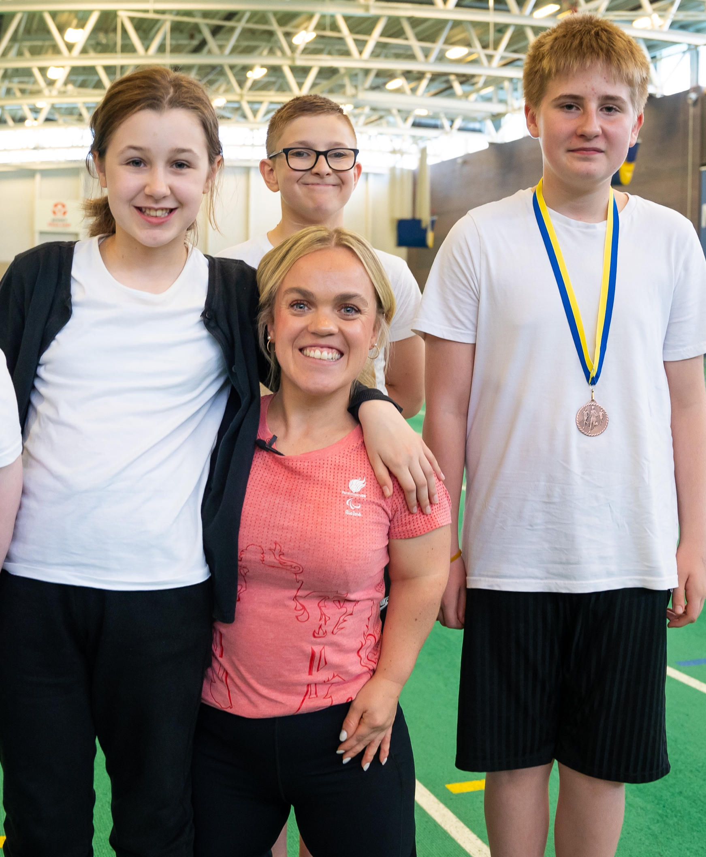
Breaking Limits competition!
Fancy winning an Olympian or Paralympian to host your sports day?
Let us know how you are breaking limits to be in with the chance to win an Olympian or Paralympian at your sports day!​
Your task is to create a visual – either a photograph, video or drawing – that demonstrates how you have broken a barrier to movement. This could include a barrier you've broken yourself, or one you've helped a classmate or friend to break.
Check out our competition entry PDF for more information.

