Slide 2
Aim
I can discuss things I am thankful for and I can focus on the things I do have, rather than the things I do not have.
Success Criteria
I can name things I am thankful for.
I can show my gratitude in different ways.
I understand that being thankful makes me and others happy.

Slide 3
The Big Questions

Slide 4
Saying Thank You
How can we be thankful for the things that we have?
In small groups discuss the questions above.
How can being thankful help to make us happy?

Slide 5
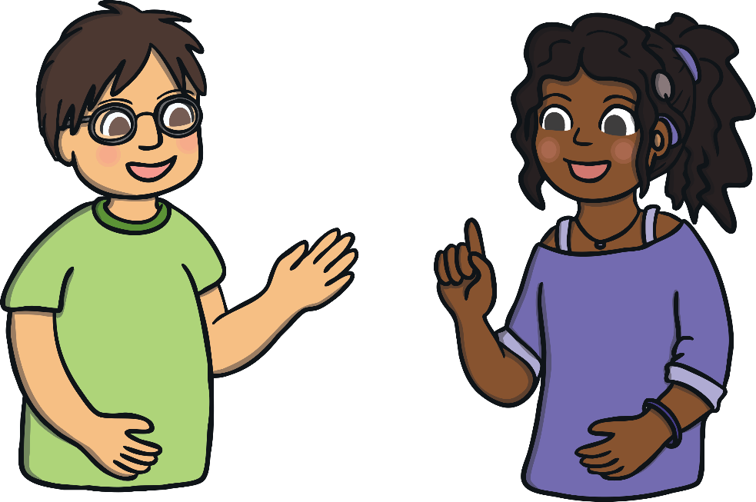
Saying Thank You
When was the last time you said thank you?
Thank you!
Why do we say thank you?
Tell your partner some things that you thank others for.
Saying thank you makes us and the other person feel good!

Slide 6
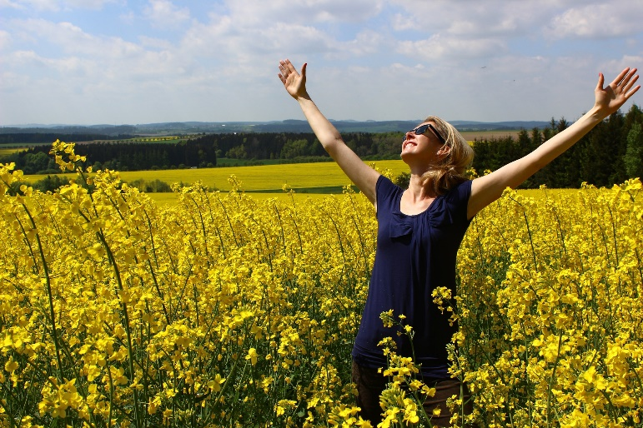
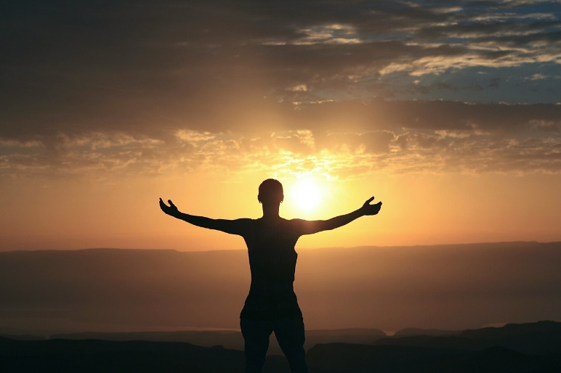
Being Grateful
What does being grateful mean?
Being grateful (or thankful) means that you appreciate things you have in your life, including the people you have around you.
If you appreciate things, it means you are pleased when you think of all the things you have and you realise how lucky you are.

Slide 7
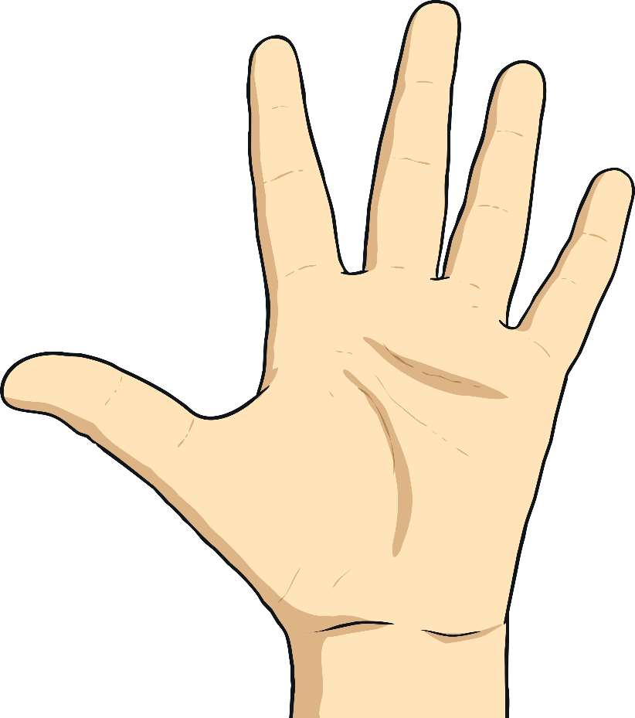
Being Grateful
Can you think of five things you are grateful for?
List them while counting on your fingers.
Was it easy to think of five things you are grateful for, or was it difficult?

Slide 8
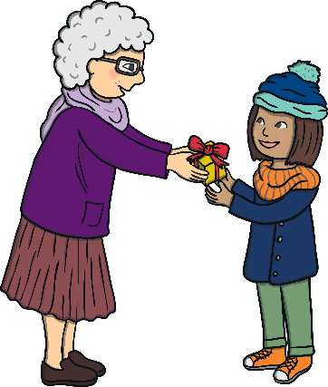
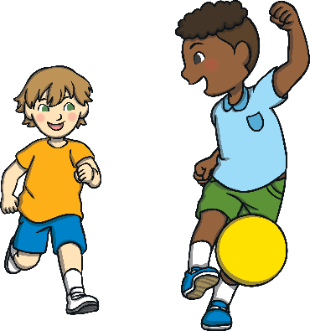
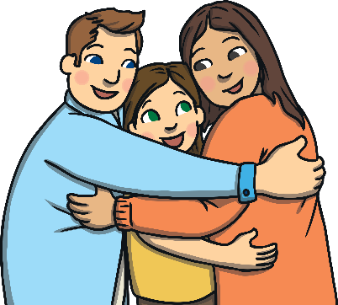
Being Grateful
How can we be grateful, or thankful, towards others?

Slide 9
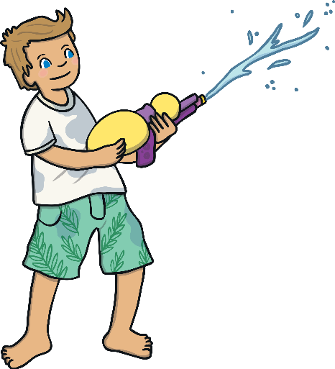
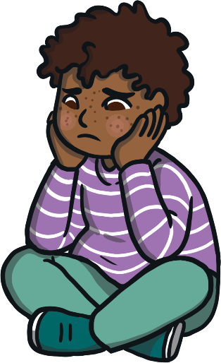
Being Grateful
How can we be grateful, or thankful, for what we have?
we can think about those who are not as lucky as we are;
We can enjoy what we have;
we can look after what we have.

Slide 10
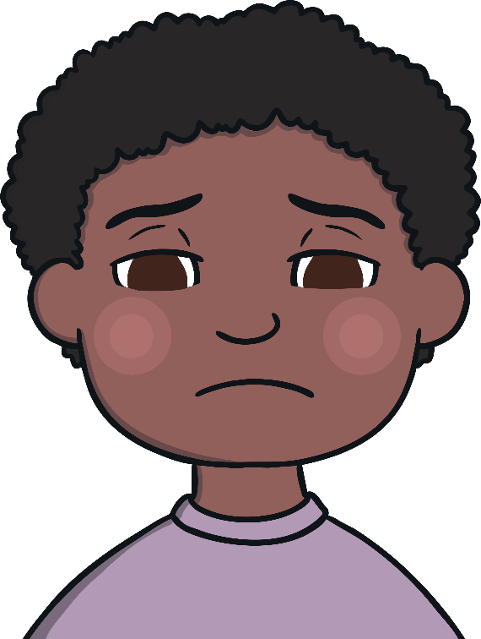
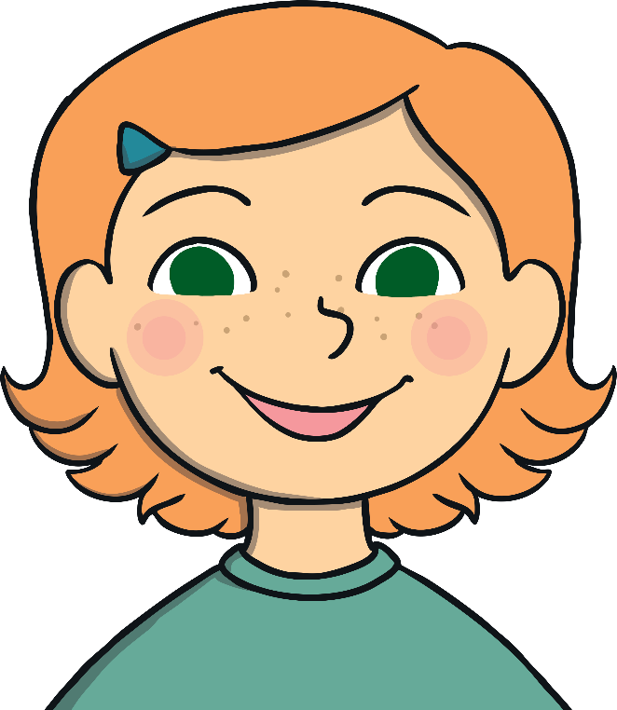
Thankful People are Happy People
How can being thankful make you happy?

Slide 11
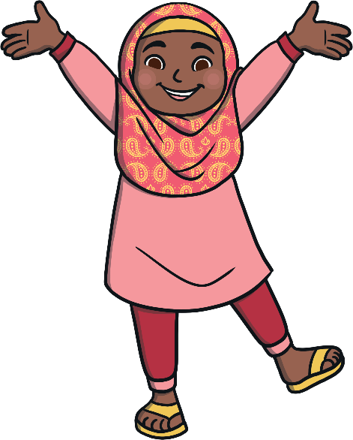
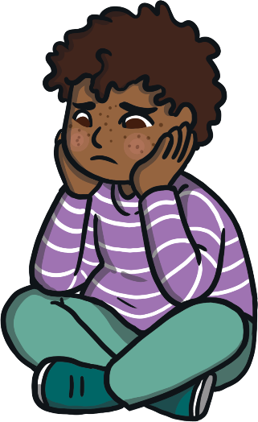
Thankful People are Happy People
If we think positive thoughts, we feel happier.
If we think negative thoughts, we don’t feel so good.
If we focus on the things we have and think how lucky we are, we will feel good, because this is a positive thought.
If we think about all the things we don’t have, we will feel miserable all the time, as this is a negative thought.
How does being thankful make us happier?

Slide 12
Thankful People are Happy People
Think carefully about this quote…
Happiness isn’t about getting what you want all the time.
It’s about loving what you have and being grateful for it.
Can you explain what it means to your partner?

Slide 13
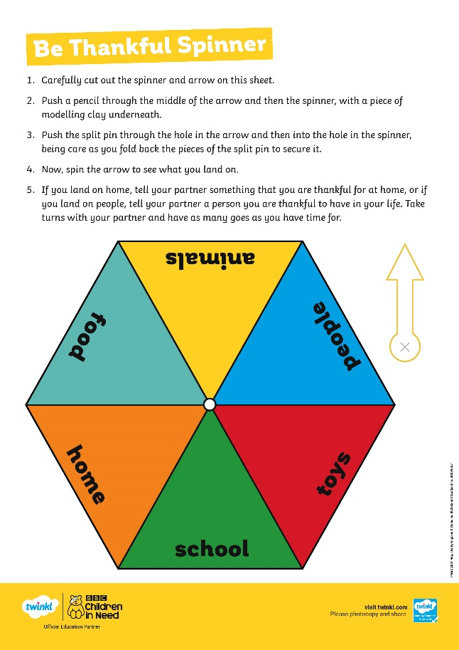
I am Thankful For…
It’s time to play a game, which you can play in pairs.
You are each going to make a spinner using a pencil and a cut out hexagon shape.
You take turns to spin your spinner and see what it lands on. Then think of something you are thankful for in whichever category it lands on.
BBC Children in Need helps to ensure all children have things in their life which they can then feel thankful for.
You can help raise money with your school to support BBC Children in Need?

Slide 14
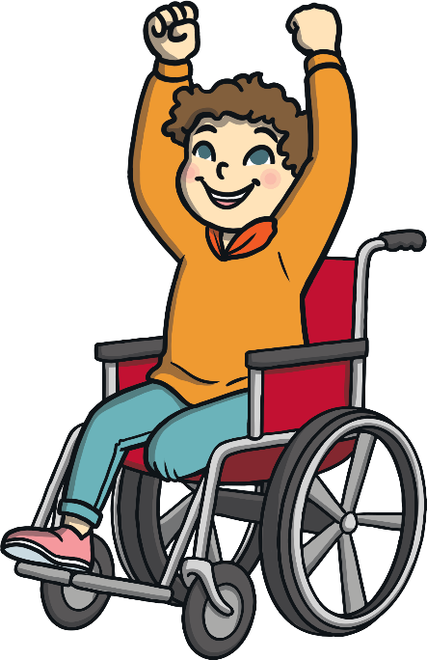
Thank You For the Memories
Even when a time we have enjoyed has ended, or a guest has had to leave, if we have lost a toy we used to love, or a family pet has sadly died, we can still be thankful for the memories we have.
Close your eyes and think carefully about a lovely memory you have about a special time, a special place, or a special person.
Choose a happy memory and think how lucky you are to still have that memory.
Be thankful for that special person, place, or time.

Slide 15
Aim
I can discuss things I am thankful for and I can focus on the things I do have, rather than the things I do not have.
Success Criteria
I can name things I am thankful for.
I can show my gratitude in different ways.
I understand that being thankful makes me and others happy.

