Slide 1
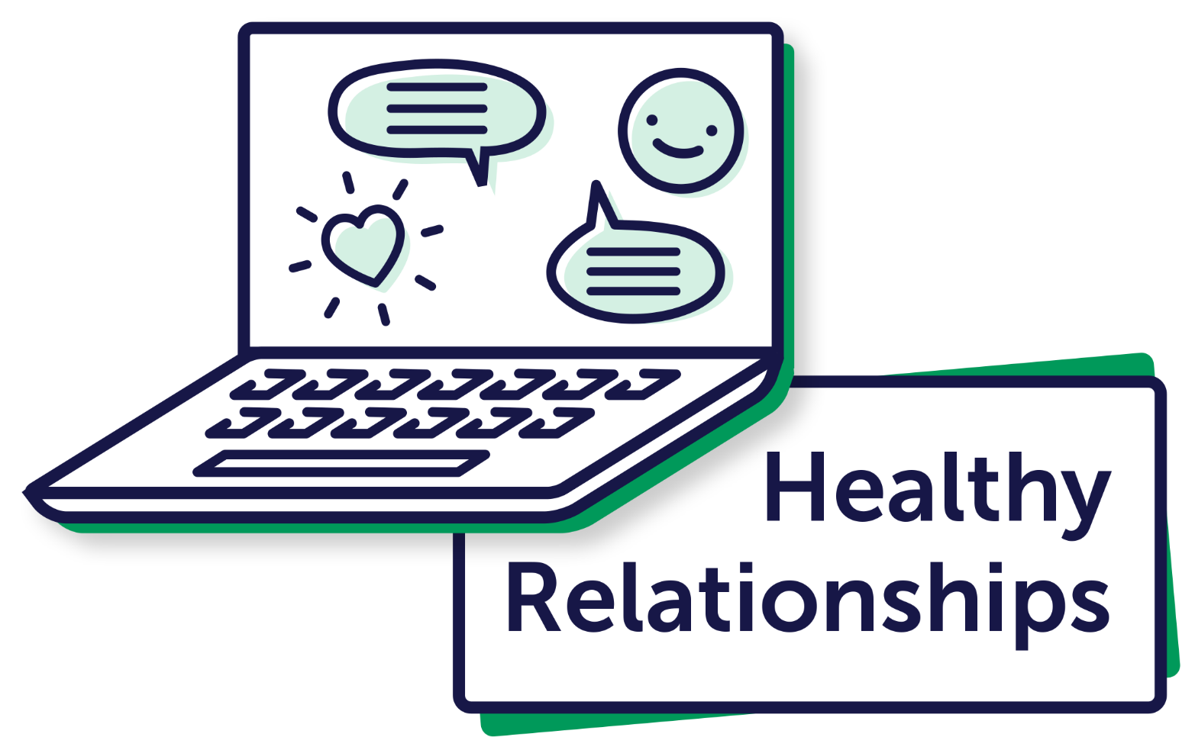

Slide 2
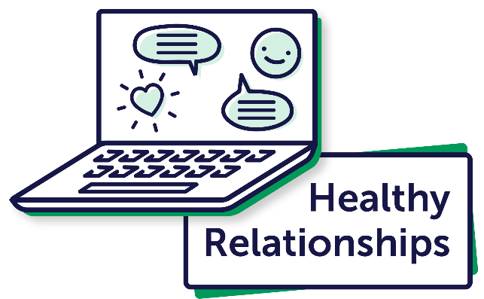
Lesson 1:
Understanding healthy and unhealthy relationships

Slide 3
Learning Objectives:
You will know…
•
•
what online relationships are
healthy and unhealthy behaviours in online relationships
which trusted adults you can talk to if you need support
•

Slide 4
Starter
?
What is a relationship?

Slide 5
Relationships
A relationship –
the way two or more people talk and behave towards each other.
A romantic relationship
A friendship – for example, a friend from school
A relationship with a family member – for example, a brother, a sister or parent
A relationship with someone professional – for example, a teacher, doctor or social worker

Slide 6
Online relationships
How do you use the internet to communicate within the relationships you have?

Slide 7
Online relationships
Play online games with people
Comment under posts and videos
Look at and like your friends’ pictures online
E-mail your teachers
Use messaging / group chats to speak to your friends
Video call friends and family who you can’t see in person

Slide 8
Healthy Relationships: Film 1

Slide 9
Main Activity
Healthy vs Unhealthy

Slide 10
Recognise and respect each other's feelings
They listen
Value and respect each other's choices
How do people treat each other in a healthy relationship?
They are kind
Say sorry when they made
a mistake
Make each other feel happy
and safe

Slide 11
Don’t care about how the other person feels
Put pressure on someone
Make someone do something they don’t want to do
How do people treat each other in an unhealthy relationship?
Unkind
Don’t say sorry when they make a mistake
Make someone feel sad, worried and unsafe

Slide 15
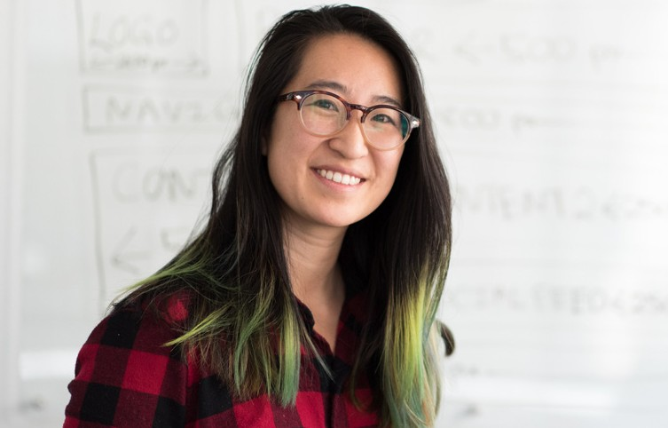
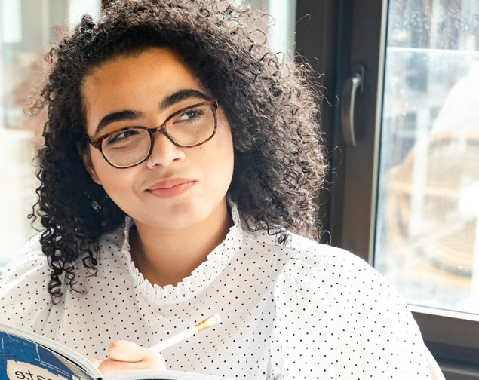
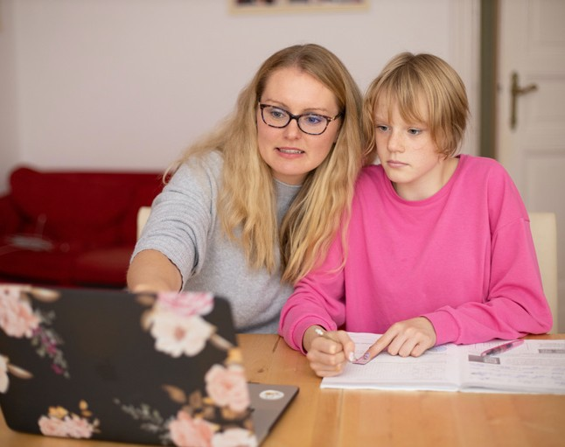
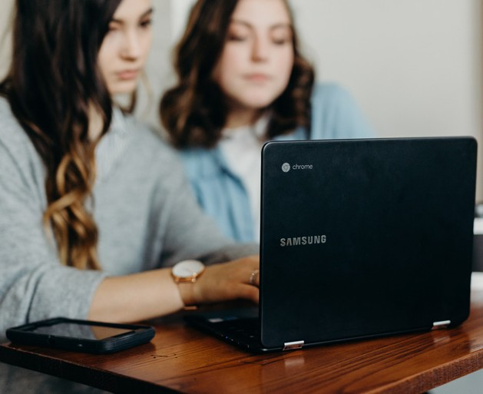
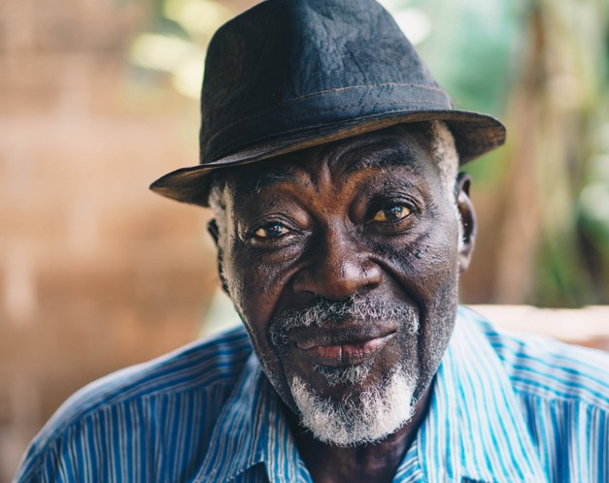
A support worker or social worker
Plenary
A teacher or another member of staff at school
A counsellor
Who are the trusted adults in your life?
Another family member (e.g. grandparent, aunt, etc.) or
friend of the family
A parent or carer
A youth worker

Slide 16
Celebrate a healthy relationship in your life this week by telling a friend, family member, or someone else you know, something you enjoy about your relationship.
You could say:
“It’s great that you respect
my boundaries and don’t try to pressure me.”
“Thank you for making me smile and telling funny jokes.”
“You are a really good friend. I like that you listen to me.”

Slide 17
Lesson 2:
Managing Online Conflict

Slide 18
Learning Objectives:
You will know…
how to recognise negative feelings caused by online conflict and how to manage them
that we have choices online
how to make good choices and to respond appropriately when things go wrong online

Slide 19
Would you rather…?
Starter

Slide 20
Would you rather…?
Publicly stand up for a friend who is being picked on online
Message them privately
It is nice to send a kind message if someone isn’t having a very good time.
Sometimes it can be good to stand up for them too. If you’re doing that, make sure your message is polite and you aren’t adding to the argument.

Slide 21
Would you rather…?
Send a mean message to someone who has upset you online
Take a break from your device
Sending a mean message or retaliating can make the issue worse and could get you in trouble. It’s a good idea to take a break if anything bothers you online and then get help and support.

Slide 22
Would you rather…?
Report bullying to the site it was happening on
Just wait for the bullying to stop
Bullying is always wrong and it’s best to report it. Unfortunately, hoping it stops might not be enough. Always talk to an adult
as well as blocking or reporting.

Slide 23
Would you rather…?
Stop playing a specific game if someone keeps being mean on it
Block them and tell an adult
Leaving the specific game will help the situation, but you shouldn’t have to stop enjoying yourself because someone is being mean. If someone has made you feel bad, don’t keep it to yourself – talk to a trusted adult.

Slide 24
Would you rather…?
Make a decision about what to do next whilst you are angry and upset
Take some time to calm down and then make a decision
We don’t always make good decisions when we are upset. Wait and respond when you feel calmer, so you don’t say or do anything you regret!

Slide 25
Healthy Relationships: Film 2

Slide 26
?
Main Activity
Brindi’s Choice

Slide 27
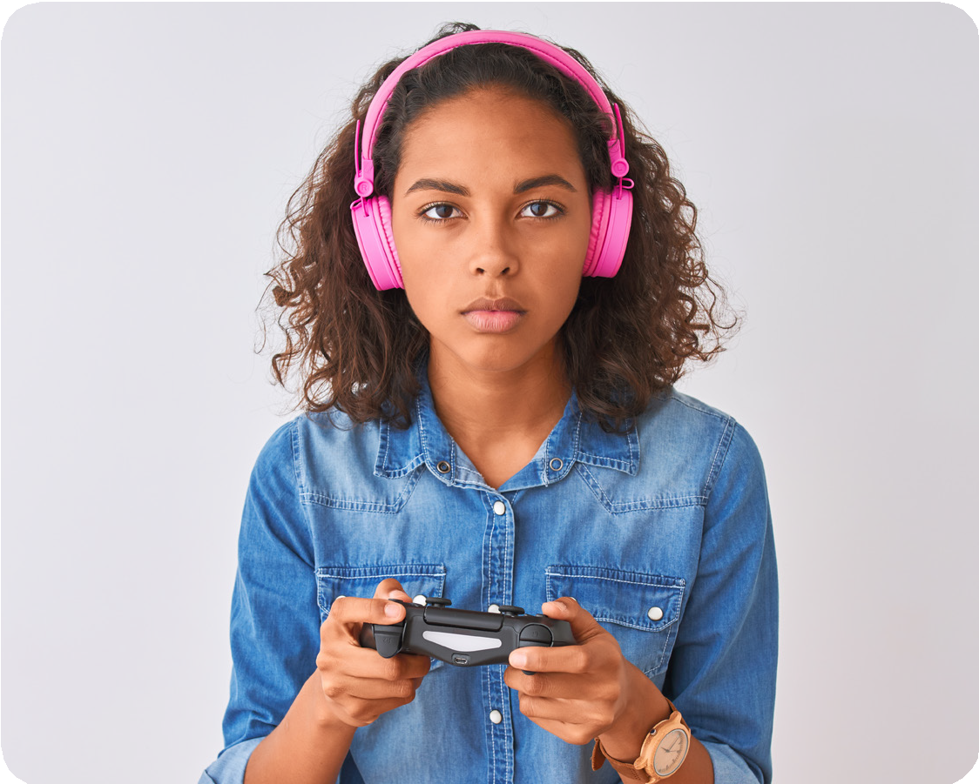
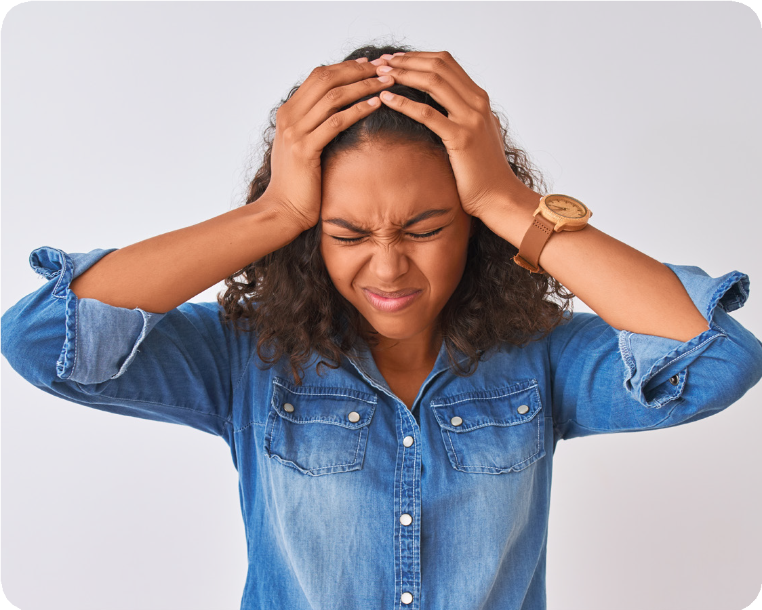
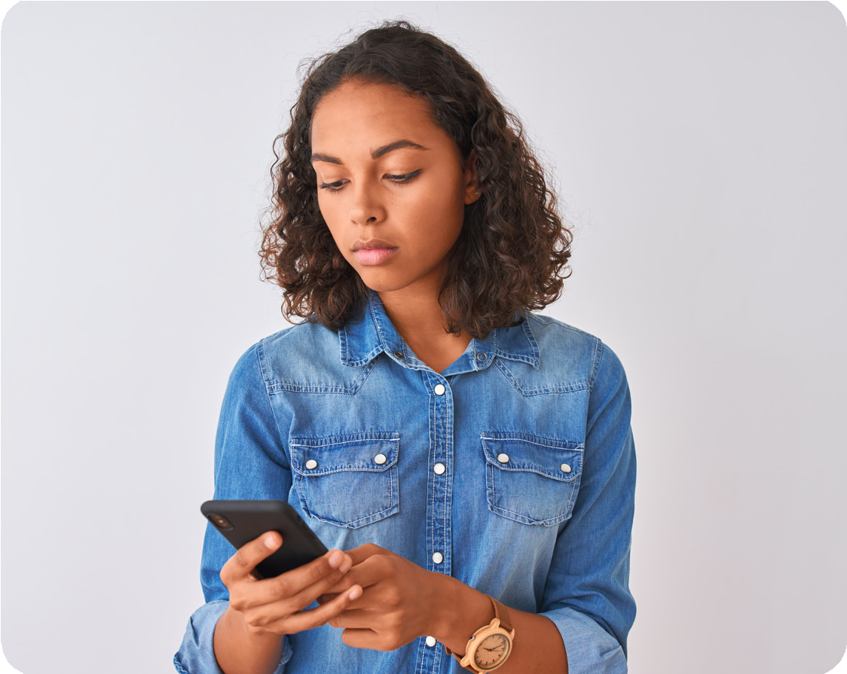
Brindi is playing a game online and keeps making mistakes. She is already stressed because she has exams on and she is normally really good at the game and loves playing.
Suddenly, everyone starts making fun of Brindi for the mistakes she’s making and calling her names. She tells them to stop but they tell her to chill out and that it’s just banter. They continue to make jokes about her gaming skills, and it makes Brindi feel really upset and angry.
The messages don’t stop, so Brindi decides to send a really rude message to all of them, and throws her controller across the room.

Slide 28
Help Brindi make a better choice…

Slide 29
Count to ten
Try another activity
Take deep, slow breaths
How can you keep calm online?
Turn your device off and take a break
Talk to someone about how you’re feeling (e.g. a close friend or trusted adult)

Slide 30
What better choices could Brindi make?
Explain to your friends how they’ve upset you
Take a screenshot / photo
Block the people
of the mean comments and
being mean
show to a trusted adult
Tell a trusted adult
Report the people
what has happened
being mean to
and ask for help
the game

Slide 31
Plenary
Something you can do if someone has sent you an unkind message…
A positive action you can take if someone upsets you online is…
A person you can talk to if someone has upset you
online…
Some advice you would give a friend if they had fallen out with someone online…
A way to calm down if something has made you angry online…

Slide 32
Practise a strategy for keeping calm at least once this week!
Even if you’re not feeling stressed or upset, strategies like deep breathing or counting to 10 when things are busy can help us feel happier and support our wellbeing. It’ll also help you know exactly what to do next time you are feeling stressed.

Slide 33
Lesson 3:
Consent in online relationships

Slide 34
Learning Objectives:
You will know…
•
•
•
how to make healthy choices in online relationships
what consent is
when you can safely give consent in online relationships

Slide 35
True or False?
Starter

Slide 36
If someone says no to something online, it’s okay to keep pushing them.
False
^{True} or False?
True or False?
You should never push someone or pressure someone into something they have said no to.

Slide 37
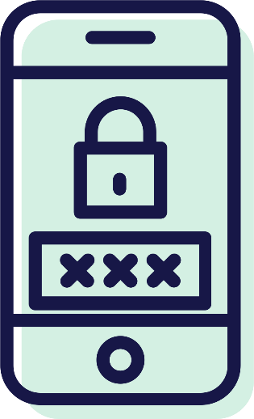
If you trust someone, you should be able to share your passwords with them.
False
^{True} or False?
True or False?
In a healthy relationship, you should always still have privacy. It’s never a good idea to share your passwords with anyone, no matter how close you are.

Slide 38
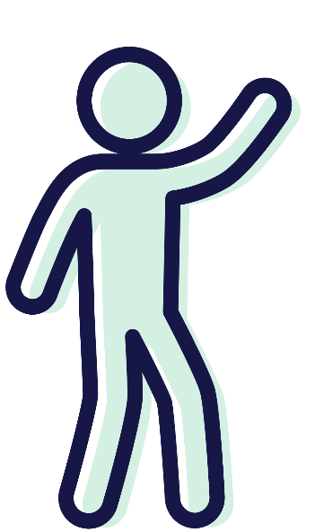
In a healthy relationship, you can be yourself.
True
^{True} or False?
True or False?
It’s really important to be yourself and to be accepted for who you are. Anyone that doesn’t like you for who you are is not a true friend.

Slide 39
Disagreeing about something is always unhealthy.
False
^{True} or False?
True or False?
It’s okay to disagree, and it’s unlikely that you and your friends will agree on everything!
The important thing is to respect each other’s opinion and still be nice to each other.

Slide 40
If I’ve been speaking to someone I only know online for a long time,
I can trust what they’re saying
False
^{True} or False?
True or False?
Even if you’ve been speaking to someone you only know online for a long time, and feel like you know them really well, that person is still a stranger to you.

Slide 41
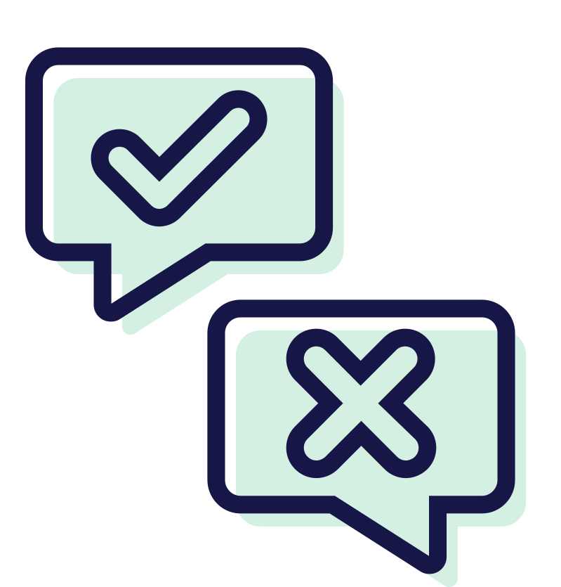
If you’re going out with someone, they are allowed to tell you what to like or post online.
False
Being controlled or told what to do is never okay and isn’t part of a healthy relationship.
^{True} or False?
True or False?

Slide 42
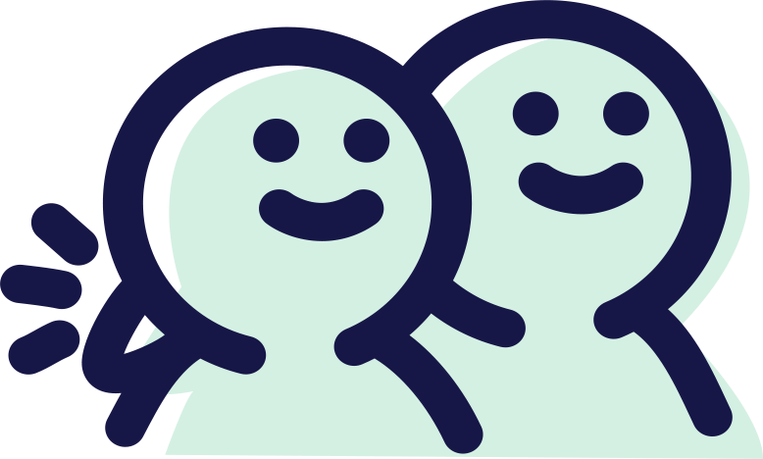
You should always feel safe in a relationship.
True
^{True} or False?
True or False?
Your safety and wellbeing are always important.
Anything that makes you feel unsafe is not okay.

Slide 43
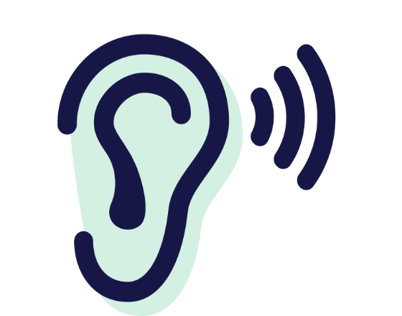
Part of a good relationship is being listened to and being respected.
True
^{True} or False?
True or False?
You always deserve respect, and listening is an important part of a good relationship.

Slide 44
Healthy Relationships: Film 3

Slide 45
Consent Check
Main Activity

Slide 46
What does consent mean?
You might consent to:
Consent means giving permission
or agreeing for something to happen.
someone sharing a photo of you online.
filming a dance routine with someone
being sent a link to a website someone wants to show you
Can you think of any more things you might consent (say yes to) online?

Slide 47
When deciding whether you should give consent
to something, you should ask yourself three questions:
Do I feel happy and comfortable?
Is it safe?
Is it kind?
Think carefully about how the situation
is making you feel.
Are you feeling worried or concerned about something?
Could there be any risks to giving consent?
Is it dangerous?
Are people being nice or friendly?
Can you think of other things that are kind, safe and make you feel happy online?

Slide 48
Plenary
I deserve…
1. To be respected…
2.
3.

Slide 49
Say no!
Saying no is an important way of showing someone we don’t consent to something.
How many ways of saying no can you think of?
Think about words and sentences, as well as actions or other visual signs, like hand gestures.

Slide 50
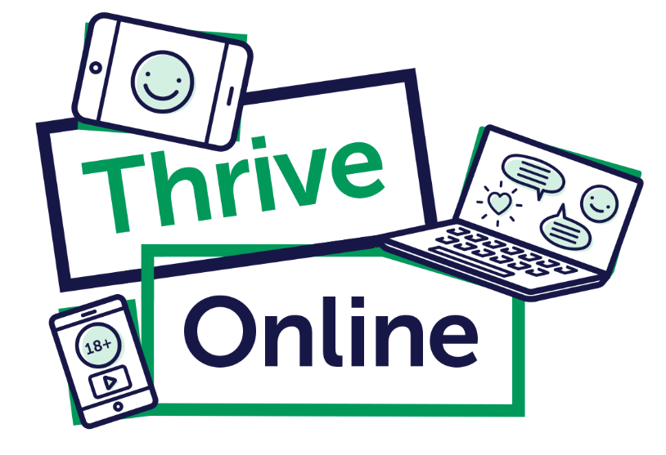
childnet.com/thrive
©Childnet International 2022

