Slide 1

Physical and mental wellbeing

Slide 2

Overview
In this lesson, students explore the link between physical and mental wellbeing.
Recommended age group
Education providers for ages 11-16 (KS3/4)
Time
55 minutes approximately
Preparation
Before delivering the lesson:
consider cross-curricular links and how this could be related to other content such as resources on Sleep, Smoking and Alcohol.
familiarise yourself with the film content on slide 12
read through the classroom tips on slide 3
This activity has been designed to be used within form time part of the planned programme for PSHE education and should be taught within the context of other PSHE education lessons. It supports the mental wellbeing strand of the Relationships and Sex Education (RSE) and Health Education statutory guidance. See Curriculum links for further information.
You may also wish to read through the Department for Education
training supporting teachers to deliver mental wellbeing and the
PSHE Association's mental health and emotional wellbeing through
PSHE guidance.
Resources
Blank A5 and A4 paper and colouring pencils/pens (for each student)
Post-it notes (for each student)
Physical and mental wellbeing: true or false? activity sheet - easier/harder version (1 per student of whichever version is appropriate)
Key vocabulary
Wellbeing (feeling good and functioning well), mindfulness (paying attention to the present moment), mental (relating to the mind), physical (relating to the body), learning, kindness, active, health, connection, social health, self-care.
Follow up
Extend students’ learning with one of the extended learning projects on slide 19 or support students’ wellbeing further with these additional resources:
Building connections KS3/4 supports students to connect with others
Social media KS3/4 explores how the five ways to wellbeing can be supported on and offline

Slide 3
Classroom tips
Climate for learning
Read through Guidance for Learning in a Safe Environment.
This includes advice on:
developing and revisiting effective ground rules
drawn up with students
familiarity with your school’s safeguarding policy and procedures, including Child Protection and other relevant policies
being prepared in case students make a disclosure
including and protecting vulnerable students
using distancing techniques so that students can
discuss sensitive issues without being encouraged
to make a disclosure
handling sensitive questions
involving students with special educational needs
and disabilities (SEND) and/or autism
You may also wish to familiarise yourself with any schemes or offers available in your school, organisation or local area to support young people’s mental health. Your local public health team or school nurse should be able to help signpost you to this.
Anonymous question box
Place a question box or envelope somewhere in the classroom.
Students write down any questions that occur to them during the
lesson and submit them anonymously. You can address these questions in the next lesson.
Identify students for whom this topic may be challenging
For children and young people with disabilities or who have experienced abuse, extreme trauma, bereavement, or themselves suffer with a mental health condition, may find discussions around physical and mental health quite challenging. Conversations about exercise should also be handled sensitively with students who have an eating disorder. It is important to be aware of these students before teaching this lesson and of any sensitivities or issues that may come up.

Slide 4
Ideas for adapting
Preparation
Managing the changes that have come about because of Covid-19 will have posed many different challenges for young people. It will have affected every young person differently and it will be more important than ever before for students to have a safe space to explore their feelings and experience.
This lesson has optional questions and scenarios related to Covid-19 and this may be particularly sensitive for any students who have experienced significant distress, loss or trauma prior to Covid-19 or during this time. There is clear guidance for teaching sensitive issues in the Guidance for Learning in a Safe Environment document and it is important that this is read before delivering this lesson.
Reassure students that it’s normal to worry about the impact of Covid-19 and that everyone will have had different responses. For example, loneliness may be an issue for some while others may have had more positive experiences – for many, there will have been a mixture of different emotions.
Adapting lessons to social distancing
Please refer to the Government guidelines and your own school’s advice
Where pair or small group discussions aren’t possible, replace with personal reflections or individual contributions to whole class discussions
Virtual delivery ideas
Please note that the following ideas may vary depending on the platform your school uses.
Use the narration function in PowerPoint to record a voiceover of the slides, including activity instructions and pause points. Post them on your school’s VLE page or share via your school’s preferred method.
If delivering as a live lesson, use polls to assess learning
Use online rooms or breakout spaces within your platform for group discussion or ask students to consider the questions individually

Slide 5
Ideas for adapting
Lesson stimulus and baseline assessment (Slide 6): Wellbeing wall
In class: Students could draw their images/write their words on scrap paper or mini-whiteboards and then all hold them up at the same time to look for similarities. Ask students to feedback reflections as a whole class and write them up for all to see.
At home: If teaching the lesson live, students could photograph and share images of their writing/drawing.
Activity 2 (Slide 12-14): Move your body to help your mind
In class: The discussion questions could be answered in pairs, written in students’ books or on mini-whiteboards.
At home: Have students complete the task individually.

Slide 6

Wellbeing wall
Write or draw it
1.
Physical wellbeing
2.
Mental wellbeing
Notes:
Lesson stimulus and baseline assessment: Wellbeing wall (5 mins)
Give students two pieces of A5 paper or sticky notes and ask them to spend two minutes either drawing an image or diagram that represents physical wellbeing on the first piece and an image or diagram that represents mental wellbeing on the second or students can write as many words as possible onto each piece of paper to reflect their understanding of physical and mental wellbeing.
(Note that students’ images can be as abstract as they like. Before drawing, explain to students that they should draw images that represent the ideas of mental and physical wellbeing generally, instead of drawing images based on their own personal experience.)
In small groups or as a whole class, ask the students to put their images/words of physical wellbeing together and their images/words of mental wellbeing together to create a wellbeing wall and discuss the similarities and differences between them.
Use this initial assessment to decide whether you might need to adapt the lesson content to extend or support students, depending on their starting point.
Note that you could also use the confidence checker on slide 17 before this slide if useful.

Slide 7
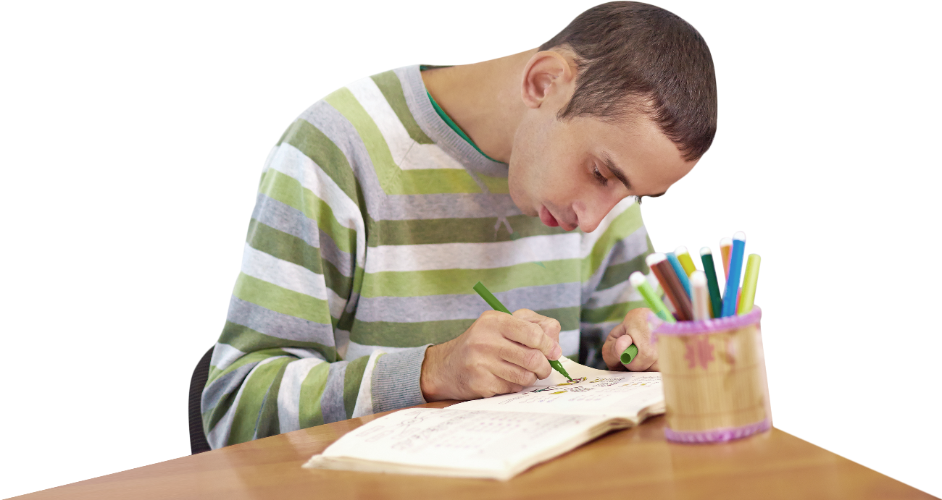
What are we learning?
Learning outcomes
Key vocabulary
Learning objectives
We are exploring the link between physical and mental wellbeing and finding strategies to support those who need help.
identify the link between physical and mental wellbeing
describe strategies for improving physical and mental wellbeing
explain ways to help those who need support with their physical and/or mental wellbeing
wellbeing (feeling good and functioning well)
mindfulness (paying attention to the present moment)
mental (relating to the mind)
physical (relating to the whole body)
learning
kindness
active
health
connection
social health
self-care
Notes:
What are we learning? (2 mins)
Note that this slide features animated content and should be viewed in presentation mode.
Briefly share the learning objectives, outcomes and key vocabulary with students. Note that easier-to-understand words are provided in brackets.
Definition: Social health is ‘the ability to interact with others, adapt to social situations and form relationships’.

Slide 8
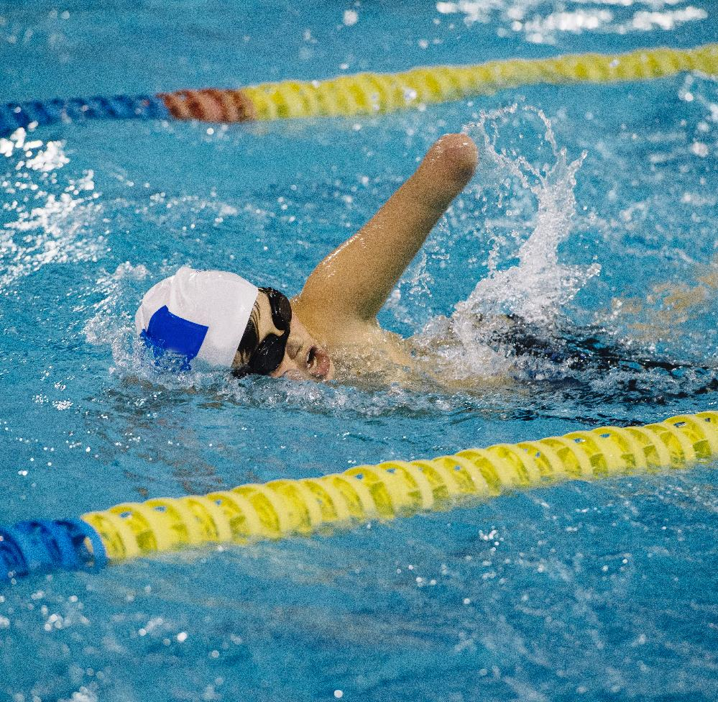

How are physical and mental wellbeing linked?
Notes:
Activity 1: Linking physical and mental wellbeing (20 mins, slides 8-11)
After discussing the question on the board, reinforce that, like physical wellbeing, mental wellbeing is an important part of daily life that is influenced by different factors, including exercise.
Explain that one can influence the other; looking after your physical wellbeing, for example by getting active, can impact your mental wellbeing and vice versa.
Physical wellbeing is about taking care of your body and enjoying movement involved in daily life.
Note: This is not being about able bodied, this term is inclusive to everyone. It's important not to make anyone with an underlying health problem or disability feel excluded here.
Mental wellbeing is about feeling good about yourself, the people around you, and the world itself.
Note: The things young people value, enjoy or are good at can all support mental wellbeing. Positive relationships, eating and sleeping well can also be beneficial.
Challenge: Prompt older students to reflect on ways they can contribute to others’ mental wellbeing, and establish which activities help them maintain their own wellbeing.
Support: Definitions could be printed off for students or written on the board.

Slide 9
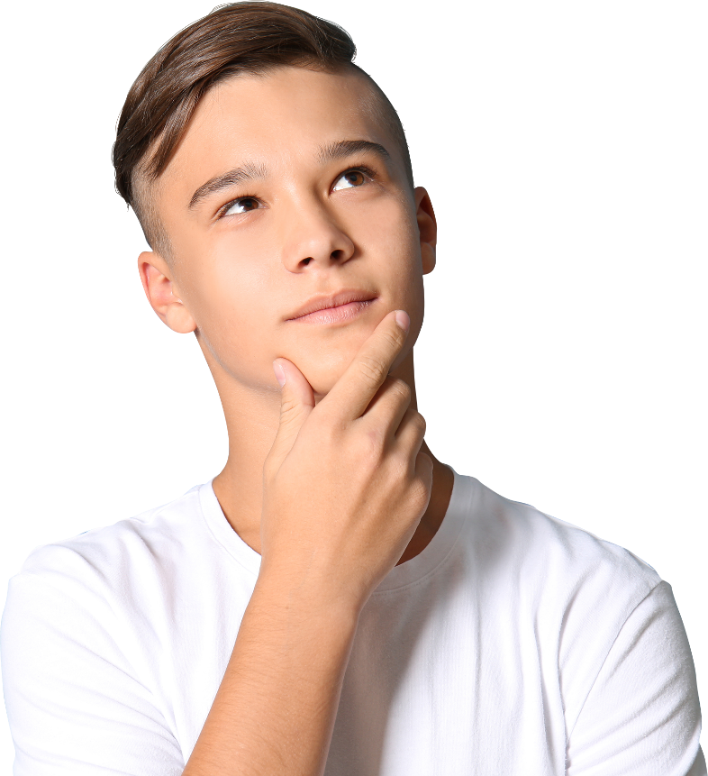
Wellbeing: fact or fiction?
Challenge
Use two different coloured pens to group the statements into strategies that support:
Mental wellbeing
Physical wellbeing
In pairs explain your choices and answer the questions:
Were your choices the same?
Why do you think this happened?
Notes:
Activity 1: Linking physical and mental wellbeing (20 mins) continued
Highlight to students that there are a lot of myths around wellbeing and quite often people do not know how they can make their bodies and minds feel better. Ask students to complete the Physical and mental wellbeing: true or false? activity sheet. (Easier and harder versions available).
Communicate to students that the activity sheet introduces new ideas about wellbeing and is not testing information they already know.
Answers:
1.(T) 2.(F) 3.(T) 4.(T) 5.(T) 6.(T) 7.(F) 8.(F) 9.(T) 10.(T) 11.(T) 12.(F)
Challenge: There are a variety of answers that could be given for this activity – the task is to highlight the difficulty in trying to separate strategies which promote mental and physical wellbeing – as the two are very closely linked.
Support: Provide the easier version of the Physical and mental wellbeing: true or false? activity sheet, and/or answers can be given to students who are struggling, and they must try and re-write the false statements so that they are correct. To extend learning direct students to complete the challenge task.

Slide 10
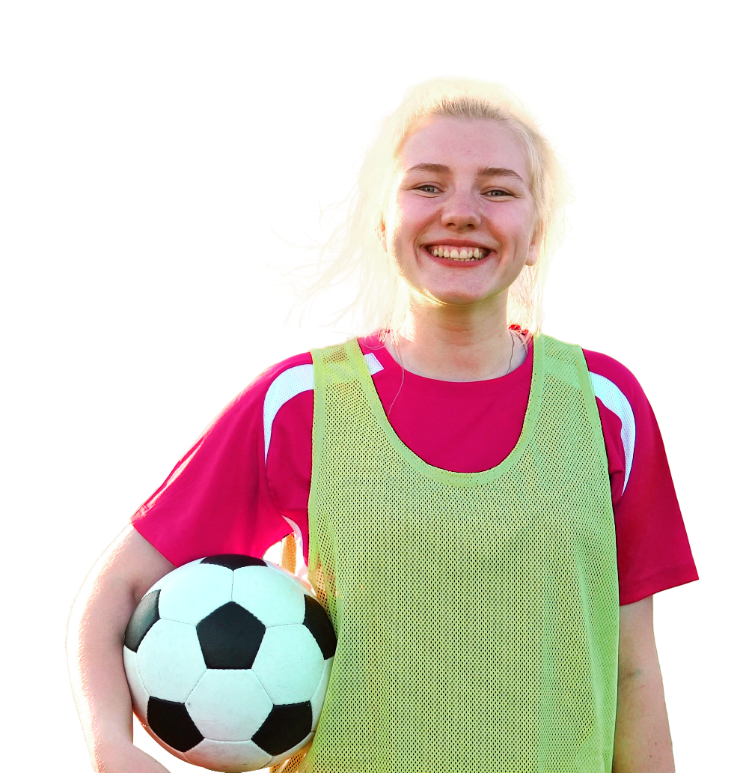
Physical and mental wellbeing
Ideas to support physical
and mental wellbeing
Notes:
Activity 1: Linking physical and mental wellbeing (20 mins) continued
Ask the students to complete a spider diagram of ideas that could promote/support someone’s physical and mental wellbeing. Feedback as a class.
Explain to younger students that things they value, enjoy or are good at can all support mental and physical wellbeing. Positive relationships, eating a balanced diet and sleeping well can also help.
Encourage older students to reflect on ways they can contribute to others’ mental wellbeing such as being a good friend or supporting those experiencing bullying or loneliness.

Slide 11

Five ways to wellbeing
Connect with people
Be active and look after physical health
Learn something new and get creative!
Be kind
Pay attention to the present moment (mindfulness)
Notes:
Activity 1: Linking physical and mental wellbeing (20 mins) continued
Explain that the five ways to wellbeing can help to support mental wellbeing. Using ‘Think, pair, share’ ask students to think of examples for each area.
Encourage students to link connecting with people as being part of social health – ‘the ability to interact with others, adapt to social situations and form relationships’.
Prompt students to think about the five ways to wellbeing as part of their self-care. They could add examples to their spider diagram.
Explain that this lesson is focussing on point number two, ‘Be active and look after your physical health’, but it may have links with some of the other ways to wellbeing and they can use all five of the ways to wellbeing.
Examples:
Connect with people: Contact someone you haven’t spoken to for a while, write someone a letter or talk on the phone asking how they are, plan to do something fun with some friends, reach out to people to talk about your thoughts and feelings, send some funny memes/gifs/pictures. (Consider the ways this can be done safely during the Covid-19 pandemic).
Be active and look after physical health: Try a new class such as yoga, Zumba or boxing, go for a brisk walk, stretch at home, go for a run in a park, do some sit-ups, kick a ball around… anything to move your body!
Learn something new and get creative: Teach yourself a new skill online, ask a family member to teach you how to sew or cook, play a new game, paint something, design something, write a story or a play, try a musical instrument, get outdoors and plant something, learn or teach someone a language, or read a new book.
Kindness: Volunteer, thank someone for something, make another person a thoughtful gift, send a card, offer to help your family with chores around the house, help someone with something, or make a list of all the things you value about another person.
Mindfulness: Take a moment to notice/think about your feelings, write/paint/draw to express how you feel, turn off phone notifications, try to not use your mobile phone, go into nature and look around, meditate, have a hot drink and just relax.
Support: It may be helpful to write some of the examples from the lists above on the board to help with their conversations or examples could be printed out for students after the ‘Think, pair, share’ activity.
Challenge: Were there any of the five ways to wellbeing you had fewer ideas for in your original spider diagram – why might that be?

Slide 12
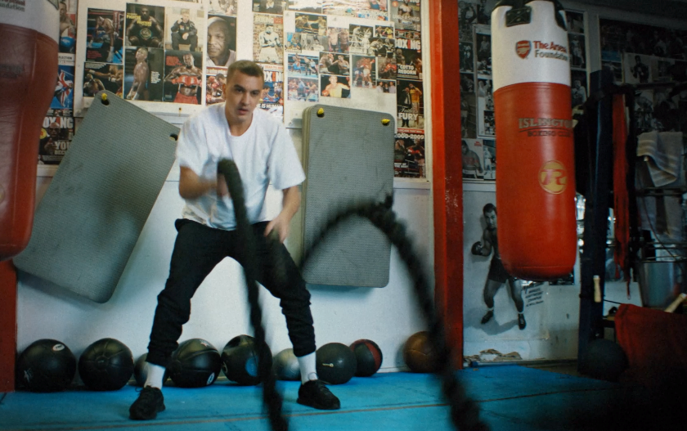
Move your body
Watch the ‘Sweat’ video here
Notes:
Activity 2: Move your body to help your mind (20 mins, slides 12-14)
Watch the sweat video by clicking on the play button button (when the PowerPoint is in presentation mode) or copying and pasting this link into your browser: https://www.nhs.uk/oneyou/every-mind-matters/youth-mental-health/
On this web page, you will need to select the film titled ‘Sweat’.
You may want to ask students to take notes to support discussion questions afterwards.

Slide 13


Discussion questions
How did physical activity affect MC Malik’s mental wellbeing?
What did MC Malik suggest are good ways to motivate people and get the most out of exercise?
Challenge
Do you think exercise alone can achieve better mental wellbeing?
Notes:
Activity 2: Move your body to help your mind (20 mins) continued
Be aware that this discussion needs to be handled sensitively for students with eating disorders. Stress the importance of rest and recovery and not over exercising.
How did physical activity affect MC Malik’s mental wellbeing?
Malik felt like he had more energy, exercising ‘cleared his mind’ and helped to lift his mood.
What did MC Malik suggest are good ways to motivate people and get the most out of exercise?
Bring a friend to the gym as this can be enjoyable and motivating. Set small targets so that you can monitor your progress. (If discussing this while gyms are not accessible due to Covid-19, emphasise other options for physical activity – such as parks, walks or online classes like dance or strength training).
Challenge: Do you think exercise alone can achieve better mental wellbeing?
Exercise is a great way to boost your mood and give your more energy which can help both physical wellbeing and mental wellbeing. However think back to the five ways to wellbeing, it is important that exercise is part of other routines that are carried out to maintain good wellbeing…
Connect with people
Be active and look after physical health
Learn something new and get creative
Be Kind
Pay attention to the present moment (mindfulness)
Support: To extend the learning students from each group can share their top tip on ‘moving your body to help your mind’. Class top tips list could be created.

Slide 14
Moving matters
Create a blog post or poster to show your understanding of the following:
The benefits of exercise on physical and mental wellbeing
The options for physical activity in your local area
Helpful strategies to help people do physical activity every day
The ways in which you would encourage people to be more active who are lacking in confidence
Being physically active is one of the five ways to wellbeing.
Notes:
Activity 2: Move your body to help your mind (20 mins) continued
Students could work in small groups. They must include the following key criteria:
The benefits of exercise on physical and mental wellbeing
The options for physical activity in your local area
Helpful strategies to help people do physical activity every day
The ways in which you would encourage people to be more active who are lacking in confidence
Support: Answers from the Physical and mental wellbeing: true or false? activity sheet can be printed off for students to help with their task.
Challenge: To increase challenge students can undertake individually or individual students chosen to share their work with the rest of the class.

Slide 15
Helping others
1.
“I am finding it hard to be active,
all I want to do is sleep.” Leon
“How about starting to go to a sports club after school? Being active can give people more energy and boost their mood.”
Look at the advice that has been
given to these two young people.
How good do you think
this advice is and why?
How could the advice
given be improved?
2.
“I moved to this area a few weeks ago and I don’t know anyone. I am starting to feel low and I don’t know what to do.” Sam
“These things can take time, people make friends eventually.’’
Notes:
Activity 3: Helping others (8 mins, slides 15-16)
This activity could be carried out individually on paper or discussed in pairs/groups/as a class. For students who need further challenge, see slide 16.
Tips and advice for young people might include:
Increasing the amount of sleep and relaxation
Trying to drink more water to help create a feeling of improved energy levels
Trying some new type of exercise to get you excited about moving your body
Creating more routines in your day/week to help increase the amount of exercise
Connecting with new people, joining a club or going online to find out about social sports teams
Speaking to family/friends or trusted adult about the things you find challenging
Showing kindness to yourself, you are trying to eat well, sleep more and get moving so think positively and celebrate your successes.

Slide 16
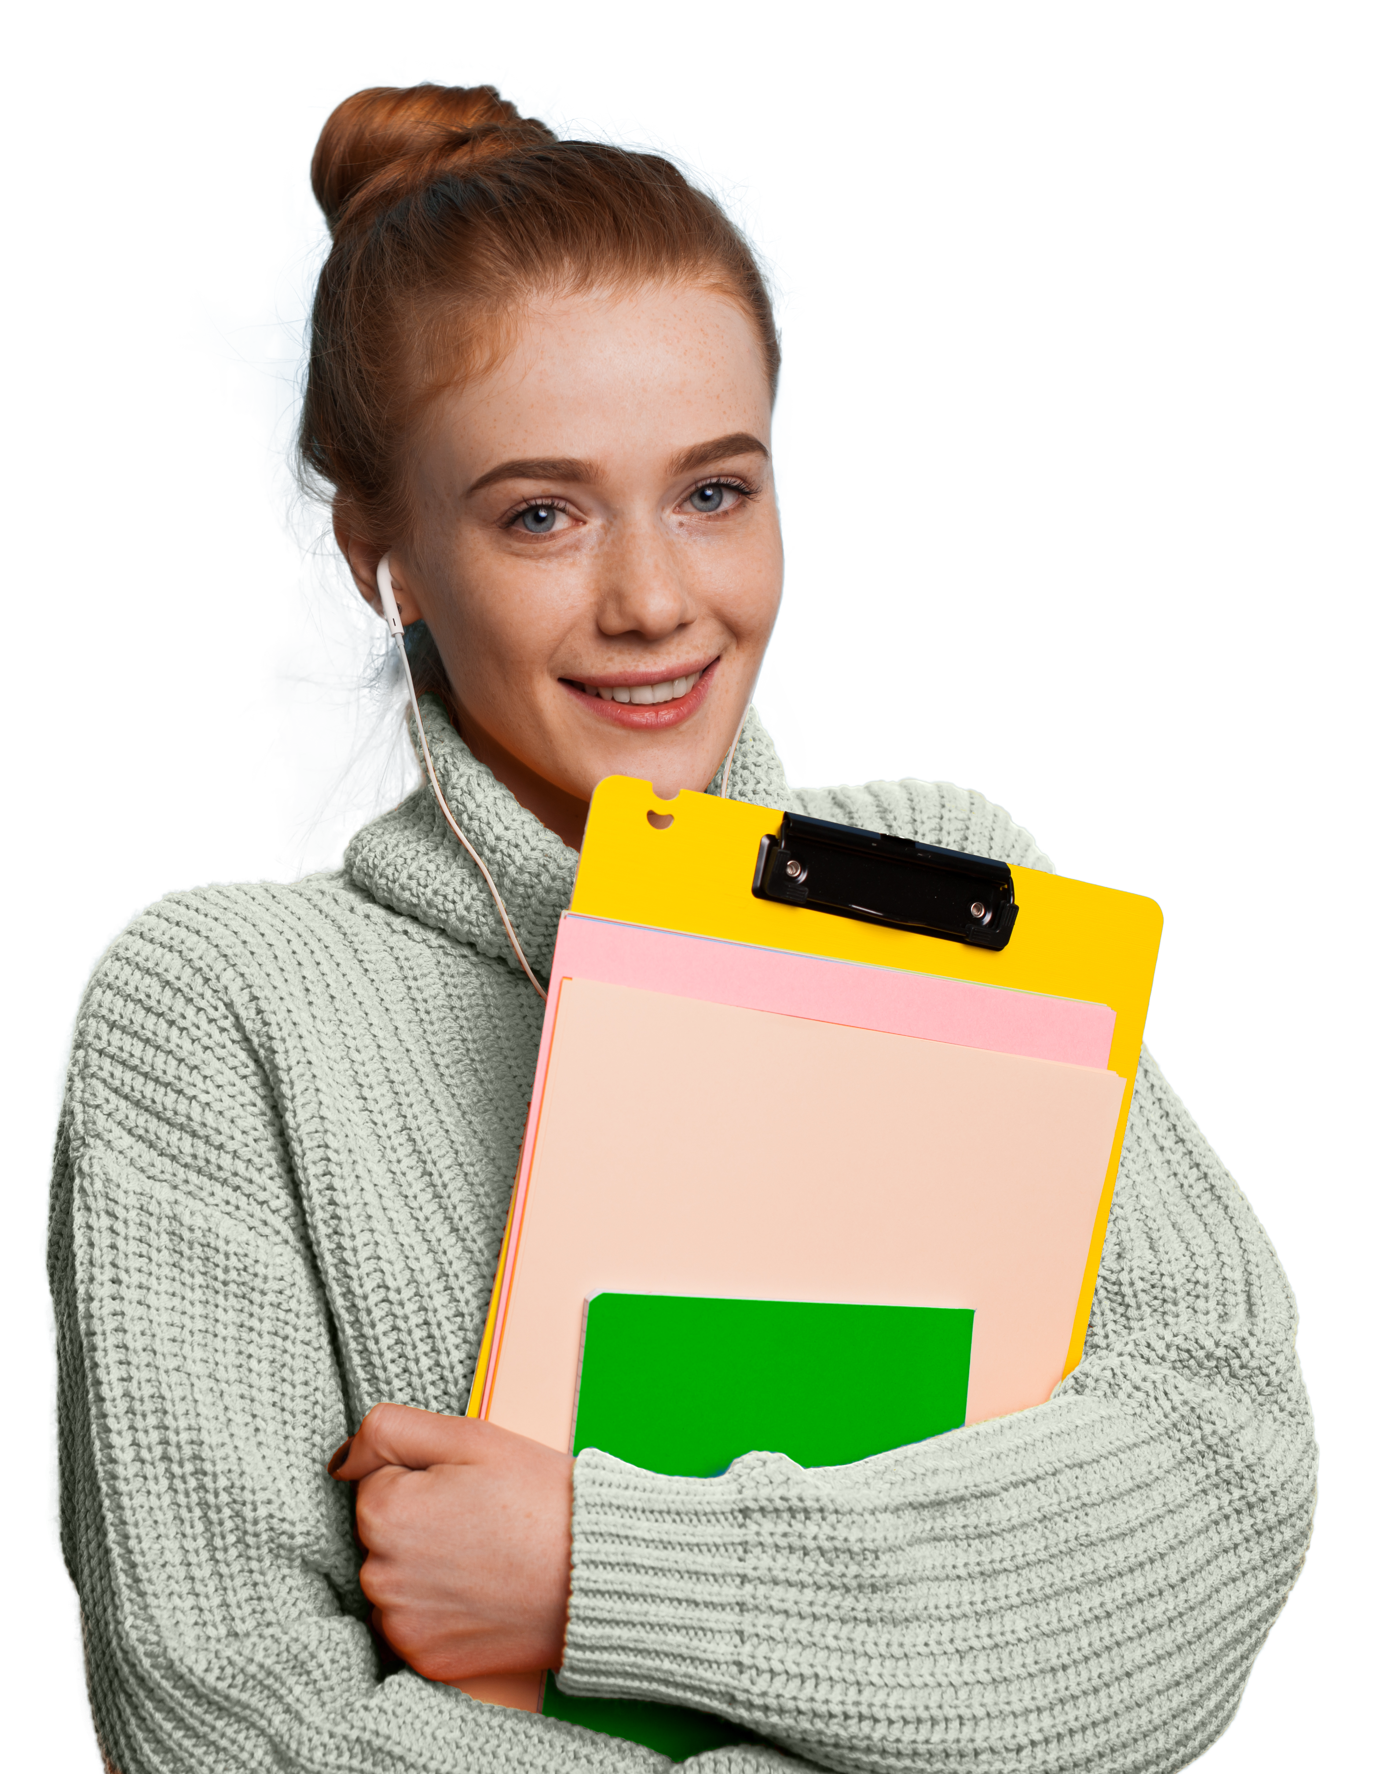
Helping others
Challenge
Write some advice to these young people…
“I am getting really worried about all my school work.” James
“I love dancing – but people at school make fun of me.” Abdi
“I want to improve my fitness but I’m not sure where to start.” Tara
Notes:
Activity 3: Helping others (8 mins) continued
Use this slide for students who need further challenge.

Slide 17
How confident are you in…
10
Extremely confident
9
8
7
6
identifying the link between physical and mental wellbeing?
describing strategies for improving physical and mental wellbeing?
explaining ways to help those who need support with their physical and/or mental wellbeing?
5
4
3
2
1
0
Not confident
Notes:
Follow up assessment (3 mins)
Show the students the three statements and ask them to rate their confidence in each using a scale from 0-10 (0 = not confident, 10 = extremely confident), considering whether their confidence has changed over the course of the lesson.
There are lots of ways you might do this activity. Students could respond to the statements individually by writing their three numbers down on paper, or verbally by discussing their feelings in pairs/groups. You could also use ‘traffic lights’ (red/ amber/green) or ask students to hold up the relevant number of fingers in response to each statement.

Slide 18
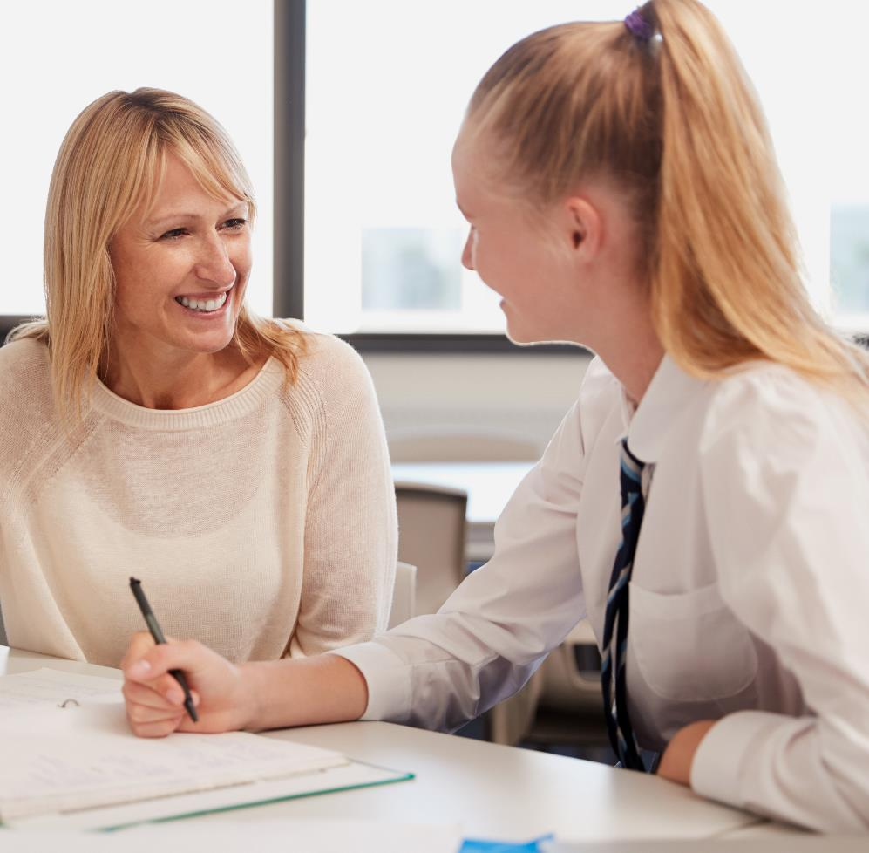
The journey to better wellbeing is different for everyone.
It is always good to talk about it to friends and trusted adults and there are lots of organisations that can help such as Childline, the Mix or Shout.
Childline: childline.org.uk/info-advice
Or call 0800 1111
The Mix: Call 0808 808 4994
Shout: Text 85258
Notes:
Signposting (1 min)
Let students know that it can be very common to experience ups and downs throughout life, but it is always good to talk about it to friends and trusted adults and there are lots of organisations that can give support such as Childline, or the Mix which run free telephone helplines for children and young people. Shout 85258 is a free, confidential, 24/7 text messaging support service for anyone who is struggling to cope.
You could also remind students of school support services they can access, such as their tutor or school counsellor.

Slide 19
Extended learning projects
Ask students to create a piece of artwork inspired by the lesson. Students could look back at their work from the lesson for ideas, and think about how they involve the wider school or even the local community in developing their art.
Students create an anonymous questionnaire to find out what other students think about wellbeing and the ways in which they try and achieve better physical and mental wellbeing. Students could think about whether they want to gather quantitative or qualitative data and what questions they would need to ask.
Students could find out about volunteering initiatives in their area and create a brochure to share options with other students. Students will need to ask their parent/carer before volunteering.
Students could practise and perform a school assembly raising awareness about physical and mental wellbeing.
Students could create a personalised weekly timetable to promote the five ways to wellbeing; one activity for each day during the school week.
Students could create a Q and A board to pin up around school about the five ways to wellbeing.
Notes:
Extended learning projects
These can be given to students as projects to extend their learning, these could be done either in school as group projects or at home.

