Slide 1

How would you change the world?
Think on your own about this question.

Slide 2
How would you change the world?
Think about your idea in more detail.
How would this change impact you?
How would this change impact others?
Would this be a beneficial for everyone?
Why or why not?

Slide 3
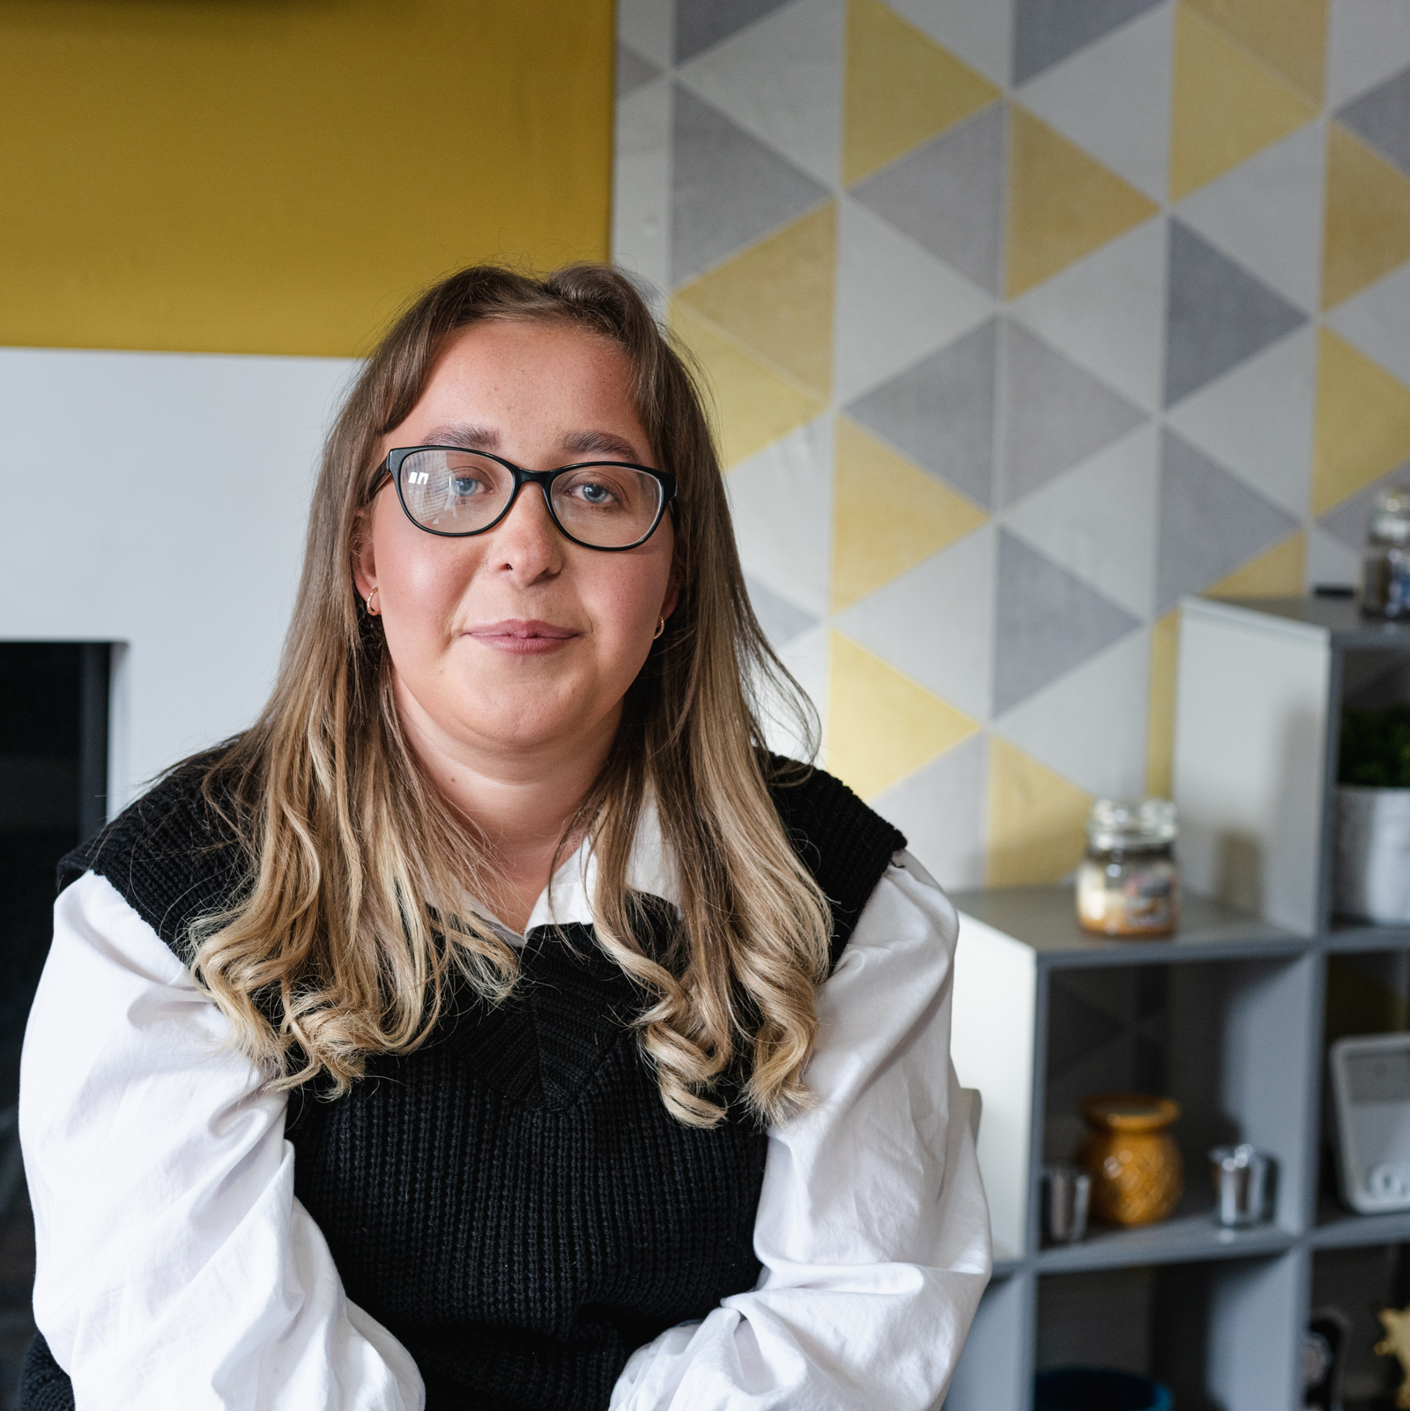
Think together about this suggestion.
“I prefer learning at home so I would close all schools and make teachers provide independent online learning tasks.”

Slide 4
Why might someone want to make this change?
Why would some people oppose this change?
Raise your hand if you would like to share your thoughts.
Notes:
Self-Empathy

Slide 5
Sometimes when we make decisions we are so focused on solving our own problems, we forget how changes can affect other people.
We often forget to consider what people need, particularly if those people are different to ourselves.
To really change our world for the better, we need to take time to try to understand a range of perspectives.
Can you think of any more examples?

Slide 6
“To change the world, you first need to understand the people in it.”
Think together.
How could thinking like this help us make better decisions?
How do you think this type of thinking could make the world better?

Slide 7
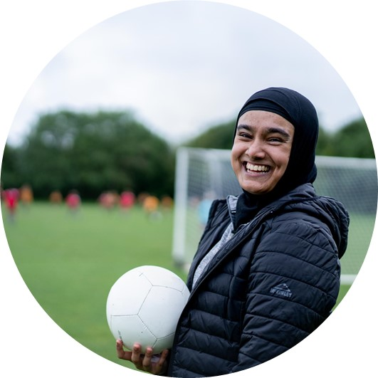
Empathy
Empathy is the skill that allows us to understand what is going on in other people’s lives: what they are thinking, feeling and experiencing.
Empathy helps us connect with others by allowing them the space to be their true self, safe from judgement. This way we learn to understand them as they really are.

Slide 8
Empathy is not kindness
…it’s understanding what someone needs.
Empathy is not feeling sorry for someone
…it’s making an effort to understand what things are like for them.
Empathy on its own cannot solve our problems
…but it can help us make better, human-led decisions.

Slide 9
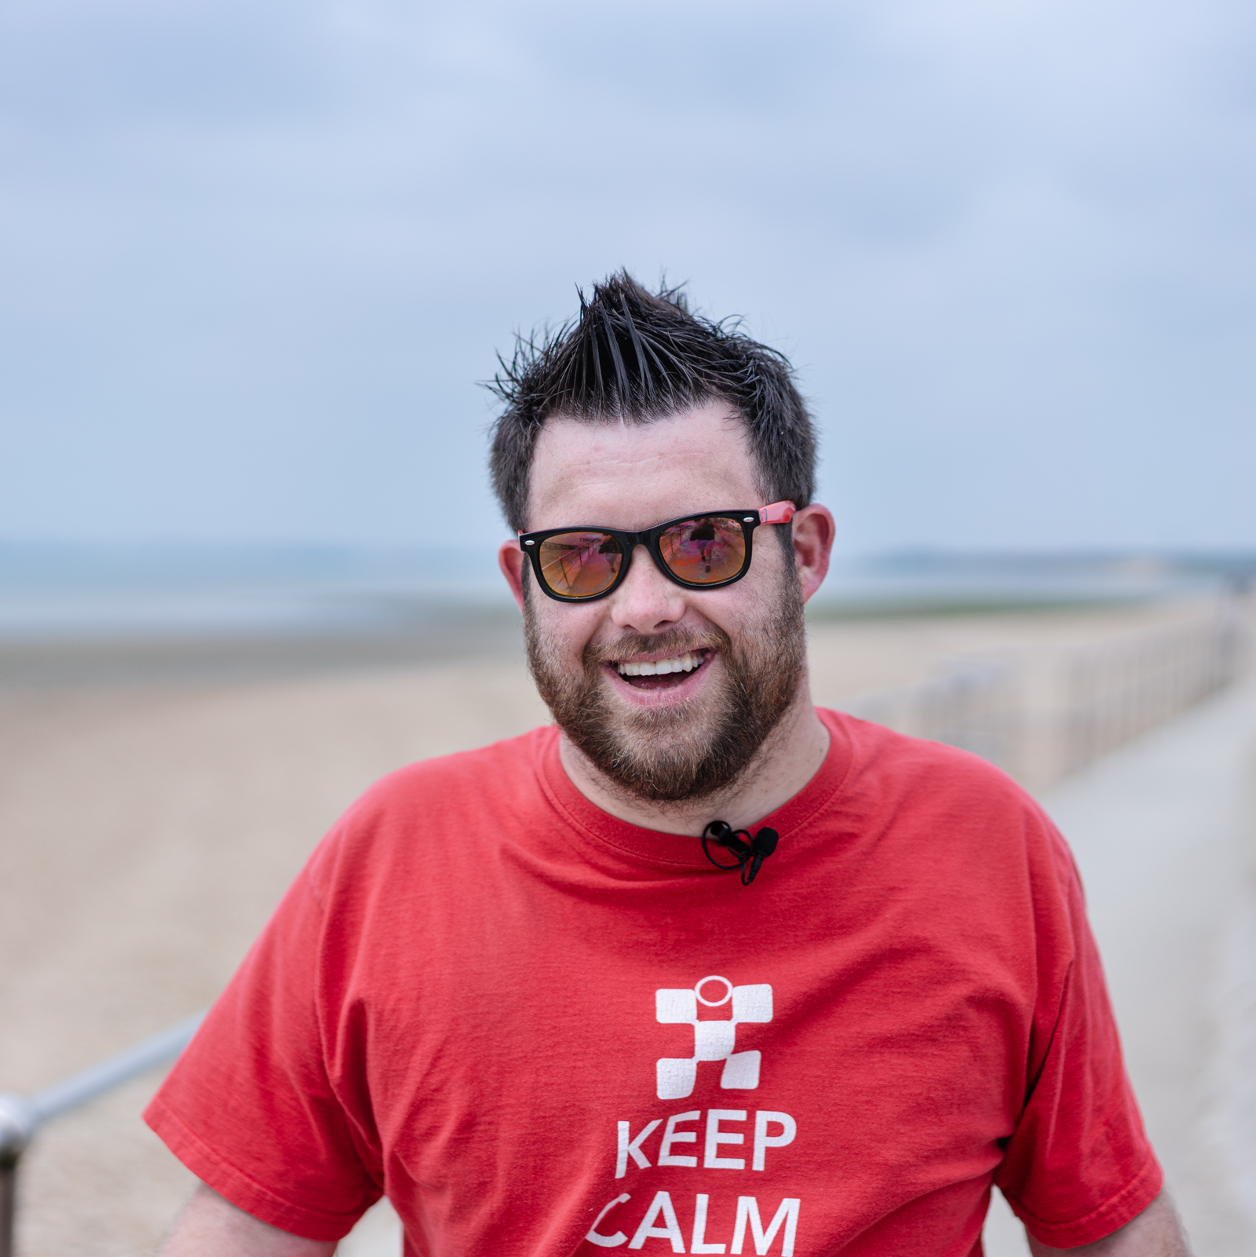
Let’s try it!
Imagine…
You and your friend both work really hard in preparation for a test. It is really important to you both that you do well.
When you receive your results, you are very pleased and want to celebrate. But you notice your friend is very quiet and looks disappointed.

Slide 10
How could you show empathy to your friend with your words and actions?
Can you think of any reactions that would not be understanding of your friend’s experience?
Discuss these questions with the person next to you.
Notes:
Self-Empathy

Slide 11

A simple first step towards empathy we can all take right now is to remember that
everyone wants to be heard, feel seen and be valued.
Adopting this approach, we can even show empathy towards people we do not know, however different their lives might be.

Slide 12
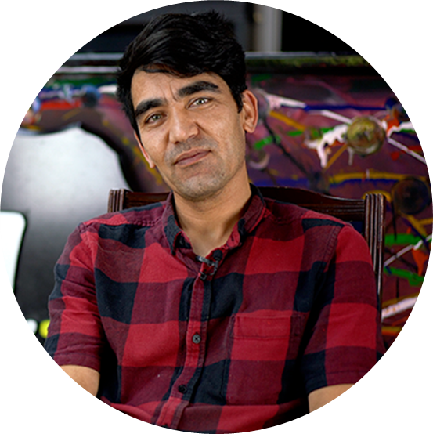
Meet Habib
Watch on Vimeo
Watch on YouTube

Slide 13
Habib’s Story
What did you learn about Habib?
How did you feel when you heard Habib speaking?
Did Habib’s words make you think differently about anything?
Discuss these questions with the person next to you.

Slide 14
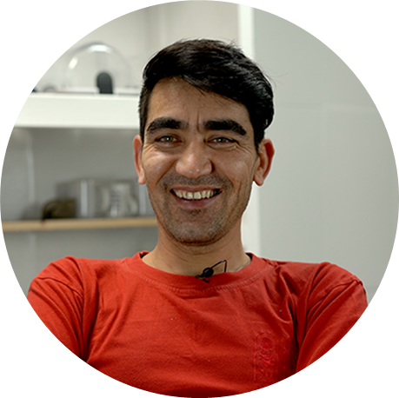
How did you connect?
Raise your hand if….
You learnt something from Habib’s words
You felt something
You thought about something from someone else’s perspective
You considered something for the first time
You changed your mind about something

Slide 15
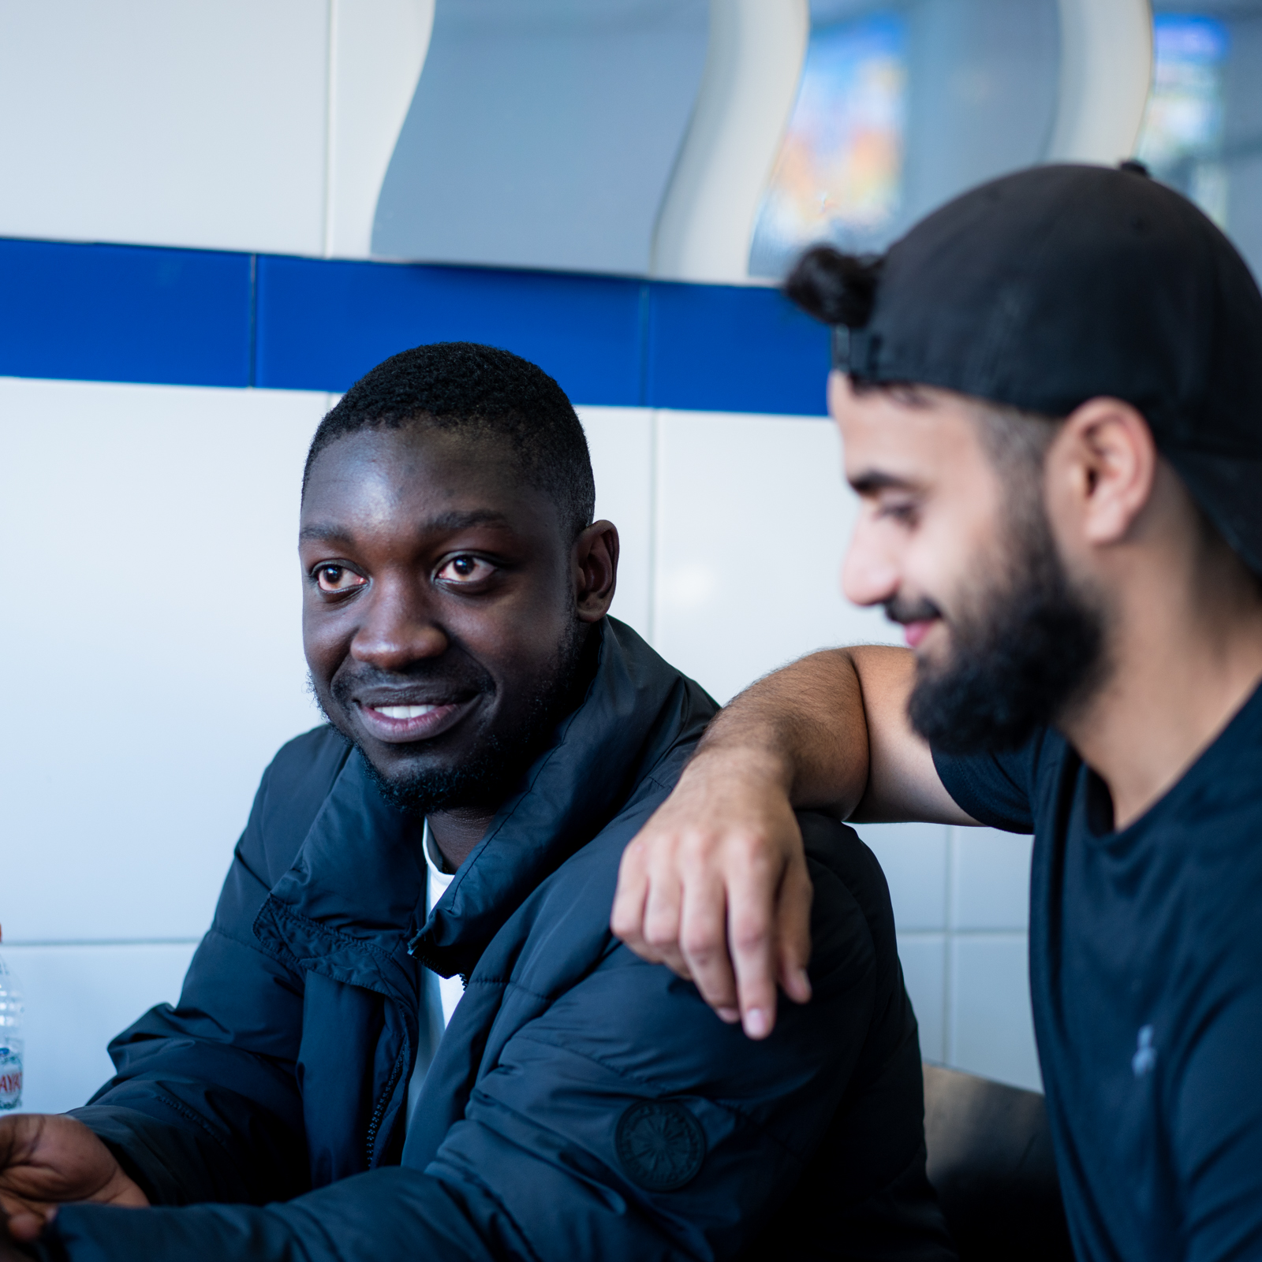
Empathy Week 2022
If you take part in Empathy Week 2022, you will connect with five more amazing individuals: Lipa, Kwasi, James, Courtney and Dami.
By watching films about them, you will gain an insight into their thoughts, feelings and experiences, as well as learning to empathise with yourself.
Watch the Empathy Week 2022 trailer here! Vimeo YouTube

Slide 16
