Slide 1
Eating Disorders
Student Session
Ages 16-18
Gemma Fieldsend on behalf of the CWT

Slide 2
We will be covering sensitive topics
Remember talking about mental health can generate feelings and emotions; so, it is important that if anything upsets you that you talk to a trusted adult
You will not be asked to share anything personal
We will be talking about mental health, eating disorders, body image, social media
We will look at the importance of being a supportive friend and seeking help

Slide 3
Our rights …
We all have the right to:
Speak our mind without other people laughing or commenting
Be listened to
Be respected
Stay safe
Hands up
Right to pass on any question
Don’t talk about other people using their names
Does anyone want to add anything else that will help you to feel comfortable today?

Slide 4
Aims of the session
What we will cover today
Why looking after your mental health is important
What are eating disorders
Coping strategies
Myths v facts of eating disorders
What to do if worried about a friend
The importance of self-care
Where to go for help and support available across the UK

Slide 5
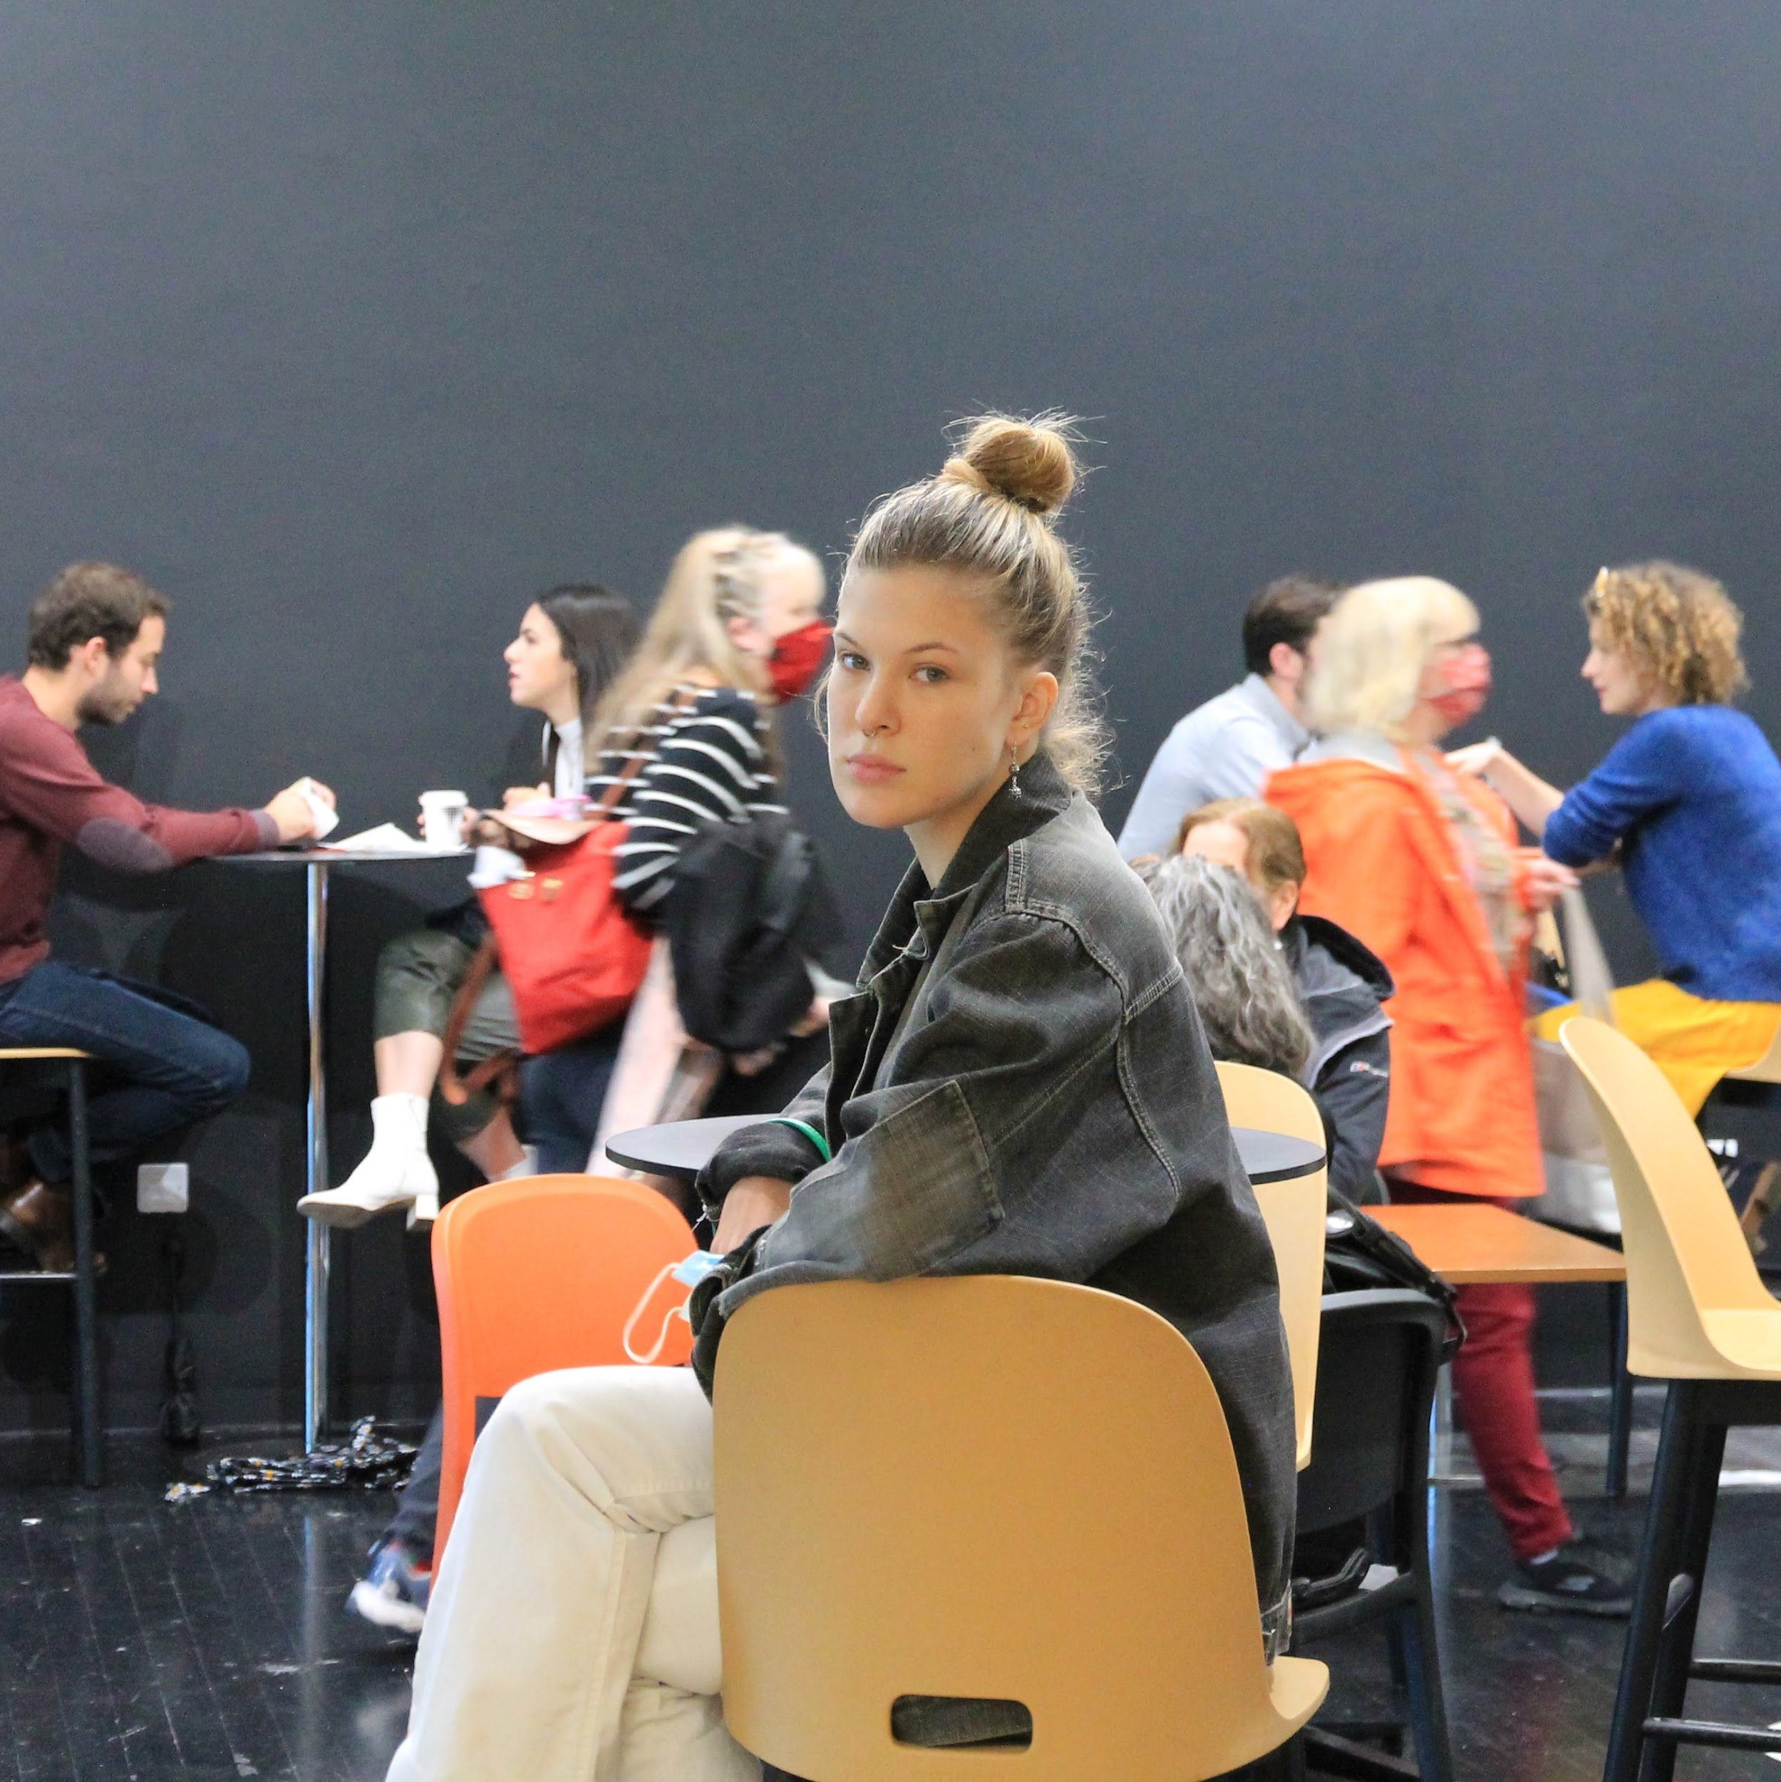
Why looking after your mental health is important
Both physical and mental health are important to our wellbeing
Mental health can be more difficult to talk about
It is equally important to seek help for our mental health problems as for physical issues

Slide 6
Let’s do an exercise
5 minute exercise
Notes:
Spend about 5 minutes encouraging students to think of words or things they already know about eating disorders using the handout, next slide lotus blossom exercise, give worksheet

Slide 7
Lotus blossom exercise
 | Eating disorders
Notes:
Fill in the blanks, so in the other 8 boxes right down anything that you know about eating disorders, think, share , printout of the exercise .. Do in groups 5 minute exercise you may want to show the next slide to give a couple of examples

Slide 8
Lotus blossom exercise
 | Eating disorders
A way of coping | Anorexia nervosa, bulimia, binge eating
Notes:
Losing weight
Not eating
Exercising
Avoiding meal times , not wanting to eat in front of others
Feeling overwhelmed
Secretive, hidden, don’t want others to know
Sad
Using laxatives, self induced vomiting

Slide 9
Myth or fact
We will now look at some myths and facts in relation to eating disorders
Notes:
Give worksheet

Slide 10
Myth or Fact?
“I heard that only teenage girls suffer from eating disorders.”

Slide 11
“I heard that only teenage girls suffer from eating disorders.”
Eating disorders can affect anyone, of any age, gender or background.
The highest rate of onset of eating disorders is in females aged 13 to 20, however it is believed that between 10 and 25% of people diagnosed with anorexia are male.

Slide 12
Myth or Fact?
“Eating disorders are a result of vanity and are caused by the media.”

Slide 13
“Eating disorders are a result of vanity and are caused by the media.”
This is partly true!
Although being surrounded by the ‘thin ideal’ and images of unobtainable beauty can lower self- esteem and contribute to the onset of disordered eating, any diagnosed eating disorder goes far beyond diet and vanity and is a serious mental health condition.

Slide 14

Looking through the lens
It is important to recognise that some of the pictures we see in the media give us a distorted image of what normal bodies look like

Slide 15
Body Image
Sometimes, we worry about how we look or what our friends think about our body.
When we talk about body image, there are lots of ways we can think about our body and the way we look. You might find that there are times when you like your body, or parts of your body, and times when you struggle with how you look.
Sometimes when you’re struggling with your body image, you might change your eating habits as this can make you feel like you are in more control of how you look. This can be things like changing what you eat, how much and how often you are eating.

Slide 16
Myth or Fact?
“People don’t ever recover from an eating disorder.”

Slide 17
“People don’t ever recover from an eating disorder.”
Myth
It is possible to recover and lead a happy life having suffered from an eating disorder, especially if it is identified early. However, many people say they still have to make an active choice everyday to eat healthily (a little like an alcoholic making an active choice not to consume alcohol).
Notes:
Up to 25 minutes

Slide 18
Eating Disorders
Mental illnesses, which affect physical health too
Complex, with no single cause
Treatable conditions
Recovery is possible

Slide 19
What is an Eating Disorder?
Lots of people have different eating habits.
You might eat loads one day, be less hungry another day, or go through phases of wanting to eat more or less. But that doesn’t mean you have an eating difficulty or disorder.
All kinds of things can cause eating difficulties or disorders.
You might develop eating difficulties when things don’t feel right in other parts of your life, especially if you’re feeling worried, stressed or feeling out of control.
Images we see online and in the media can add to the feeling that we have to look a certain way, or be a certain weight which may not be healthy for our body or mind.
Notes:
Eating problem/disorder language

Slide 20
Eating Disorders
Eating disorders are not all about food itself, but about feelings that can develop
It can be a way of coping for some people
It can be a way of managing emotions
An eating disorder is a serious mental health condition involving extreme, unhealthy eating behaviours and can take various forms, such as anorexia, bulimia and binge eating disorder. People might eat too much or too little. They may not always know they are doing this. We can’t tell just by looking at them-these are secret and often hidden disorders.
Notes:
Eating problem/disorder language

Slide 21
Types of eating disorders
Anorexia Nervosa
Bulimia Nervosa
Binge Eating Disorder
Other eating disorders
Notes:
It may also be helpful to talk to students about the fact that many of us have a complicated relationship with food, and may have times when our eating habits are unhealthy, often at times of stress. Reassure students that, although a person may have periods of ‘disordered eating’, this doesn’t necessarily mean they have, or are likely to develop, an ‘eating disorder’. Poor eating habits are only problematic when they are repeated for a long time – and a snapshot may not reflect a more healthy diet over the longer term.

Slide 22
"I used eating as a way of keeping control, I didn't have much confidence but felt that if I could control what I ate I could cope with everything."

Slide 23

Video

Slide 24
Unhealthy coping strategies
Unhealthy coping strategies are behaviours people use to deal with difficult emotions which have long-term negative consequences. For some people, the only thing they may control at a difficult time is their eating or how much exercise they are doing. When this impacts on their life, they may have something called an eating disorder.

Slide 25



Unhelpful Coping Strategies
Unhelpful Strategies
Stressors
Healthy balance
cannot be achieved
Notes:
Get group to think of possible unhelpful coping strategies

Slide 26
Helpful Coping Strategies
Stressors
Helpful Strategies
Healthy balance
is achieved
Notes:
Helpful examples could have flip chart paper at tables

Slide 27
Let’s make a list
Unhelpful coping strategies
Healthy coping strategies
Notes:
5 minutes worksheet

Slide 28
Responding to opinions
Earlier today we looked at the following opinions, Have any of your responses changed? Can you add more to any of your original responses based on today’s lesson?
“I heard that only teenage girls suffer from eating disorders.”
“Eating disorders are a result of vanity and are caused by the media.”
“People don’t ever recover from an eating disorder.”
Notes:
Teacher Notes (5 MIN) Endpoint assessment
Revisit the baseline myths and facts , by asking students to reflect on whether their responses have changed, or whether they could add more detail to their responses based on today’s learning.
This could be written in student books, or on a postcard to be handed in at the end of the lesson. This can be kept as assessment evidence and used to inform future teaching.

Slide 29
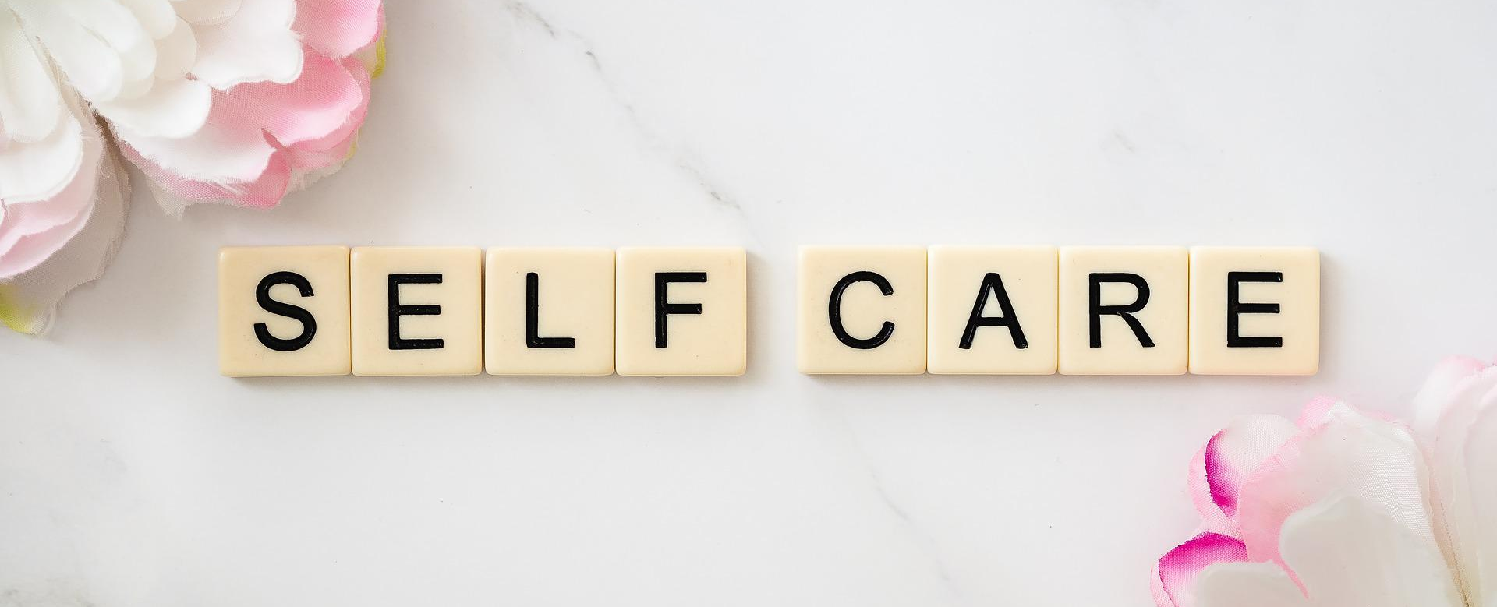
Try to practice some self-kindness. Think about something you can do avoid using social media to determine how your day is going or to make yourself feel better. It’s likely to have the opposite effect…
Notes:
Up to 10

Slide 30
Speak Out :
Talk to a friend
Call Beat / visit online
Speak to a trusted family member
Talk to a college staff member
Speak to a trusted adult
Counsellor
Notes:
Highlight the importance of speaking out about a worry- remember naming to tame it

Slide 31
Worried About a Friend
If you’re worried about a friend who’s struggling with their eating, listen to them. They might have difficult things going on in their life which are causing the changes to their eating
Remember, if you are worried about them, you don’t have to keep their secret - if they don’t get the help they need things can get much worse for them very quickly. Telling a family member, teacher or someone else you trust might feel hard for both of you, but it’s important because the quicker your friend gets support, the more likely they are to recover

Slide 32
Supporting a Friend:
Remember it’s ok Not to be OK
We all have good and bad days
Listen and try to understand/ empathise
Encourage a friend to seek help
Go with them if they are worried/ unsure
Talk to a trusted adult
Beat is there to listen
Check in with the friend

Slide 33
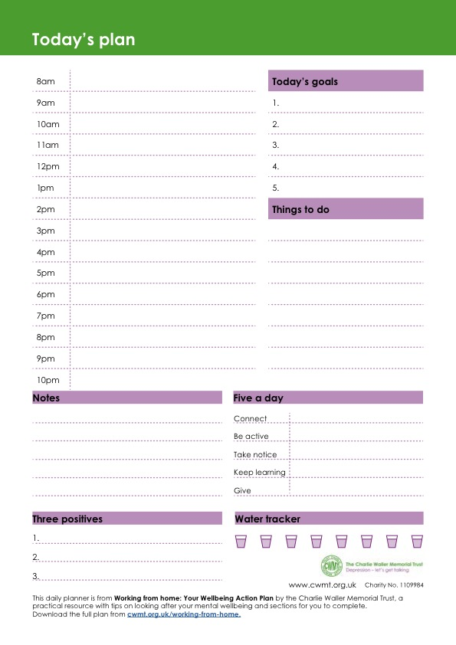
A plan for everyday
Remember structure, routine and purpose is really important for your mental health
Be aware of your sleep patterns, eating habits, relaxation time and screen time
Plan your college work
Plan your downtime
Plan your breaks

Slide 34
Further support and resources
BLAST approach
https://www.beateatingdisorders.org.uk/get-information-and-support/about-eating-disorders/downloads-resources/blast-distraction-techniques/
Beat helplines
Help for England
Helpline: 0808 801 0677
Email: help@beateatingdisorders.org.uk
Help for Scotland
Helpline: 0808 801 0432
Email: Scotlandhelp@beateatingdisorders.org.uk
Help for Wales
Helpline: 0808 801 0433
Email: Waleshelp@beateatingdisorders.org.uk
Help for Northern Ireland
Helpline: 0808 801 0434
Email: NIhelp@beateatingdisorders.org.uk

Slide 35
Further support and resources
CHILDLINE
Call: 0800 1111 (free line) Online: childline.org.uk
Confidential listening, 1-2-1 chat, online message boards for under 19s.
BEMUSLIM YOUTH HELPLINE
Call: 0808 808 2008 (4pm - 10pm) every day
Email: help@myh.org.uk
Online: myh.org.uk
Faith and culturally sensitive confidential support by phone, live chat, WhatsApp or email for young Muslims in the UK.
SAMARITANS
Call: 116 123 (free line) Email: jo@samaritans.org Online: samaritans.org
Confidential and emotional support 24/7
YOUNGMINDS
Text: YM to 85258
Online: youngminds.org.uk
Free, 24/7 text support for young people across the UK experiencing a mental health crisis.

Slide 36


