Slide 1

LISTENING TO PALESTINIAN AND ISRAELI PEOPLE WHEN WE SEE VIOLENCE IN THE MEDIA
Notes:
Please refer to our teacher resources (available for download on the ‘Classroom Learning Resources’ page of our website) for an understanding of how this issue may be affecting your students. This presentation is intended for a 30/40-minute school assembly on any morning when the issue of the Israeli-Palestinian conflict hits our media headlines and students come into school with strong emotional responses to what they are seeing in the news. The following slides have a script in the slide notes for you to use. It is strongly recommended that you provide deeper learning opportunities for students who feel strongly about this at some point during the academic year. Please visit our website to book a session.
“Good morning, everybody. As you may have seen, Israel-Palestine has become prominent in our news headlines again this week. As a school we care about the people there who have been suffering due to the violence, and about those in our own school community who may affected in any way.
It is important this morning to acknowledge that the conflict and the loss of life that we are seeing in the news is deeply upsetting, and it's okay to be angry, sad, confused, or any other emotion. Please be aware that staff are here to support you if you are struggling with this issue.”

Slide 2
AS A SCHOOL, WE CARE
1. Learn, as a school, how to express concern about this issue in a way that is civil and respectful to all members of our community
2. Reflect on how ordinary people are affected by violence in the region
3. Consider an approach that is centred on finding solutions rather than supporting one side to win against the other
Notes:
“As part of that support, today, we are using these slides from an organisation called Solutions Not Sides to:
Learn, as a school, how to express concern about this issue in a way that is civil and respectful to all members of our community
Reflect on how ordinary people are affected by violence in the region
Consider an approach that is centred on finding solutions rather than supporting one side to win against the other
Let’s start with taking a moment to reflect on whether this issue is important to us personally, and if so, why we feel that it is important. (Allow 10 secs silence).”

Slide 3
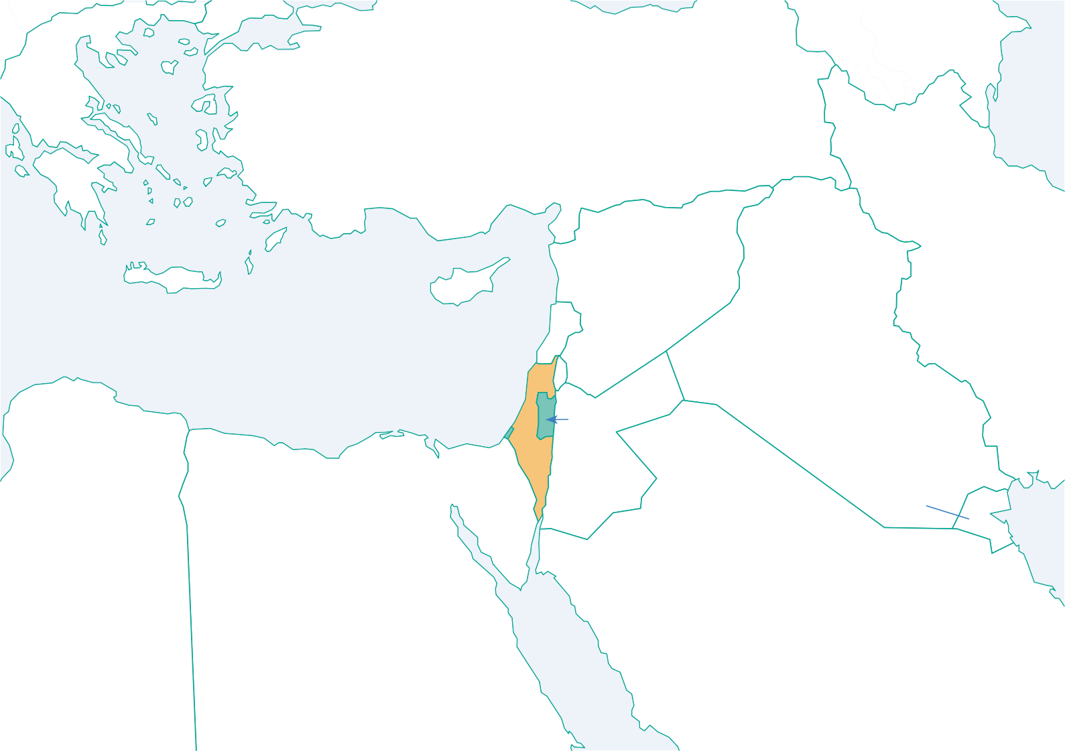
Ankara
•
Greece
Turkey
Cyprus
Syria
Lebanon
Beirut •
Iran
Damascus
Baghdad •
Iraq
Israel & Palestine
Tel Aviv •
Gaza •
Amman
Jerusalem
Jordan
Kuwait
Libya
Egypt
Saudi Arabia
Notes:
“The region we are seeing in the news at the moment is located here on the far eastern side of the Mediterranean Sea. The borders you see here for Israel and Palestine are outlined in International Law but have not been officially agreed upon or implemented by the Israeli and Palestinian leaders. They are disputed borders. The situation is complex, and as a school we will be providing opportunities for you to learn a lot more about it from both perspectives. But for today’s assembly, we will be reflecting on the people of the region who are just like us, and who are most affected by what is going on.”

Slide 4
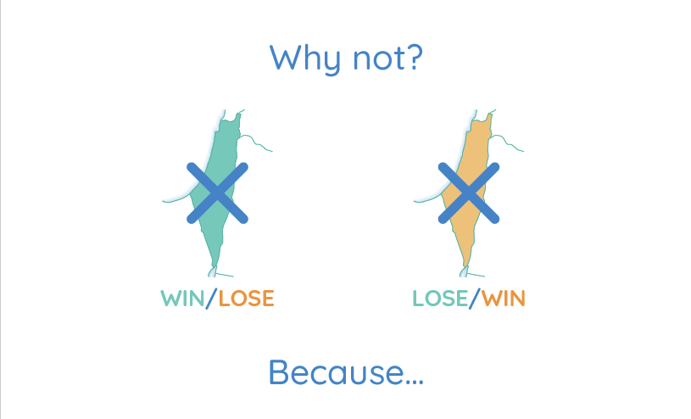
Notes:
“Because we care about the people of Palestine and Israel, we want to see a future in which there is a just and peaceful solution for them. If we support one side to win against the other (so all of the land for Israel or all of the land for Palestine) then the violence and pain will continue and so will the current situation of…”

Slide 5
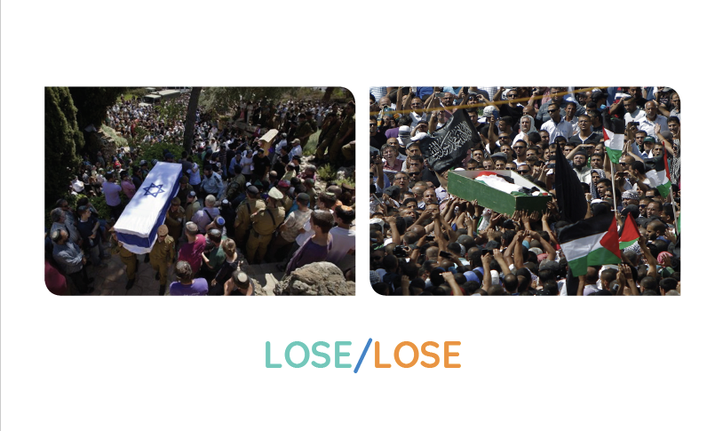
Notes:
“…lose-lose. That is why from a humanitarian perspective, the approach we are suggesting that we take as a school is to support an outcome that is…”

Slide 6
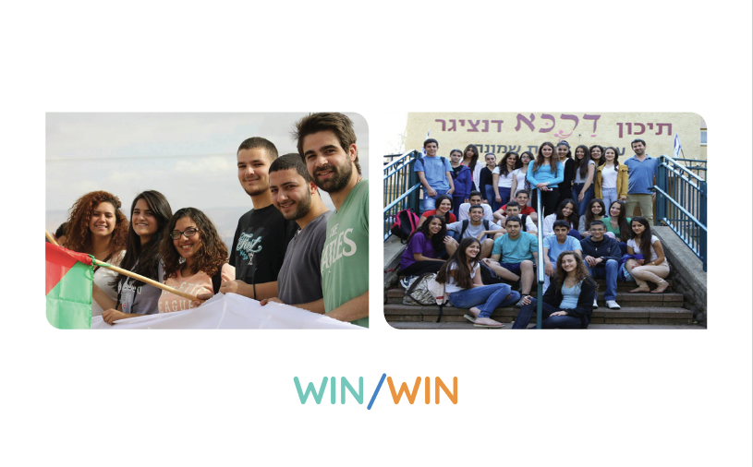
Watch the video: Rage, Revenge & Repair
Notes:
“…win-win, where the people on both sides get their human rights and security guaranteed and the land is shared. We are now going to watch a short film that illustrates for us the cost of lose-lose for the people living there, and why it is so important that we promote the values of non-violence, equality, and the rejection of hatred when we talk about and engage in activism on this issue. The film is called Rage, Revenge and Repair and includes the theme of bereavement. If for any reason you find watching this an emotional experience, please feel free to leave your seat during or after the film, and a member of staff will accompany you to another room and support you. We will have 20 seconds at the end of the film for reflection on the issues raised, and I would ask you to maintain silence for that time as we consider these people’s story.”

Slide 7

Notes:
“Thank you for watching and reflecting on this important issue that many of our students and staff care about. Hopefully, this film has helped all of us understand how people can be affected and as we now go about our day, we would ask everyone to bear in mind that this is a sensitive issue for some of our school community. As a school, we care about this issue, but also each other. Respectful discussion about the topic is encouraged, and if you would like a member of staff to help mediate a discussion on this, then please don’t hesitate to approach a teacher. Before we finish this assembly, we are going to run through some guidelines that we would like you all to respect when having conversations about this.” (Read through following slides).

Slide 8
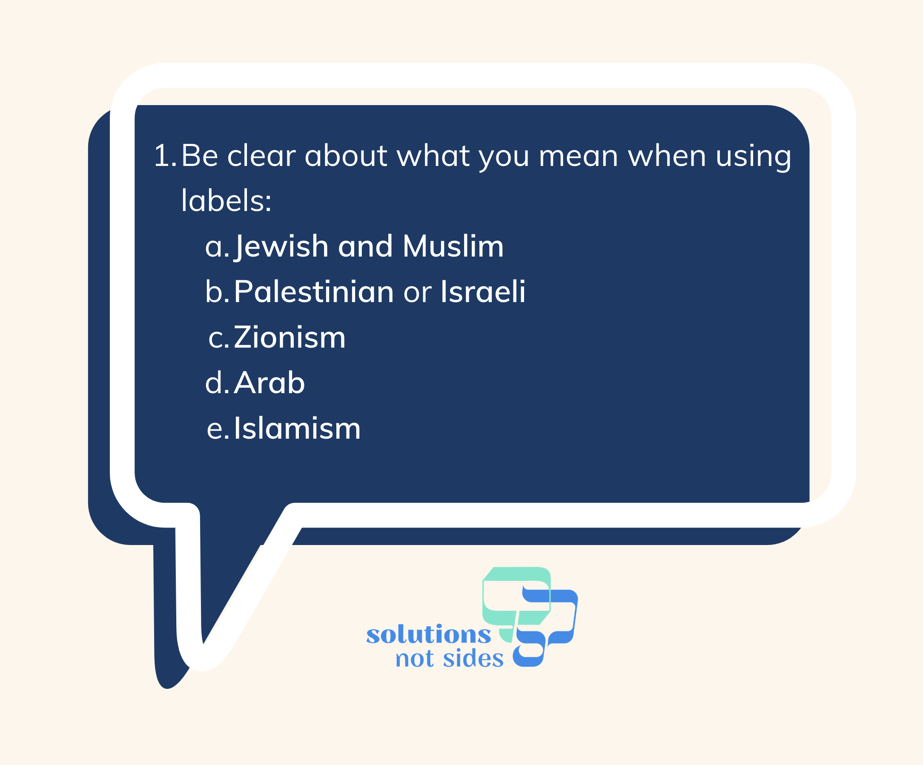
Notes:
“Be clear about what you mean when using labels:
Jewish and Muslim refers to two minority groups in Europe and some other regions who experience racism, and this tends to get worse when violence in the Middle East hits our news headlines
Palestinian or Israeli are national identities
Zionism is the belief in the right of the Jewish people to self-determination (and not all people who call themselves Zionist share the same opinion about the exact territory, principles, etc. of the state of Israel). ‘Zionist’ or ‘Zio’ should not be used as a term of abuse
Arab is a grouping of people whose mother tongue is Arabic and there is great diversity across the Arab World (e.g. Jordan can’t simply become Palestine just because they are Arabs)
Islamism is an academic term with French origins that refers to a broad spectrum of political ideologies. Islamism is not a synonym for terrorism and should not be used as such”

Slide 9
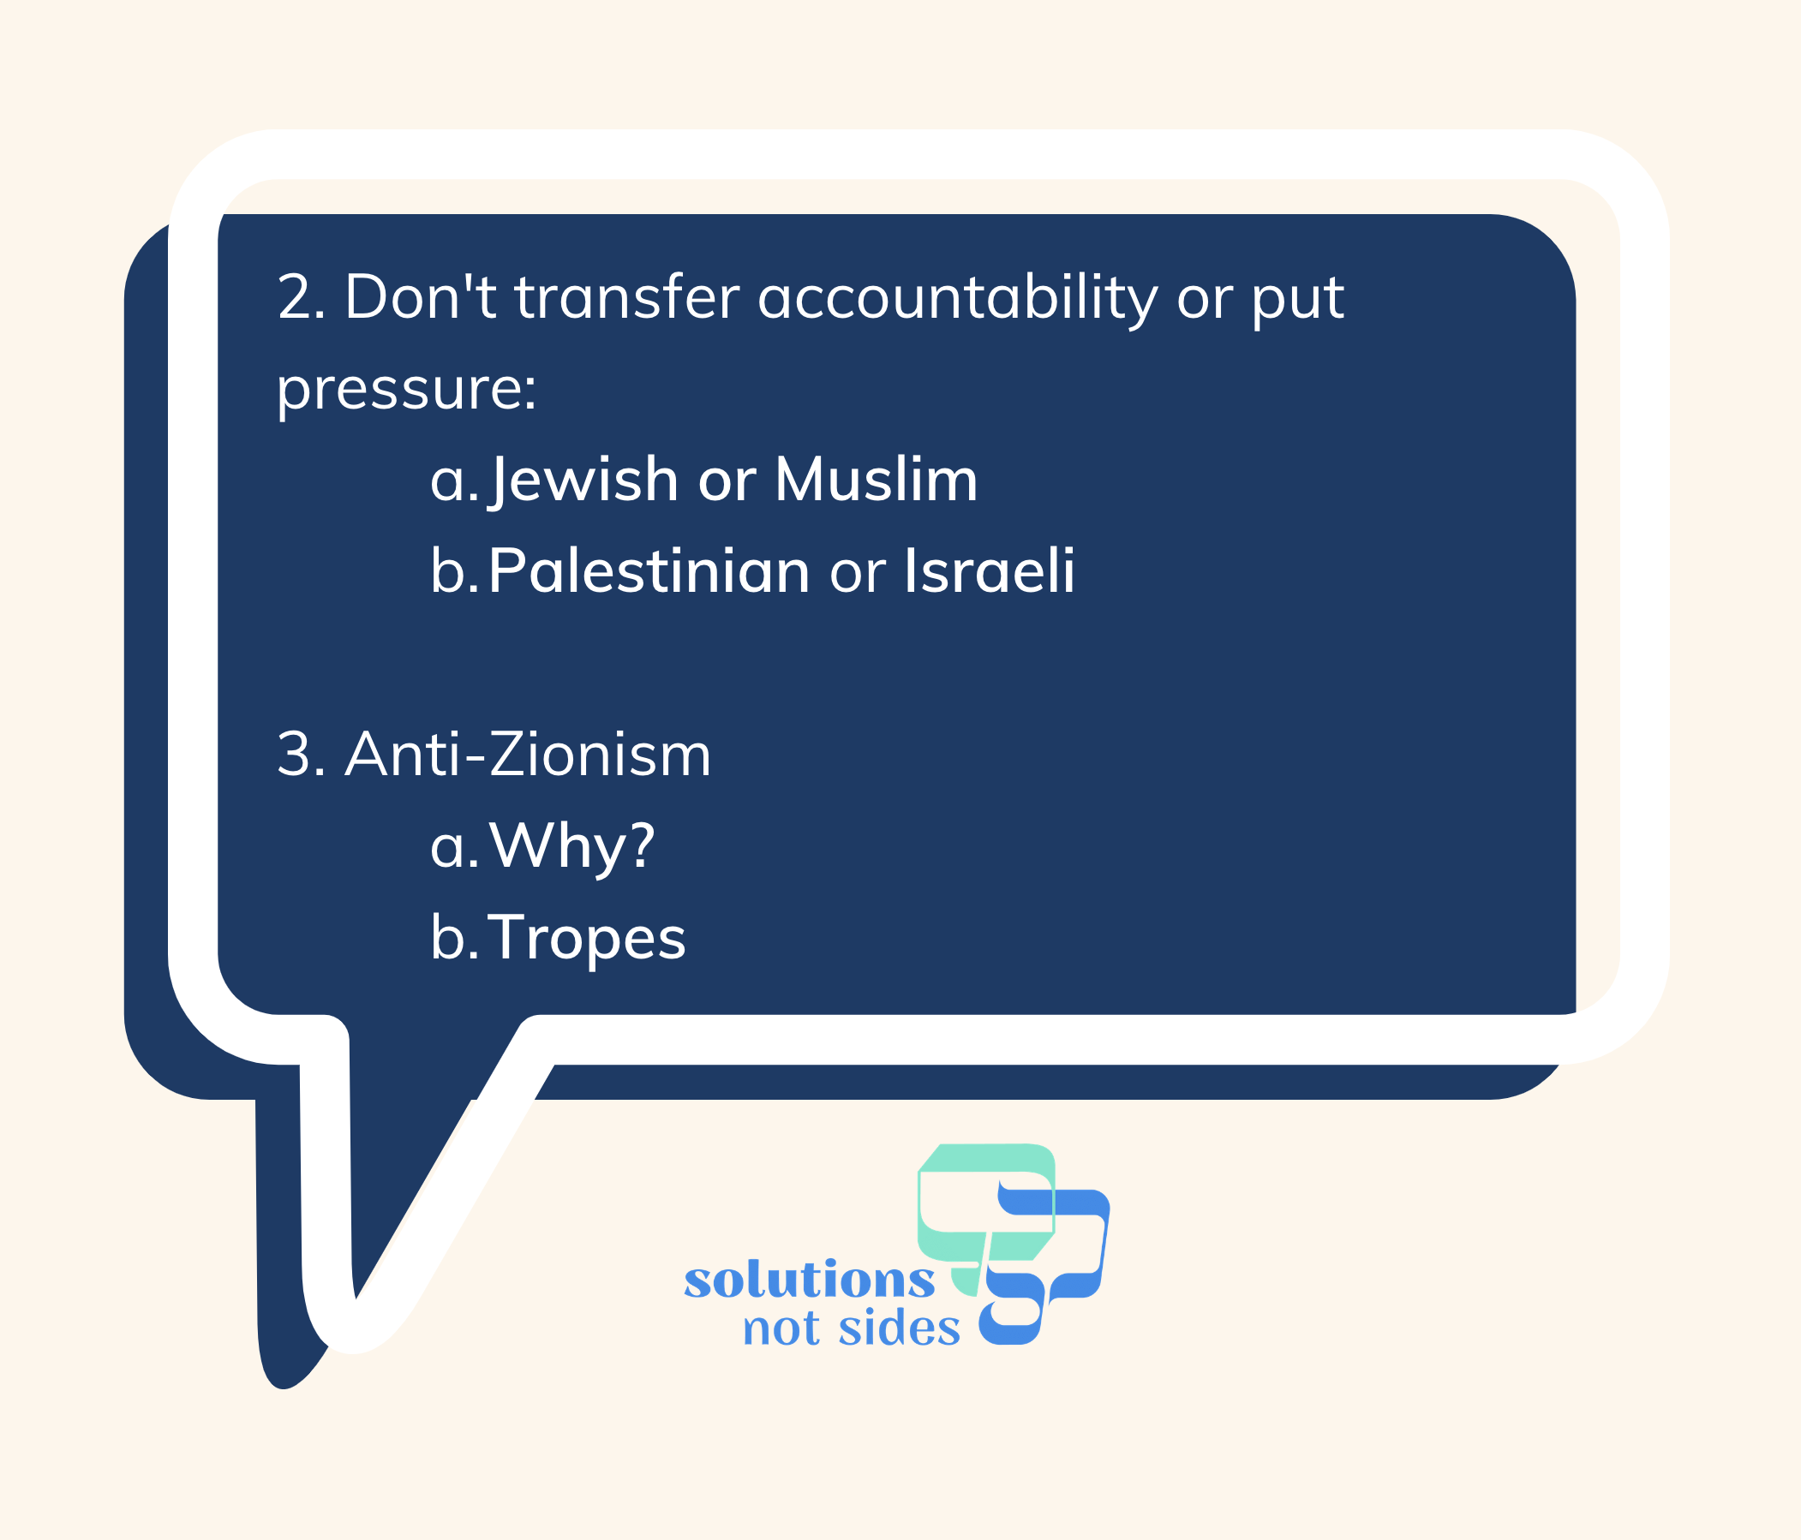
Notes:
“2. Do not hold Jews responsible for the decisions of the Israeli leaders, or Muslims responsible for the decisions of the Palestinian leaders
3. Do not demand that Jews or Muslims must take a certain political position on the issue
4. Do not assume that all Palestinians or Israelis support the actions of their governments
5. Anti-Zionism is not always antisemitic (for example if someone is generally anti-nationalism and believes in abolishing nation-states), but it can be, for example if criticism of Israel goes beyond that of its government policies and uses antisemitic tropes (these are stereotypes about Jewish people being connected to wealth, power and global domination)”

Slide 10
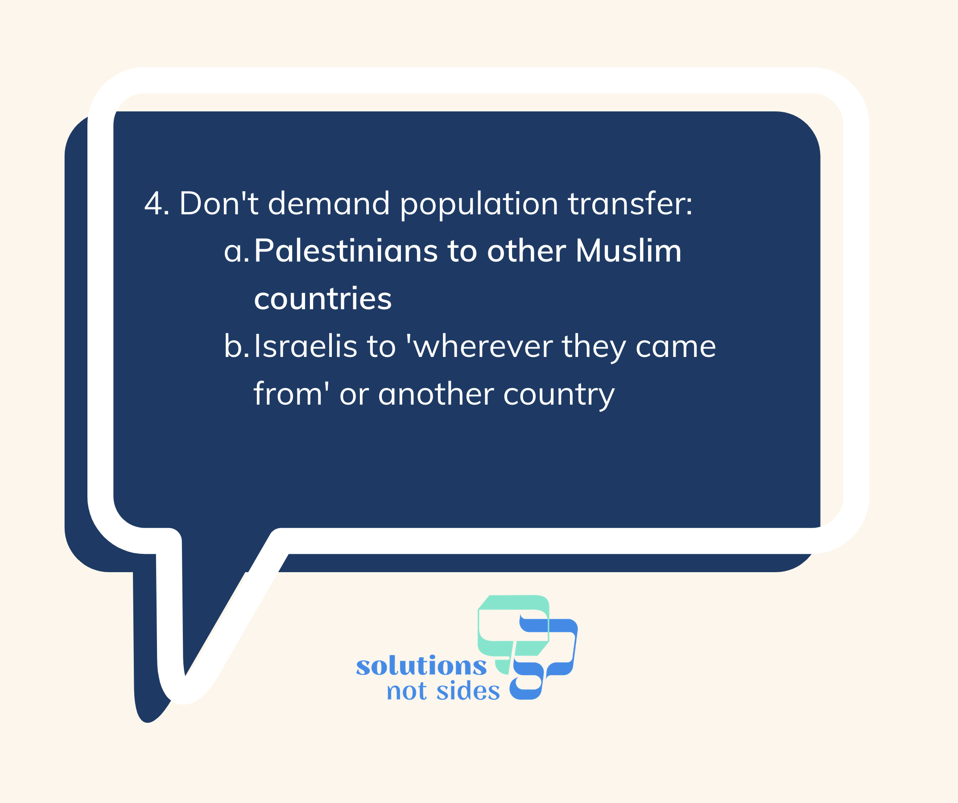
Notes:
“6. Do not state that Muslims should leave Palestine because they have the whole of the rest of the Middle East or that Israeli Jews should ‘go back to where they came from”

Slide 11
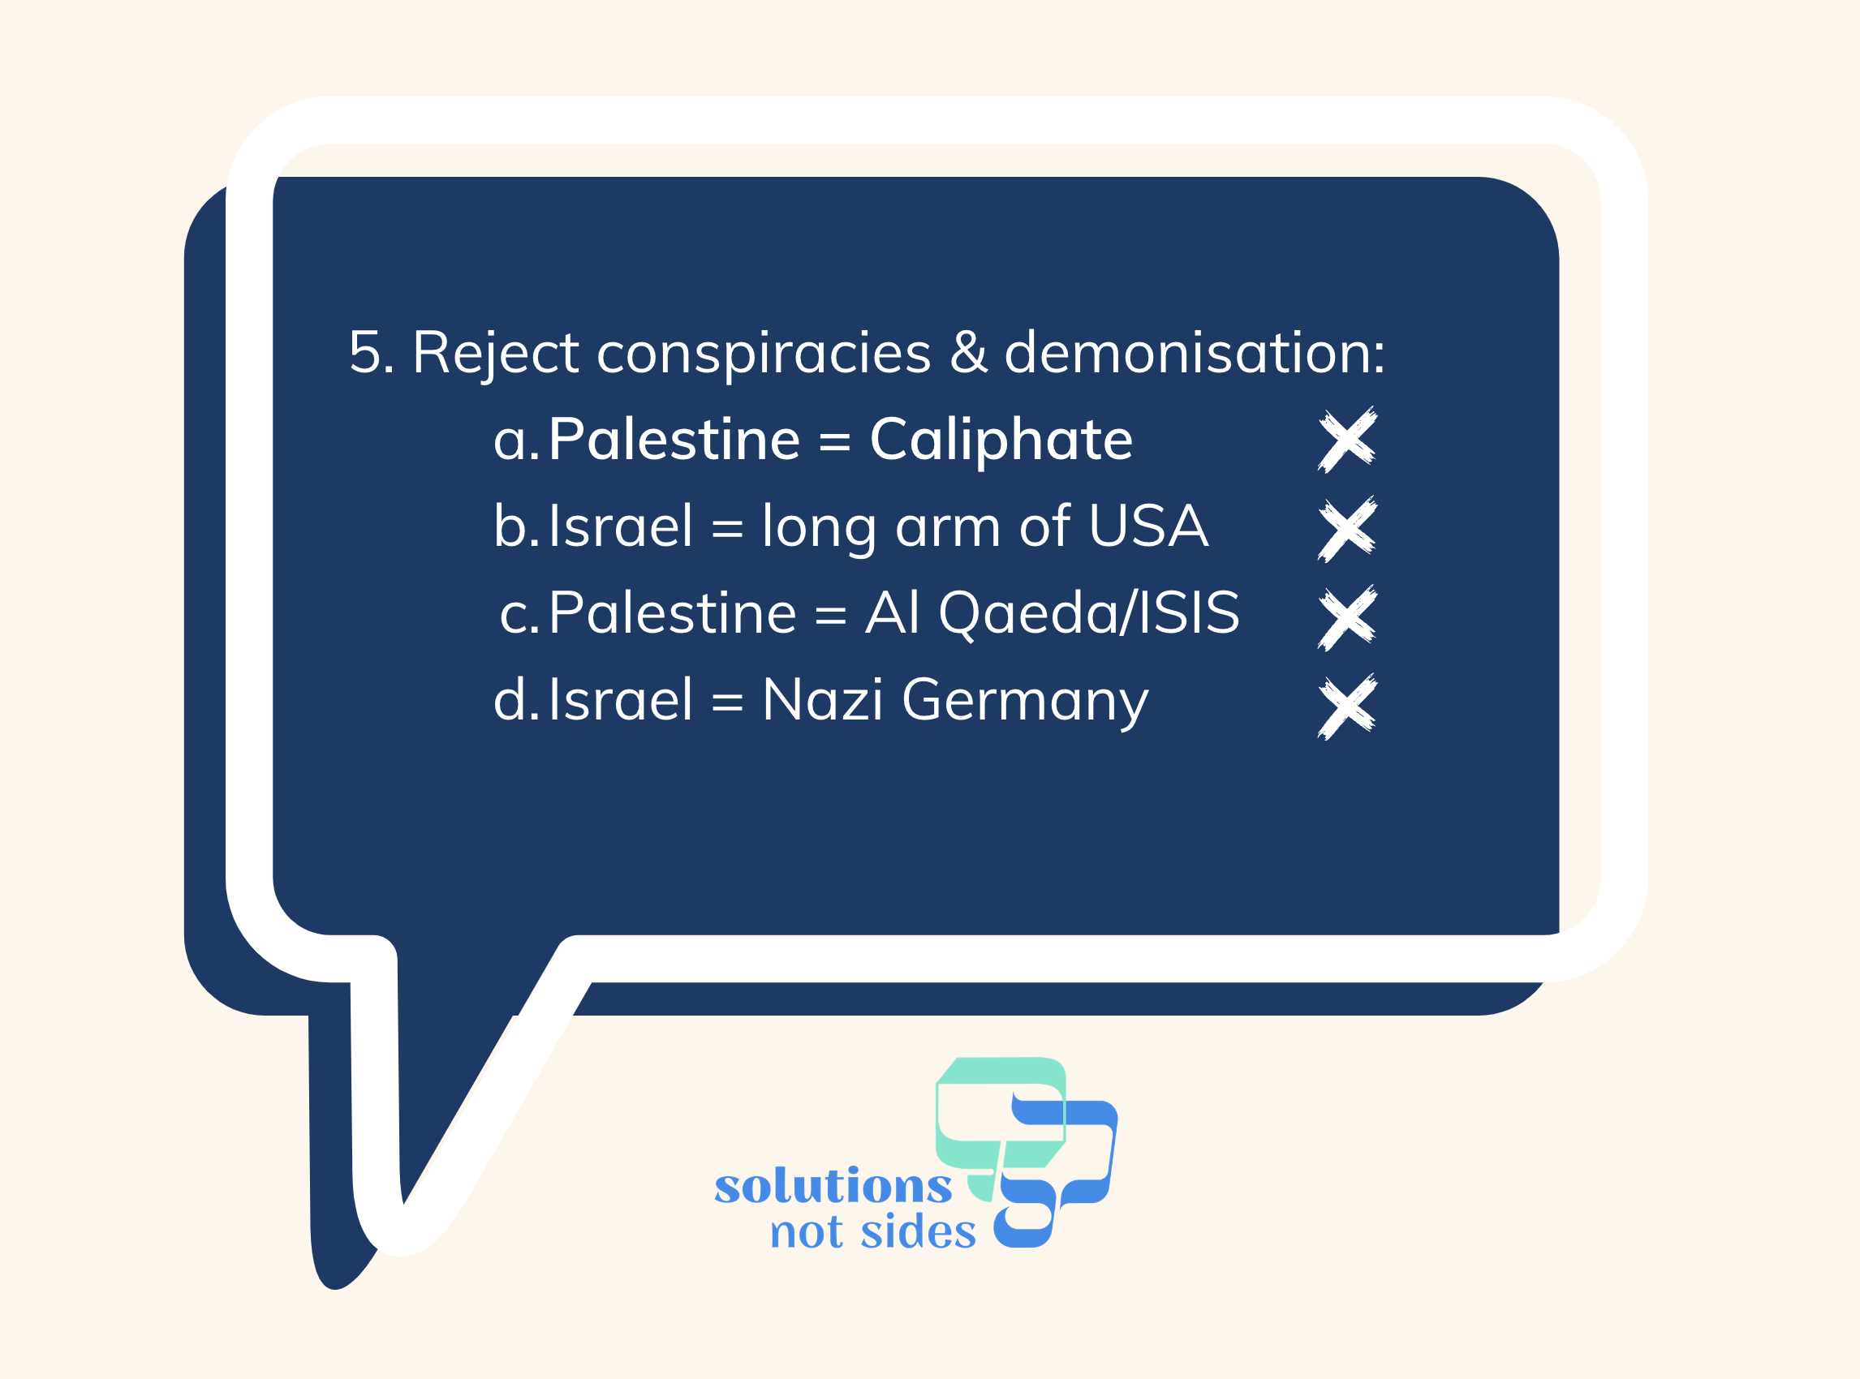
Notes:
“7. Israel is not a conspiracy to take over the Middle East or the World, and Palestine is not a conspiracy to enforce a Caliphate on Israel/Europe/the World. These are two national identities who both want to exist in the same piece of land
8. Israel is not Nazi Germany. Palestine is not Daesh/ISIS.
Please be sensitive towards people who are pro-Israel and/or pro-Palestine at this time - they may have friends/family involved in the situation, or Israel/Palestine may represent something important to them such as their own sense of struggle or oppression or a place of safety in times of persecution. Solidarity with one side or the other is not a crime, they can be pro-Israel/pro-Palestine and still be pro-solution.
These guidelines will be made available to you, so you have them as a reference.”

Slide 12
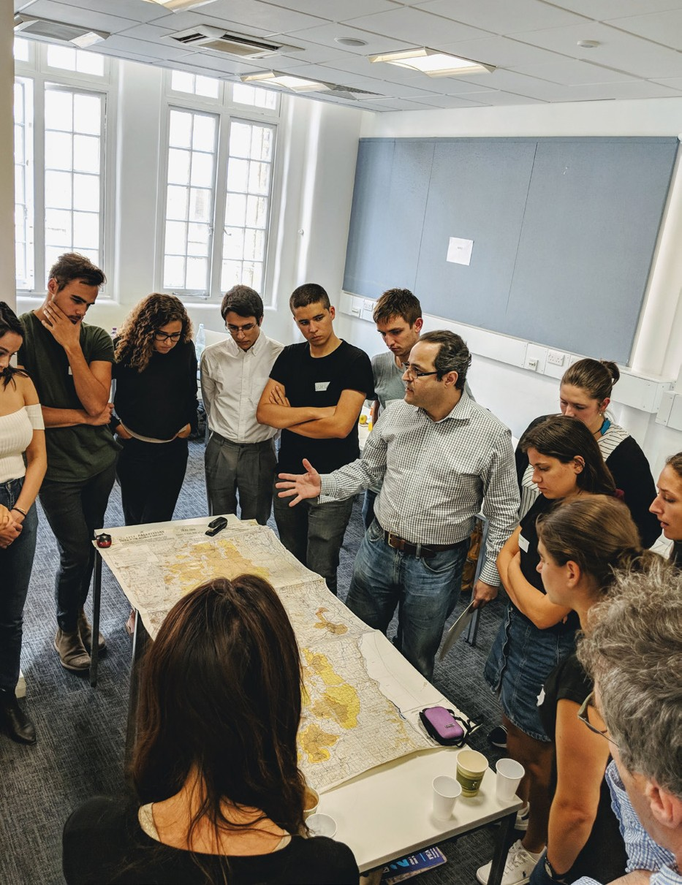




AGED 16-19? APPLY TO OUR STUDENT LEADERSHIP PROGRAMMES
@ITMAKESSNS @SOLUTIONSNOTSIDES
THE SOLUTIONS NOT SIDES EDUCATION PROGRAMME
WE’LL BE SENDING YOU EXCITING INFO ABOUT OPPORTUNITIES TO GET INVOLVED IN PALESTINIAN-ISRAELI PEACE BUILDING!
WANT TO DO FURTHER RESEARCH? CHECK OUT OUR WEBSITE FOR PODCASTS AND STUDENT-LED LEARNING RESOURCES!
SIGN UP ON OUR WEBSITE FOR OUR WEEKLY UPDATE ON ISRAEL-PALESTINE NEWS FROM DIVERSE SOURCES! WWW.SOLUTIONSNOTSIDES.CO.UK
Notes:
“Finally, remember that the media has many different voices on this issue and a lot are biased towards one side or the other. You can follow Solutions Not Sides online for more information and resources. Every week, they issue a news update on current events in Palestine-Israel that draws from diverse news sources so that you can get a broader picture of what is going on. They also have other opportunities for you to learn more and get involved on this issue, and we as a school can let you know about other organisations that provide multiple perspectives, as well.
Thank you for your attention this morning and let’s be mindful of those around us who feel strongly about this important international issue in the coming days.”

